Slide 1
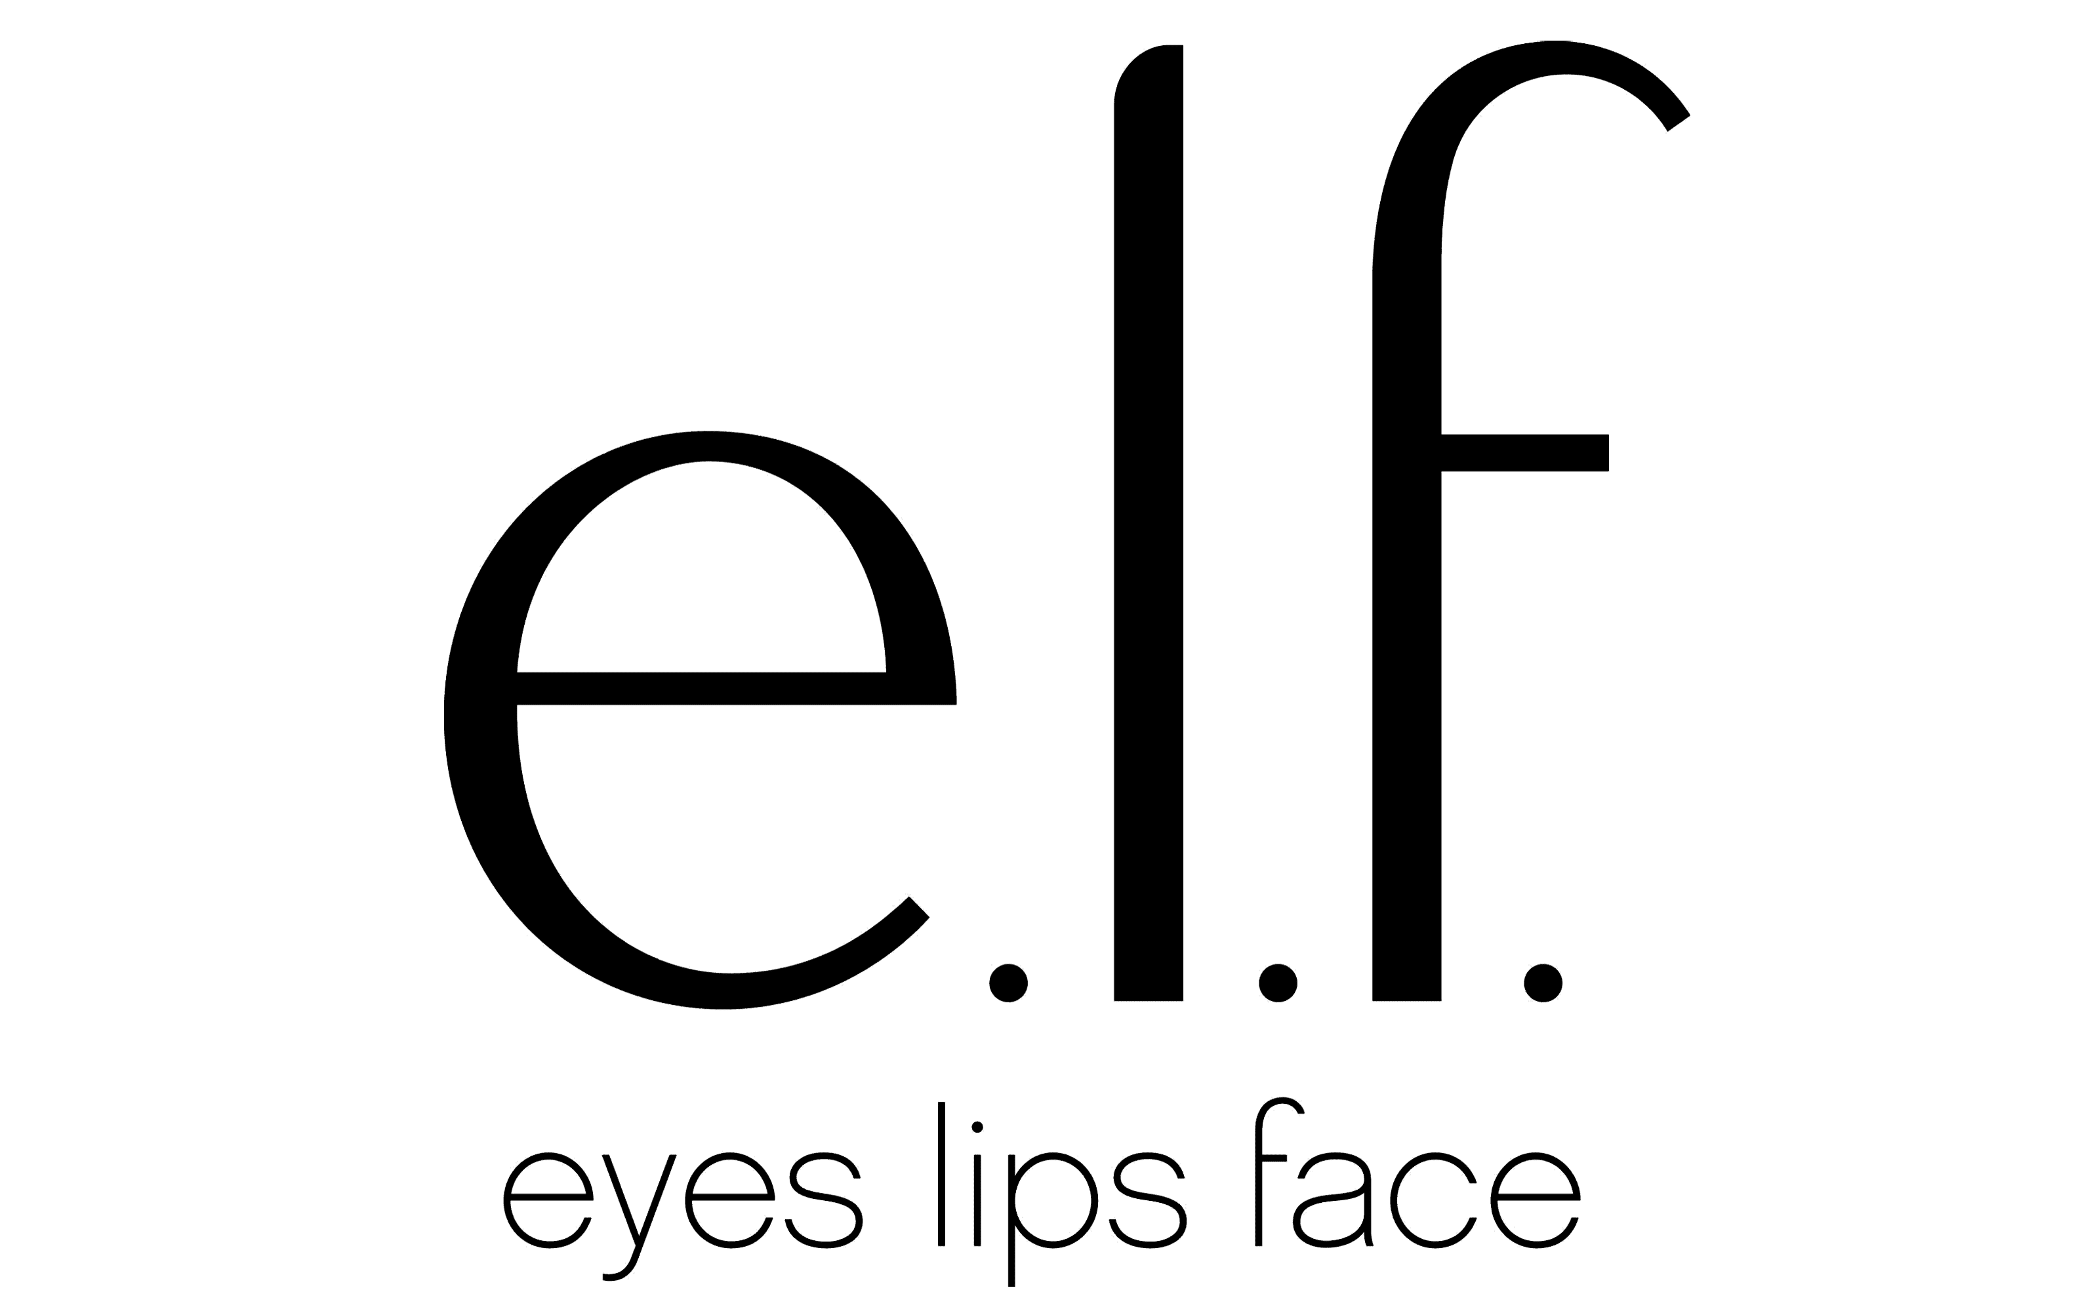


e.l.f. Cosmetics: TV on YouTube
The Challenge:
Having started as a digital disruptor selling premium beauty products over the internet for $1 and having conquered the American market, e.l.f. looked to replicate their success internationally within the UK market. But with only 60% of Gen Z audiences familiar with the brand, awareness was a key objective. The campaign would need to increase brand awareness, consideration and land the brand purpose, that e.l.f. is for every eye, lip and face.
The Solution:
Fleeting video encounters meant that traditional TV wouldn’t deliver the right encounters. Wavemaker UK took the opportunity to partner with Channel 4’s YouTube offering, Channel 4.0 and produce the content series ‘Ready or Not’ to engage viewers and show that e.l.f. is for every eye, lip and face.
The Results:
Spontaneous awareness moved e.l.f. to 5th in competitor set and consideration moved to 2nd in competitor set. Understanding of the brand also saw growth with 94% of Gen Z audience saying that e.l.f. was for every eye, lip and face.
Notes:
The Challenge
e.l.f. was born in the US in 2004, as a digital disruptor selling premium beauty products online for $1. As a brand they are focused on encouraging self-expression, they are for the community, by the community. Since the launch, they have seen huge growth in the US becoming the number 2 mass cosmetics brand and number 1 among Gen Z (Piper Sandler Taking Stock with Teens survey fall 2024).
Having conquered the American market, e.l.f. set out to replicate their success internationally. They wanted to grow awareness and increase consideration in the UK. This would be a difficult task as research had highlighted that 60% of Gen Z in the UK were not familiar with e.l.f. and what they stood for. As a result, e.l.f. set media agency Wavemaker a clear set of objectives. They needed to increase awareness and consideration for e.l.f., land the core purpose that e.l.f. is for every eye, lip and face and entertain the audience with content that connects with popular culture and communities (the brands core values).
The TV Solution
With clear objectives in place, Wavemaker got to work in understanding how they could tackle the campaign. With a core belief that the community is at the center of everything e.l.f. does, Wavemaker knew that the e.l.f. community would provide learnings to help guide the awareness campaign in the UK. With a strong following across TikTok and millions of views on YouTube, it was very clear to Wavemaker where the community found their entertainment, away from TV. Audience insights into the 16-24 audience highlighted they were moving away from TV, with viewing figures showing that video sharing and social platforms made up the majority of the audiences total video viewing. This video viewing had highlighted the importance of influencers to the audience with research highlighting that 63% of 16-24s trust what an influencer says about brands vs what the brand says about themselves. With an objective of raising awareness and shifting brand metrics, fleeting video encounters across TikTok and Instagram wouldn’t be enough and research from Channel 4 had highlighted the importance of premium content. Advertising placed around premium content is seen as more credible, trustworthy and genuine.
But media choices of the audience didn’t mesh with the objectives. But there was one solution that Wavemaker saw that would allow them to enter the TV market but do so in the place where the audience was watching, that was the newly created, Channel 4.0. Channel 4’s social first ecosystem that would allow e.l.f. to authentically show up in the places the audience were watching around premium content. Just what they needed to shift brand metrics, by allowing e.l.f. to blend fresh creators with mainstream talent.
The Plan
e.l.f. weren’t just partners with Channel 4.0 but in fact, commercial launch partners, they would sponsor all the content that sat on Channel 4.0 YouTube offering that would see full episodes of Channel 4 content uploaded along with bespoke social only content to fill the channel on YouTube. But to authentically engage with the GenZ audience and delight the e.l.f. community. Working closely with Channel 4, Wavemaker and e.l.f. looked to find the right person to front the activity, this led to the discovery of Adeola Patronne, who with her following across social platforms, a track record of creating engaging YouTube content and an authenticity that shines through the content she produces. She was the perfect e.l.f. star. An influencer with serious content creation chops.
Working with both Adeola and Channel 4.0, e.l.f. created a three-part series that played on ‘Get Ready With Me’ trend of social called ‘Ready or Not?!’ the show centred around Adeola and a special guest as take on unfamiliar jobs while expressing their true selves through make up, skincare and style, with e.l.f. branding and product placement throughout. With challenges ranging from a win or lose football challenge with Former England player, Faye White, to mucking a vegan animal sanctuary in a ball gown and a stunt training with Chole Burrows. They were all selected as showcased e.l.f.’s ability to overcome challenges while expressing yourself. The trailer for the series was promoted across the channel 4.0 YouTube, TikTok and Instagram channels to generate buzz and excitement before launch. The series was launched with a live screening including influencers and the talent from the show generating further earned buzz. Once the campaign went live, the e.l.f. enabled viewers to get products in their hands by leverage YouTube’s e-commerce integration in each episode. With one click allowing the viewer to purchase there and then directly from the e.l.f. store.
Results
With the objective of shifting brand metrics around awareness and consideration, the partnership and content pieces with Channel 4.0 delivered great results. Spontaneous awareness among the key audience of 16-24 year olds increased, moving e.l.f. up to number 5 vs competitors. The partnership saw e.l.f. move up to 2nd in the consideration set, hitting the target of top 5.
Along with this, with the aim of landing the understanding of the brand and their purpose, the campaign was also a success. With 95% of 16-24’s agreeing that e.l.f. cosmetics stands for every lip, eye and face and 84% agreeing that ‘e.l.f. cosmetics resonate with me’.
Should this be sourced?
Same here

