Slide 1


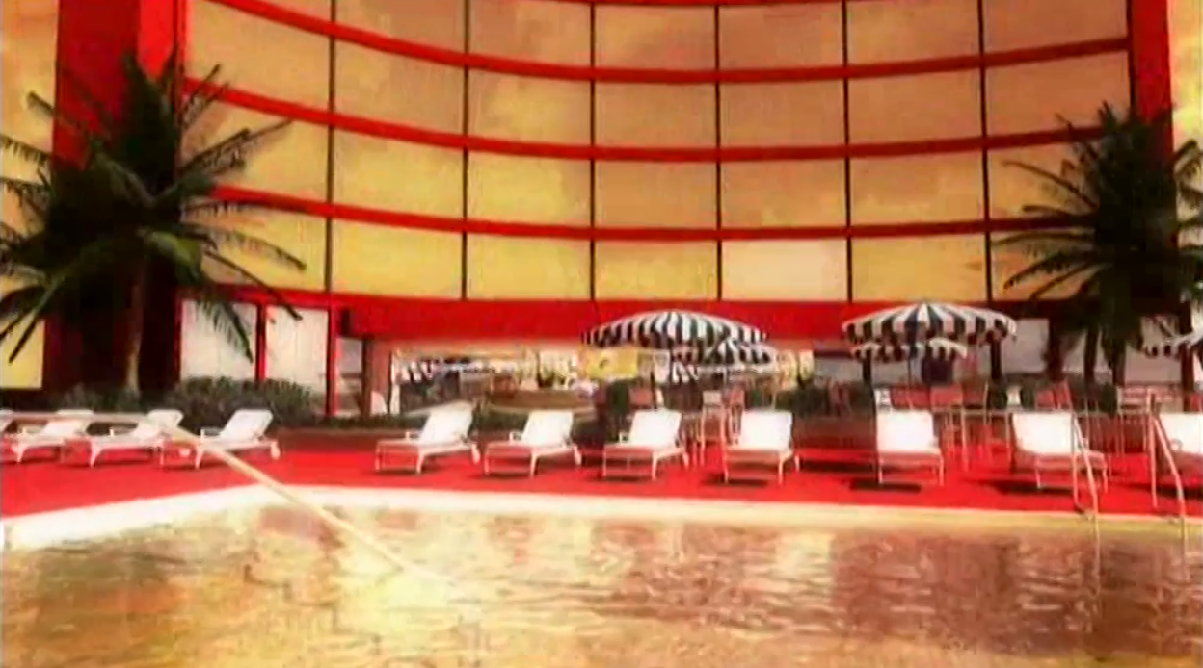
Hotwire.com: Hotting up response through TV
Challenge
Hotwire.com wanted to launch in the UK but had a unique business model that needed to be communicated to the most relevant viewers
Solution
Planned a TV campaign when people tend to book short term holidays targeting affluent, urban professionals aged 25 to 44 without children
Results
42.6m adults saw the Hotwire TV advert at least once
TV delivered a 48% incremental uplift on rolling baseline response
Notes:
Challenge
Hotwire.com is a travel website that offers low priced deals on hotels by selling off unsold rooms at discounted prices. When hotel rooms go unsold, hoteliers use Hotwire.com to sell them. Hotwire does not identify the participating hotels until after the purchaser has paid so as not to directly compete with regular retail sales of the travel partners. This “opaque” sales model is very new and unheard of by the vast majority of the UK online travel consumers.
The challenge for Hotwire.com was to launch a new brand and new business model in the UK. To do this, the brand needed to educate its target market and explain the “opaque” form of purchasing a hotel room. Would UK audiences understand, accept and ultimately have trust and confidence in not knowing the hotel they were going to stay in? Coupled with this were ambitious and aggressive response targets in a fiercely competitive marketplace. £27m was spent on TV by their competitors who were the hotel aggregators and hotel chains direct in 2011, and a further £45m was spent by tour operator giants.
Hotwire.com and Total Media identified that the best time to launch would be when people tended to book short term holidays – in the summer months from Easter onwards and in particular leading up to the May Bank Holiday. They also knew the target audience were savvy short-breakers who were affluent, urban professionals aged between 25 and 44 and didn’t have children.
The Solution
Coupled with the planning insight data, Total Media identified the dayparts and channels in which their target audience were most likely to search during for deals online. They knew that their audience were watching TV whilst using other devices such as laptops and tablets. TV was used to build fame and educate and was integral in generating high coverage to create an instantly recognisable brand nationwide.
The campaign launched just after the May bank holiday and ran until the end of August 2011. The airtime was paused for two separate weeks in June to test the true immediacy and carry over effect of TV. The creative was a 30” that ran on multichannel and there were c.80 Adult TVRs per week across the campaign. Sundays and Mondays were uplifted taking into account the planning insights, and the campaign achieved 87% 1+ cover for adults and the campaign appeared in the El Classico on Sky Sports (Real Madrid v Barcelona) as well as More4, Sky1, ITV2 Sky Atlantic and sport on ITV4.
Results
42.6m adults saw the Hotwire TV advert at least once (high frequency of 14.3 OTS)
Response rates surpassed all predictions
Clear relationship demonstrated between TV and brand search
Through modelling and spot analysis, Total Media found that TV delivers a 48% incremental uplift on rolling baseline response
Hotwire.com are back on TV in 2012
To read the full case study and access the creative visit: https://www.thinkbox.tv/Case-studies/Hotwire

