Slide 1

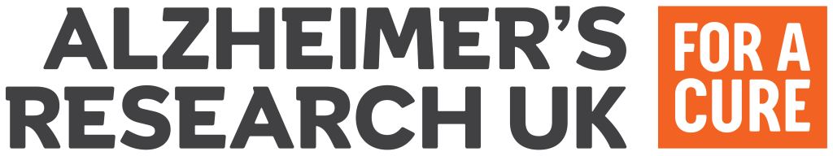
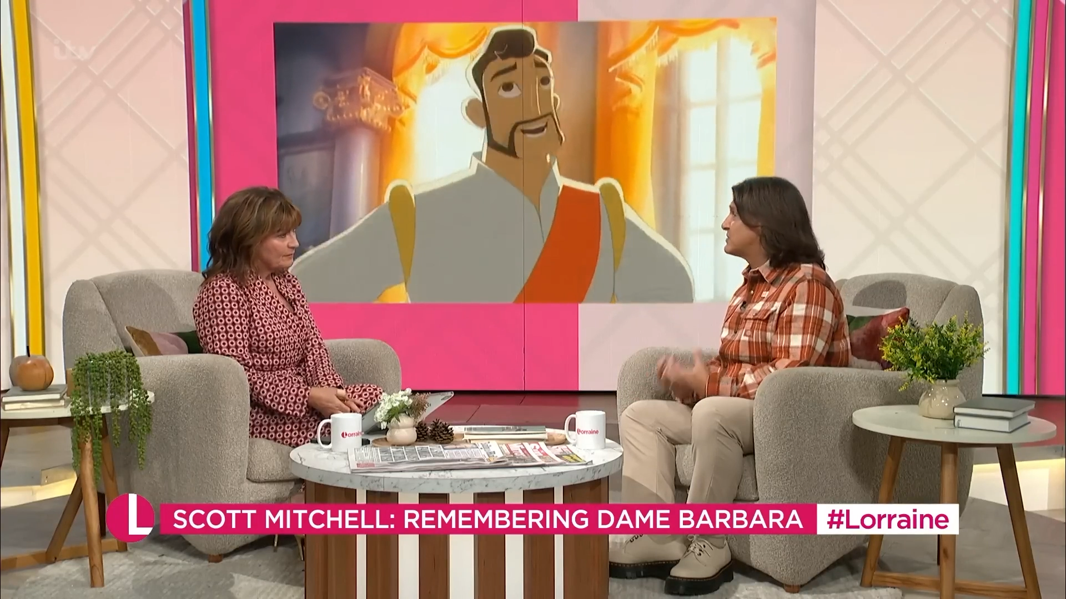
Alzheimer’s Research UK: TV’s emotional punching power
The Challenge:
Alzheimer's is the most common form of dementia and dementia is now the leading cause of death in the United Kingdom. It was crucial for Alzheimer’s Research UKto improve brand awareness and increase consideration to donate to ensure they could continue their work to find a cure.
The Solution:
By betting on the emotional power of TV, Alzheimer’s Research UK took a 120” Disney inspired creative and inserted into moments where the life maximisers custom audience would be thinking about the future and get them to confront the potential of an ‘unhappy ending’.
The Results:
Earned over 400 pieces of media coverage across broadcast, print and social. Film reached over 58 million people, led to increase in consideration and likelihood to donate to ARUK after seeing the campaign.
Notes:
The Challenge
Alzheimer’s is the most common form of dementia and dementia is now the leading cause of death in the UK. While many people believe that Alzheimer’s is a natural part of the aging process, many don’t realise it is in fact a disease, and diseases can be cured through research. Alzheimer’s Research UK exists to find a cure for dementia.
As a charity, Alzheimer’s Research UK had focused most of their marketing spend on performance communications that were designed to drive donor acquisition and fundraising. Raising awareness for the disease and the profile of the charity had been achieved largely through PR. In fact Alzheimer’s Research UK hadn’t run a brand campaign since 2019, in part because of the Covid pandemic. The charity is also in a competitive sector where differentiation from other charities with similar causes is critical. The challenge facing Alzheimer’s Research UK and their media agency Yonder was clear. They needed to increase understanding of the disease, boost awareness of the charity and their mission to find a cure.
The TV Solution
Armed with a clear set of objectives, Yonder got to work on understanding how to address the problem. This started by finding the right audience. Yonder settled on an audience called Life Maximisers; active mid-lifers, aged between 40-59, who look to live life to the fullest, believe that family is everything, have dreams for the future and consider old age and serious issues a long way off. This audience was selected because the brand metrics were lagging behind with this group the most but they also stand to benefit the most from medical breakthroughs in the years to come. By adding in the affluency data, Yonder were able to find an audience that would have both the means to contribute and the motivation to do so.
Armed with an impactful creative concept ‘Change The Ending’ played on fairy tale happy endings, created to match Disney’s iconic style of animation. The stereotypical ending was subverted by the sad reality of living with dementia; that there isn’t a happy ending and this is why Alzheimer's Research UK are working so hard to find a cure. The media choices needed to make an impact with the target audience. In the mind of Yonder, there was only one channel that would deliver the required cut through. That was TV. TV is the place where culture happens and the news agenda is set. TV would allow Alzheimer’s Research UK to confront people at a comfortable stage of life and show them what could lay ahead for them. Yonder would take a 120” copy to TV and have it play in high attention environments with relevant context to drive the biggest impact.
The Plan
Having landed on TV as the lead channel, the campaign kicked off on World Alzheimer’s Day (21st September), which allowed Alzheimer’s Research UK’s PR team to maximise coverage of the impactful 120” creative across the news agenda. The campaign didn’t actually launch in commercial airtime however, it began with 10 minute segments on both BBC Breakfast and ITV’s Lorraine. The BBC Breakfast segment saw the creative play out in full to 1 million people on a channel that carries no commercial airtime. This launch also saw the creative picked up by print and digital news brands like The Daily Mail and The Sun. The creative was used to launch a conversation about Alzheimer's and the potential to find a cure, with the creative linked on all stories, driving a huge boost on day one of the campaign.
The campaign kicked off on TV with the full 120” copy playing out in Channel 4 news in a specially created solus break. Channel 4 news was selected for the launch activity as it would reach the Life Maximiser audience in the right context, making the campaign and creative feel like a newsworthy event. The audience was profiled with YouGov data in TechEdge to target audiences by lifestage and attitudes rather than looking at socio-economic demographics or age groups. This followed on to a cherry-picked plan that would see Alzheimer’s Research UK going into programming that would deliver the creative ‘rug pull’ by contrasting the hard-hitting creative with the cosy comfort viewing mindset of the audience. Alzheimer’s Research UK would reach viewers in mid-lifers’ aspirational viewing (such as Grand Designs) to confront audiences with the possibility of their own personal unhappy ending of dementia.
Yonder pored over programming schedules to find the right programming to play out the full 120” creative, selecting new series premieres where possible to make the creative play out in must see content. When Matt Hancock was announced as joining the cast of the next series of Celebrity SAS, they jumped at the chance to place the creative into the break, to latch onto the cultural moment and reach 2.1 million viewers with the spot driving engagement across social platforms.
The campaign was integrated with the wider media mix, with the creative playing out in full on Facebook, Instagram and X (formerly Twitter), moving away from the industry standard of 5”, and extending reach and adding cut through. Engagement with the community of Alzheimer’s Research UK donors and supporters allowed for lookalike modelling which would engage those not already supporting to sign up. After 2 weeks of the full 120” creative, Alzheimer’s Research UK dropped down to a 30” across linear TV, CTV and social to add incremental reach and tap into audiences who were most likely to donate to the charity.
Results
The campaign had the desired effect of driving awareness and brand familiarity for ARUK. The TV campaign generated over 400 pieces media coverage across broadcast, print and online, and the campaign was shared by over 100 celebrities with a combined following of 41 million. Across the launch week of the campaign, the film earned a total reach of 53.8 million across all channels. This led to a rise in spontaneous awareness with the Life Maximisers target audience, taking the charity into the top 3 of charities ‘most likely to consider donating to in the future’. Web traffic also saw triple digit growth when compared with the pervious year, which in turn led to a huge uptick in donations to the charity.
Client quote
“The Change the Ending campaign has been a huge success in moving our brand metrics to a new level. We’ve been able to drive our fame far beyond what you might expect with a modest budget. The ‘impact over impacts’ strategy really paid off- and demonstrates the enduring power of creativity in advertising. Yonder’s bold recommendations were always supported by data, and that gave us the confidence to double down on the long-format and the curated planning approach. It goes to show there is more than one way to approach TV advertising and we couldn’t be happier- we are planning our next burst as we speak.”- Lorna Dawson, Head of Brand, Alzheimer’s Research UK.

