Slide 1
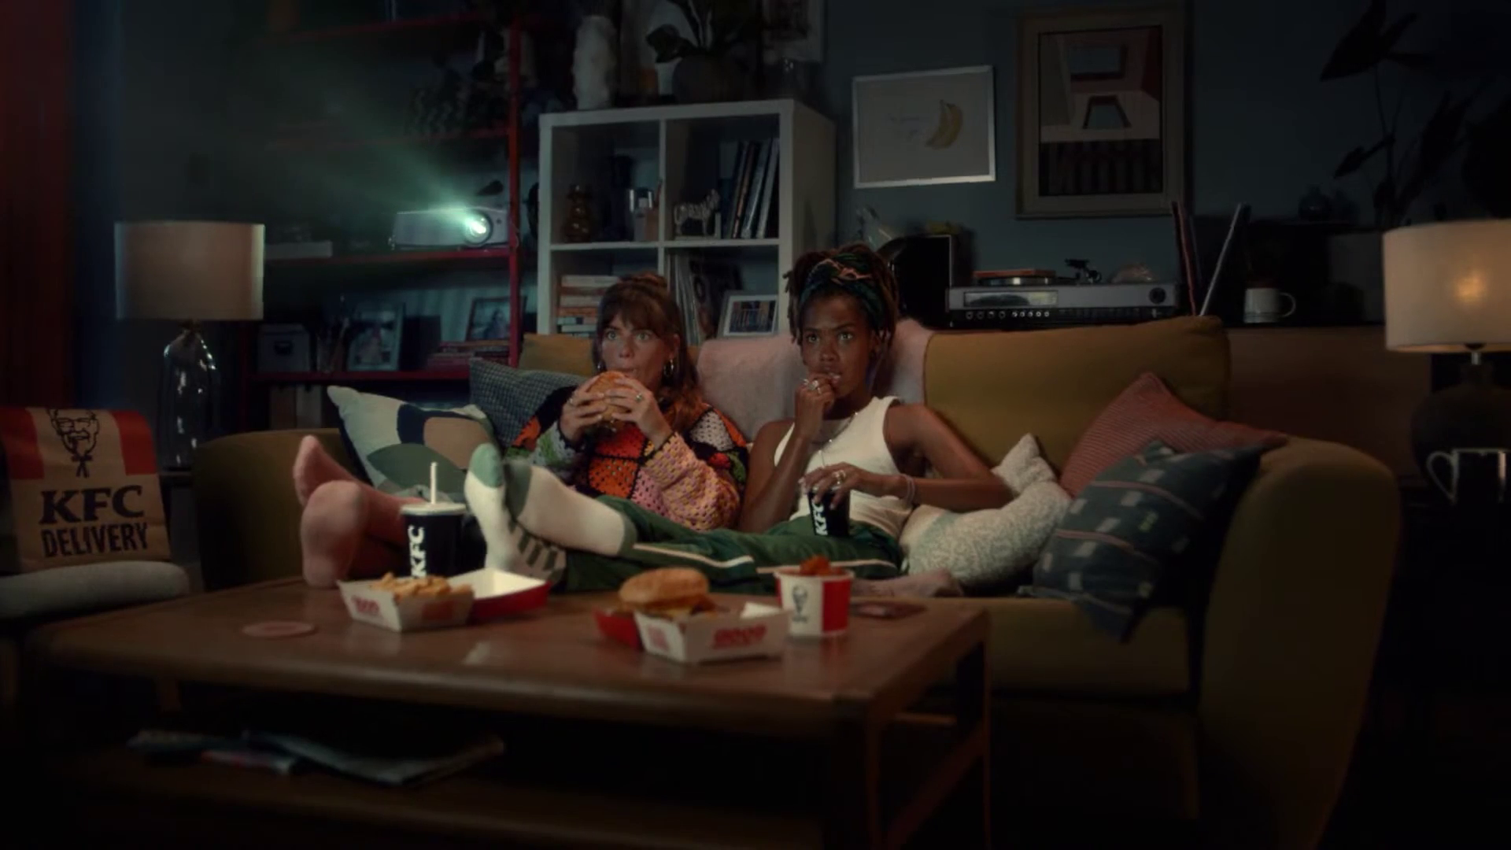
TV expenditure patterns
KFC - Delivery

Slide 2
The most viewed holding companies on TV in 2022
IMPACTS (BILLIONS)
Source: Barb, 2022, R/W commercial impacts according to Barb reporting
Notes:
Procter and Gamble was the most viewed advertiser on TV in 2022 with 23.4 billion impacts.

Slide 3
959 advertisers used TV for the first time in 2022
Source: Nielsen Ad Intel / Sky – New to TV advertisers classed as those not advertising on TV 5 years prior (2017—2021) on Linear TV and Sky AdSmart
Notes:
In 2022, there were 959 new to TV advertisers, many of whom were ecommerce business looking to supercharge their growth through TV.
Here’s a flavour of some of the businesses who’ve used TV for the first time.
BikeClub - bicycle rental service
WeAre8 – social media app
National Highways - government-owned company
Standard Life – insurance
Novo Nordisk - global healthcare company
Saga Personal Finance – financial services
Naked Wines – wine retailer
Tesco Bank – financial services
Chase Bank – financial services
EVRI – delivery service
Thames Water – water and wastewater services
North Cyprus Tourist Office – travel and tourism
Eset Software – cybersecurity
Simply Business – business insurance
Clim8 – sustainability fund
Utilita – electricity and gas supplier
Cunard Line – cruise line
Virgin Voyages – cruise line
Einhell – DIY tools
Flight Centre – travel agency
St Mungos – charity
Reddit – social news website
Tiger Group – sheds
Absolute Collagen – skincare
Tilney – financial planning and investments
Intercontinental Hotels & Resorts – hospitality chain
Exoticca – travel agency
Moda – furniture
The Trussell Trust – charity
Beauty Pie – cosmetics
Pizza Express – restaurant chain
Jo Malone – perfume
Fixter – car service
Animals Asia Foundation – charity
Pendragon – automotive retailer
Wish – online marketplace

Slide 4
Online born businesses are the biggest investors in TV
-6%
MILLIONS
-3%
+8%
-4%
+5%
+8%
-5%
+84%
-13%
-10%
+4%
Source: Nielsen Ad Intel, 2022, Thinkbox-created category of online-born businesses (YoY category % change).

Slide 5
Online born businesses by category
MILLIONS
Source: Nielsen Ad Intel, 2022, Thinkbox-created category of online-born businesses. Sorted by top 12 with highest total spend.

Slide 6
Online born businesses by category
Source: Nielsen Ad Intel, 2022, Thinkbox-created category of online-born businesses. Sorted by top 12 with highest online proportion.

Slide 7
763 advertisers spent less than £50k on TV in 2022
Source: Nielsen Ad Intel, 2022
Notes:
Looking at the make-up of TV advertisers across 2022, 763 - which is 31% of all advertisers - spent less than 50 thousand pounds on TV and 1,331, which is 53%, spent less than 250 thousand. Only 29% of all advertisers spent over a million pounds and only 6% spent over ten million.

Slide 8
B2B TV advertising spend has doubled since 2018
9%
27%
+£9m
+£21m
46%
5%
+£23m
+£3m
Source: Nielsen Ad Intel, 2018-2022, TV Spend, %’s show YoY Increase, Thinkbox-created category of B2B businesses
Notes:
There has been a growth in TV expenditure in the B2B sector.
According to Nielsen Ad Intel, B2B brands have more than doubled their investment in TV advertising over the past four years, reaching £108m in 2022.
Analysis shows that there has been growth in TV expenditure from B2B advertisers each year across 2019 – 2021. This growth was also seen in 2022, a 9% increase from the previous year, with the largest spend attributed to web hosting firm Ionos By 1&1, spending £13.5m in total (+194% vs. the previous year). Other top advertisers within the B2B sector include financial services company Sage Group (£13.4m), Intuit (£11.2m), accounting software service Xero (£8.4m), followed by Natwest who increased their spend by 326% to £7.2m.

Slide 9
Linear TV spend in electric/hybrid vehicles account for the largest share within the motors category
Source: Nielsen Ad Intel, linear TV expenditure, Advertisers and brands included in this analysis are a Thinkbox created category specifically in relation to cars (and includes brand building), and does not include other vehicles, car dealers or motor accessories etc. ‘Other’ includes all other categories in product / advertiser mid category

