Slide 1
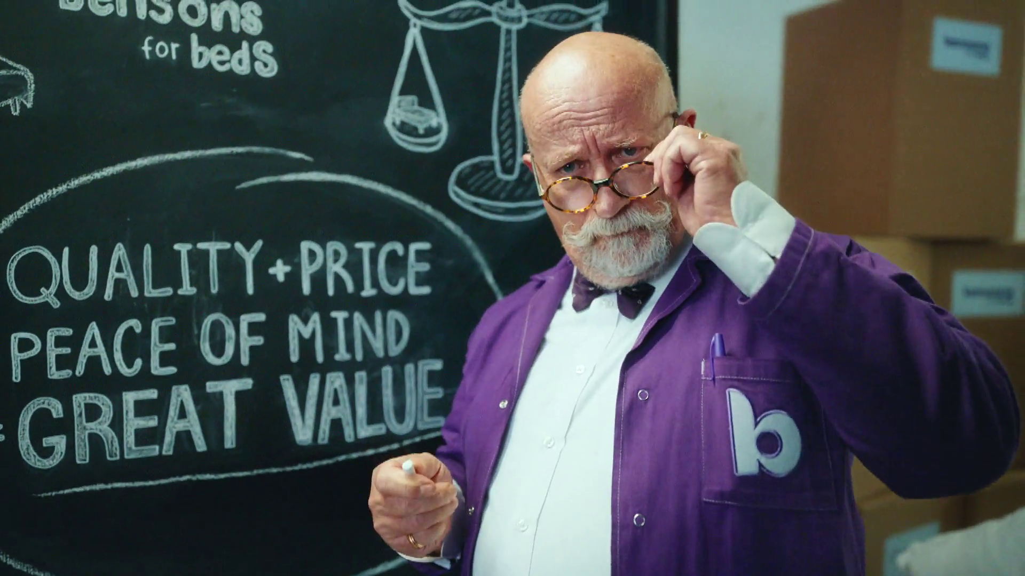

TV investment & Pricing
Bensons For Beds - Obsessed

Slide 2










P&G were the top TV spending holding company in 2024
Total TV Spend £m
Source: Nielsen Ad Intel, 2024, by holding company
Notes:
P&G were the top TV spending holding company in 2024

Slide 3




































932 advertisers used TV for the first time in 2024
Source: Nielsen Ad Intel / Sky – New to TV advertisers classed as those not advertising on TV 5 years prior (2019—2024) on Linear TV and Sky AdSmart
Notes:
In 2024, there were 932 new to TV advertisers, many of whom were ecommerce business looking to supercharge their growth through TV.

Slide 4
Online born business sector is the largest investor in TV
Millions
Source: Nielsen Ad Intel, 2024, Thinkbox-created category of online-born businesses (YoY category % change).
Notes:
Despite a year-on-year decline, online born businesses persist as the biggest investors in TV. TV investment has experienced its most significant growth from Household FMCG and Retail categories.

Slide 5
Of largest spenders, Ents & Leisure have highest share of online born businesses
MILLIONS
Source: Nielsen Ad Intel, 2024, Thinkbox-created category of online-born businesses. Sorted by top 10 with highest total spend.
Notes:
When looking at the top 10 highest spending categories, Entertainment & Leisure and Finance have the highest proportion of Online Born businesses.

Slide 6
Within all categories, Property has highest share of online born businesses
Source: Nielsen Ad Intel, 2023, Thinkbox-created category of online-born businesses. Sorted by top 10 with highest online proportion.
Notes:
Looking at all categories, Property, Computers, and Online Retail have the highest proportion of online born businesses.

Slide 7
675 advertisers spent less than £50k on TV in 2024
Source: Nielsen Ad Intel, 2024
Notes:
Looking at the make-up of TV advertisers across 2024, 675 - which is 30% of all advertisers - spent less than 50 thousand pounds on TV and 1,152, which is 51%, spent less than 250 thousand. 31% of all advertisers spent over a million pounds and 5% spent over ten million.

Slide 8
TV remains the lowest priced video channel
Average cost per 30 second (000s)
TV
Social Media - Video
£52.59
£7.32
Source: 2024, TV is inclusive of Linear, BVOD and SVOD. Thinkbox estimates using AA/WARC (estimates), Barb / Broadcaster stream data / UK Cinema Association. Ipsos Iris.
Notes:
The chart combines AA/WARC revenue estimates, with the video advertising time data to create a relative cost per 30 seconds of AV ad exposure.
Spot TV advertising (linear, BVOD and SVOD) averages £7 per thousand exposures. Social media video (which also includes YouTube) is £53.

Slide 9

Average TV view costs 0.73p (in 2024)
The average cost
of buying the media space to get one
person in the UK
to see a TV (linear, BVOD and SVOD) advert
costs over half a penny
Source: 2024, Thinkbox estimates using AA/WARC
Notes:
The average cost of buying the media space to enable one person in the UK to see a TV (linear, BVOD and SVOD) advert only costs just under a penny.

