Slide 1
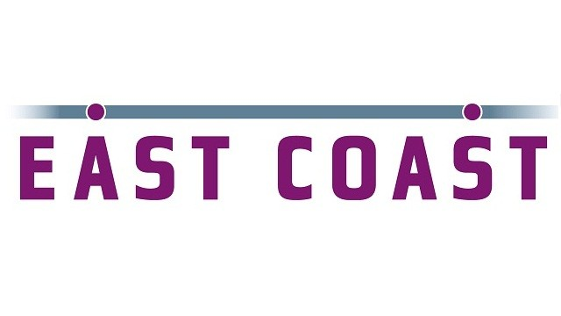

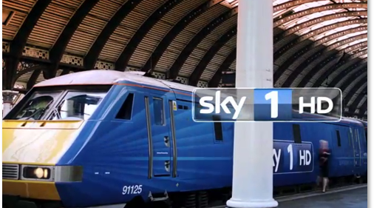
East Coast Trains’ innovative use of TV programming
Challenge
Improve key brand image metrics
Differentiate East Coast’s staff and service quality
Improve brand awareness and the organisation’s profile
Solution
Havas went beyond the normal media plan with the concept of 10 part series behind the scenes alongside a integrated marketing campaign
  primetime 10 part series on Sky 1 produced by Cineflix Productions
  ‘Feel at home’ TV spots with targeting using AdSmart
  Campaign extended across outdoor, social and PR
Results
1,752 sales from the East Coast website
79% thought the show gave a positive impression of the organisation
Brand favourability has almost doubled when comparing viewers to non-viewers
Notes:
The Challenge:
Their business objectives were to increase customer advocacy and also increase their share of website bookings. In order to achieve these objectives, they needed to distinguish the brand and to make travel prospects aware of what makes East Coast so appealing. The specific objectives were to:
Improve key brand image metrics
Differentiate East Coast’s staff and service quality
Improve brand awareness and the organisation’s profile
Solution:
The end result was ‘All Aboard East Coast Trains’ – a primetime 10 part series on Sky 1 produced by Cineflix Productions. The series would showcase the unseen hard work that goes into keeping Britain on track. It would show members of staff going above and beyond the call of duty, saving the day when things go wrong.
As editorial integrity was essential, this had to be a ‘warts and all’ exposure with complete impartiality. It took bravery for East Coast to open their doors to camera crews especially given the operational demands of running trains. However, they were so confident in their staff and business they felt able to take this leap of faith.
Havas Media then worked with East Coast’s other agencies to integrate the association across all other marketing activity. This included:
TV spots – the newly created ‘Feel at Home’ 30 second spot was broadcast in the centre break of every first run episode. In addition, they used Sky AdSmart to target mid-highly affluent people on a regional basis in Newcastle, Sunderland and Edinburgh.
Online – display ads across the Sky 1 website as well as the purchase of key search terms. In addition, the brand applied #AllAboardECT into promotion, editorially integrating across Twitter, YouTube and Facebook.
Outdoor – advertising on station-owned sites as well as leaflets that were distributed on board and at travel centres
PR - strategy based around lead characters
Results:
The series rated well, consistently performing within the top 10 best programmes for audience delivery on multi-channel. In addition:
70% of viewers were aware of publicity highlighting the success of the activation campaign
They generated 1,752 sales directly from the East Coast website
The AdSmart campaign resulted in an increase of 26% for new households booking tickets directly from the East Coast website (compared with control group)
Independent research verified that the show had significantly achieved their brand-objectives. For example:
79% thought the show gave a positive impression of the organisation
66% felt the show has improved their understanding of East Coast Trains, the routes they operate and services they provide
Brand favourability has almost doubled when comparing viewers to non-viewers
For the full case study and to view the ad campaigns visit: https://www.thinkbox.tv/Case-studies/East-Coast-Trains

