Slide 1
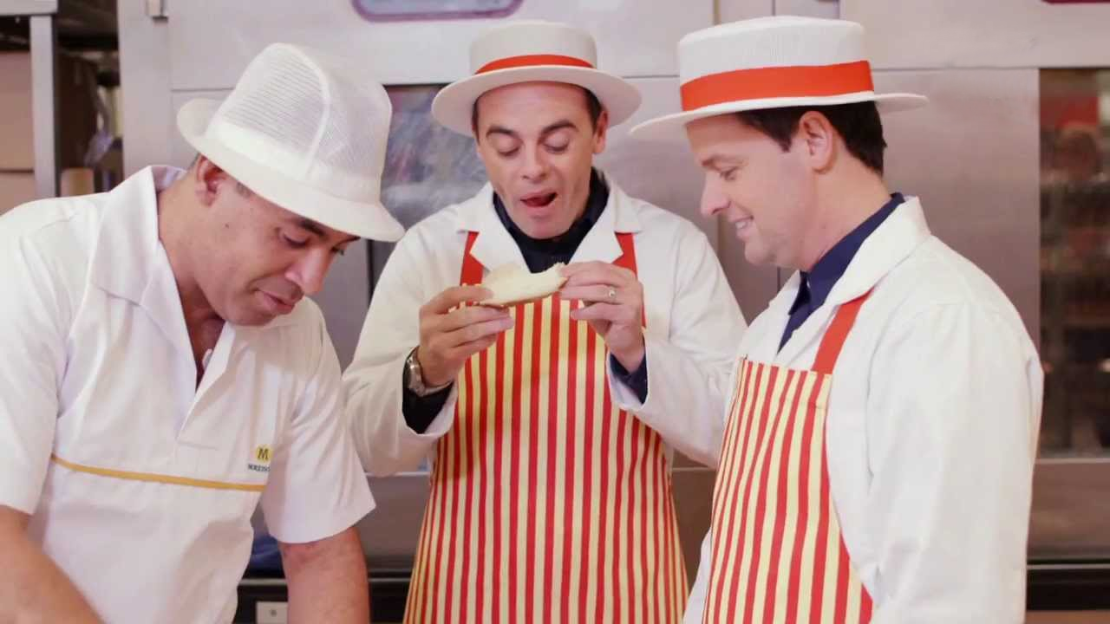
Morrisons show their talent with Ant and Dec
Challenge
Morrisons wanted to engage a family audience and showcase the talent of their market specialists
Solution
Partnership with Saturday Night Takeaway and BGT - effectively owning Saturday nights on ITV for 4 months + a licensing deal with Ant & Dec
The popular pair were seen working alongside real Morrisons specialists becoming brand ambassadors
Results
People exposed to the campaign were 70% more likely to shop at Morrisons
Delivered a ROI that doubled the category average
Notes:
The Challenge
2012 had been a difficult year for Morrisons with a decline in sales and competition as fierce as ever. However, Morrisons had a strong product offering in that they fully train all of their butchers, bakers and cake makers, as they believe that customers value the expertise of the people they entrust with their family’s food. The challenge was to reconnect with family shoppers as well as showcasing the Market Street Specialists as they prepared fresh food in store each day.
They wanted to find a way of emphasising the skills of their specialists in a relevant and engaging way, as well as driving mass reach against their core family audience. In addition, they wanted to drive participation and engagement. Their specific objectives were to:
Increase brand perceptions of Morrisons as a friendly and straight forward brand
Engage a family audience in a relevant and contextual way to improve brand consideration
Deliver a communications piece that connected with Morrisons staff
The TV Solution
Morrisons’s media agency, MEC, along with ITV, recommended associating the brand with TV personalities Ant and Dec, as much-loved personalities can help viewers establish an emotional bond with brands. Working with ITV, they developed a partnership with two of ITV’s biggest shows – Saturday Night Takeaway and Britain’s Got Talent. The sponsorship campaign would deliver mass reach against their core family audience and also drive participation and engagement. It would mean that Morrisons effectively would ‘own’ Saturday nights on ITV across four months as these shows ran from February to June 2013.
The sponsorship idents around the two programmes featured real Morrisons specialists showcasing their skills and knowledge in an entertaining way. In addition, they negotiated a talent agreement with Ant and Dec so the popular pair featured in their TV spots. In the ads, created by DLKW Lowe, they were seen working alongside Morrisons specialists in store and so became brand ambassadors through the ‘Market Street’ narrative.
The activation of the partnership spanned all available touch points and included the following:
Ant and Dec met Morrisons staff and starred in internal content material
High achieving staff were given show tickets plus meet and greets with Ant & Dec
A company-wide talent competition
Ant & Dec made an appearance at the company’s annual conference
11 million customers received Ant & Dec game cards for a weekly on-screen draw
Saturday Night Takeaway branded meal packages were created with point of sale material in store
Britain’s Got Talent held mobile auditions at Morrisons stores and also placed supportive banners outside finalists’ local stores
Content for online was produced showing Ant and Dec spending a day at a Morrisons store. This showed them learning how to bake cakes and prepare octopus. They were also filmed at a Morrisons farm and a fishing trawler.
Ant and Dec seeded content on social media
Bespoke online app games were created, including ‘Studio Rush’ where players had to navigate Ant & Dec through a Morrisons store to get them to the studio in time for the show
In addition, bespoke content for online was produced showing little Ant and Dec learning how to make cupcakes and meatballs with the Morrisons chefs
The TV activity was supported by advertising in cinema
Results
The campaign delivered an ROI of double the category average (Source: Ohal)
The Saturday Night Takeaway Meal Deal accounted for 1 in 4 of every supermarket Indian Takeaways sold during the show’s air-dates (Source: Kantar)
The campaign reached over 85% of target customers (Source: BARB)
Over 2.4 million shoppers entered the Saturday Night Takeaway Prize Draw online
Brand image metrics were also improved as a result of this campaign, particularly for the measures of friendly service and straight forward product (Source: Millward Brown)
Viewers of the sponsorship are 70% more likely to consider shopping at Morrisons (source: Millward Brown)
More than 1,000 Morrisons staff attended hospitality at either SNT or BGT and the feedback was universally positive, with a significant feeling of inclusion and excitement delivered by this partnership
To read the full case study and access the creative visit: https://www.thinkbox.tv/Case-studies/Morrisons

