Slide 1
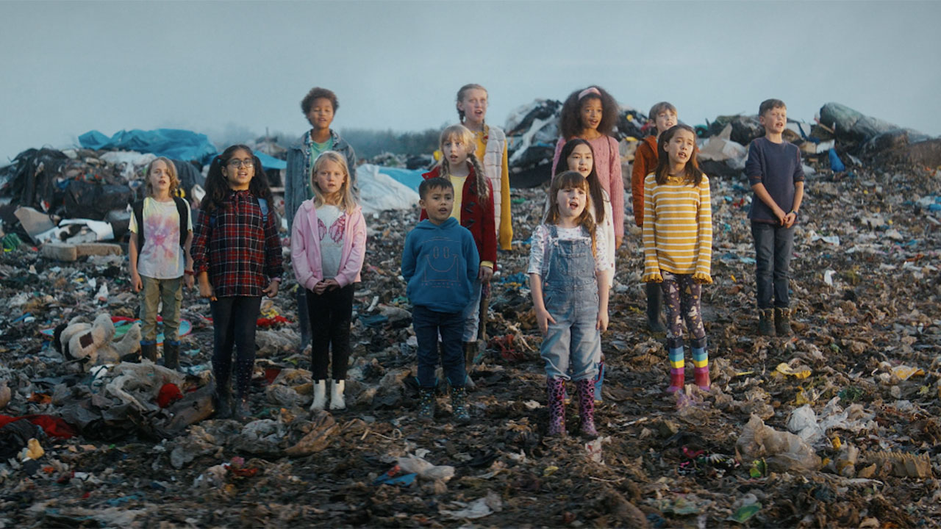
OLIO: what a wonderful waste
Challenge
OLIO wanted to put the spotlight on the food waste crisis and raise awareness about their free app that enables people to share surplus food
Solution
They utilised the emotional power of TV to affect behaviour change and connect with parents
The moving TV ad ran at Christmas as a shocking contrast to the many consumer ads at that time
Results
35,000 people signed up to OLIO
Brand awareness was up 35%
Notes:
The Challenge
Household waste is humanity’s next fight to save the planet from environmental disaster. UK households alone produced just under 27 million tonnes of waste in 2017 (latest figures from 2021). We recycle only 45.7% across the UK as a whole, while countries like Germany manage to recycle 66% of their waste – a rate more than 40% higher. If food waste were a country, it would be the third biggest contributor to CO2 emissions after the US and China (Source: United Nations Food and Agriculture Organisation)
OLIO is a free app set up to help tackle food waste. It connects neighbours with each other and with local businesses so that surplus food can be shared rather than thrown away.
In the run up to Christmas 2021, Hell Yeah! were challenged to spotlight the food waste crisis and get people to share via OLIO, helping to reduce consumer waste.
Their objectives were to:
Raise brand awareness
Encourage behaviour change and shift attitudes around household waste and sharing
Increase app usage
End overconsumption and waste & reduce landfill – the ultimate goal
The TV Solution
Hell Yeah! understood that they needed to make their target audience of parents care enough to change their behaviour, and that emotion was the key.
They wanted to confront people with the shocking reality of the UK’s waste crisis, making the problem feel urgent, close to home and impossible to ignore.
With TV’s ability to generate emotion and affect behaviour change it was the lead medium for the campaign with support from Out Of Home and Social Video.
The TV ad featured a group of British kids singing Louis Armstrong’s What a Wonderful World on a landfill in Wales. The stark reality, the simple creative and the haunting juxtaposition made the meaning clear – if we don’t begin to share more, our children will pay the price.
The Plan
The campaign was one of the winners of the Sky Zero Footprint Fund – an initiative set up to support brands that are committed to driving positive behavioural change and tangible impact towards a more sustainable future. Winners were selected based on the most impactful and creative idea with the aim to support these businesses to accelerate and amplify their initiatives to change the word for the better through the power of TV advertising.
The TV ad ran UK-wide across Sky, ITV, Channel 4 and UKTV channels from November 2021 through to January 2022. Launching in the year’s biggest consumer moment meant the ad stood out amongst the usual array of Christmas ads. The continuation of the campaign into January meant tapping into the ‘change’ mindset that comes with the new year.
There were 40 second and 30 second versions of the ads which ran across the day but with a daytime skew and across all genres but with a focus on entertainment shows.
The TV campaign was supported by OOH in London only and on Google video ads and Facebook ads which were set up to drive app instals.
Results
Listings:
39% increase in ‘first’ OLIO listings
25% uplift in web and app visits
23% increase in sign-ups
28% increase in the number of listings
35,000 people signed up to OLIO
Awareness / attitude shift
+35% brand awareness
50% of ad recognisers said it made them consider how to reduce their food/household waste
interest in using sharing apps almost doubled from 12% to 22% following the campaign
In addition, 100,000 free listings equate to approx. 54 tons of CO2 emissions avoided.

