Slide 1
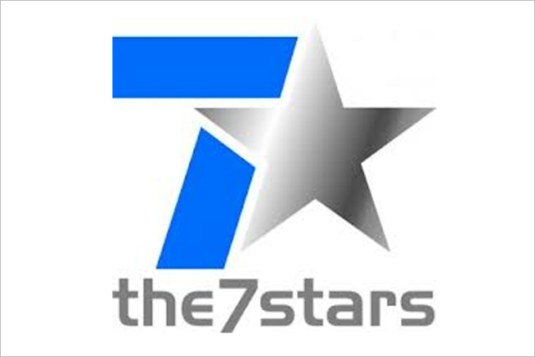
Gala Bingo hits the jackpot with The Chase
Challenge
Gala Bingo wanted to drive brand loyalty and long-term growth in a competitive market
Solution
Sponsoring The Chase, they developed an integrated partnership which included licensing rights, access to show talent, set tours and the creation of The Chase Bingo Game
Results
48% increase in ad awareness in just three weeks
Uplift in ROI of 32% YOY
Notes:
The Challenge
Gala Bingo is one of the nation’s most loved gaming brands. But, in late 2015, Gala Bingo sold their physical bingo halls and could no longer rely on an omnichannel approach to bring customers to their online offering. The online Bingo gaming market is a difficult market to operate in, partly because it is highly crowded and fiercely competitive but also because it is hard to differentiate. Research showed that about half the players are a member of 6 or more sites and 20% are a member of more than 16 sites.
The Solution:
Gala’s media agency, the7stars, had recently set up Gala Voice, a customer community of Gala Bingo customers. They turned to this panel to see what types of programmes they love. Gala is an always on TV spender, as it is the most effective media channel for driving customers, so the solution was always going to be TV based.
Analysis of the Gala Voice panel revealed that The Chase and Catchphrase were the most watched shows, but The Chase was by far the favourite. They also conducted a bespoke Sky IQ research project, which built a Gala Bingo player viewing audience to assess what programming the players loved most. The study established that Gala Bingo players were 50% more likely to watch The Chase vs all adults.
The7stars managed to secure sponsorship of The Chase for Gala Bingo. They worked with ITV to develop an integrated partnership which covered not only the broadcast sponsorship, but also activated licensing rights and access to show talent and set tours.
Results
Gala bingo saw a huge spike in ad awareness when the sponsorship commenced
There was a 48% increase in ad awareness in just three weeks amongst their target audience of women C2DE 35+, achieving the highest ad awareness to date
TV sponsorship delivered the highest ROI of all channels at 279%
TV sponsorship’s impact on DRTV performance was also successful, with ROI increasing 32% YoY
To read the full case study and access the creative visit: https://www.thinkbox.tv/Case-studies/Gala-Bingo

