Slide 1
Online born business sector is the largest investor in TV
Millions
Source: Nielsen Ad Intel, 2024, Thinkbox-created category of online-born businesses (YoY category % change).
Notes:
Despite a year-on-year decline, online born businesses persist as the biggest investors in TV. TV investment has experienced its most significant growth from Household FMCG and Retail categories.

Slide 2
TV is the biggest single source of website traffic
Contributing 42% of all visits, around 50m in all
Breakdown of web visits by driver
Source: Magic Numbers, The TV playbook for online businesses (2021)
Notes:
Analysis across the brands consistently showed a clear relationship between TV activity and web traffic.
Uplift was seen regardless of the level of investment or the size of the launch
likely impacted by the ease and convenience of searching immediately via a mobile device.
Across the 10 brands modelled, 120m visits were generated, with TV driving 42% of all visits - equivalent to 50 million in total

Slide 3

TV drives brand search
R^{2=0.90}
Source: Barb/Google Trends, Jan 2024 – Apr 2025

Slide 4
TV drives (lower cost) brand search
In comparison to Radio and OOH, TV initiates a higher proportion of organic/direct and paid brand search journeys
The journeys initiated by ATL channel
No search costs
Small search costs
High search costs
Source: Magic Numbers, The TV playbook for online businesses (2021)
Notes:
TV drives (lower cost) brand search
Within search advertising, direct, organic and paid brand search visits are highly desired as these are the cheaper and, in some cases, free visits. TV and search have always been strongly linked. Brands can capitalise on these searches as analysis showed that most online journeys prompted by TV involve your brand name early which means lower spend in the search environment. TV (in comparison to Radio and Out of Home) lands the brand name better than the other offline channels as it encourages people to search the brand and not the category.
Of the journeys initiated by TV, 66% were direct/URL or organic search visits (which carry zero additional cost), 20% were paid for brand search clicks (which carry a small search cost), and 14% were for paid generic searches (that carry a high search cost).
For more details, read: https://www.thinkbox.tv/research/thinkbox-research/the-tv-playbook-for-online-businesses

Slide 5
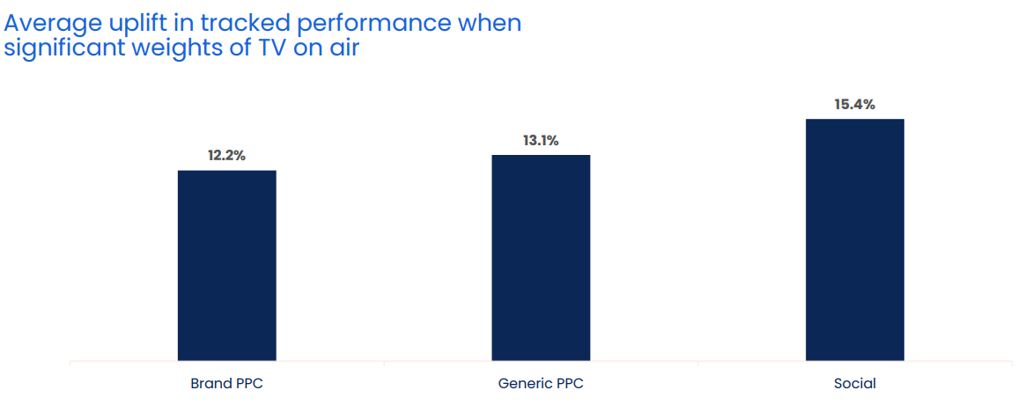
When TV is on air, digital channel performance is uplifted by 13.7%
Source: Why the Eff would you cut TV? GroupM, 2025
Notes:
When TV is on air, digital channel performance is uplifted by 13.7%
One of TV advertising’s most underestimated strengths is its halo effect — the way it boosts the performance of other media channels. While often misattributed, this cross-channel impact is both real and measurable.
According to GroupM analysis in ‘Why the Eff would you cut TV?’ presented at Thinkbox Trends in TV 2025, digital response channels see a clear uplift when TV is live. The study analysed the performance of TV, brand PPC, generic PPC and social across 14 brands, which included 1,489 weeks, and £283m total performance media spend.
Analysis found that on average, the performance of lower-funnel response channels improves by 13.7% when TV is part of the media mix.
More specifically, brand PPC, generic PPC and social saw an average uplift of 12.2%, 13.1% and 15.4% respectively in tracked performance when significant weights of TV were on air. This shows how TV makes digital channels work harder.
For a deeper dive on the consequences of taking TV out of the plan, watch ‘Why the Eff would you cut TV?’ on demand.

Slide 6
Immediate payback not exclusive to ‘performance’ media
The percentage of advertising profit driven by channel in the same week of advertising exposure
Source: Profit Ability 2, April 2024 – Short term benchmarks: Ebiquity, EssenceMediacom, Gain Theory, Mindshare, Wavemaker UK.
Immediate contribution = the same week of advertising exposure
Notes:
‘Performance’ is not the sole domain of search and social
Analysis from ‘Profit Ability 2: the new business case for advertising’ ranks channels in terms of the typical scale of their immediate payback. The size of the bar captures the percentage of the immediate profit driven by each channel within the databank – a combination of the amount spent on a channel and the speed at which it generates its return.
It’s unsurprising to see Generic PPC at the top of the list, as well as Paid Social. But it might be surprising to see that Linear TV, Audio, and Broadcaster VOD also perform favourably.
For more advertising effectiveness insight, read: https://www.thinkbox.tv/research/thinkbox-research/profit-ability-2-the-new-business-case-for-advertising

