Slide 1


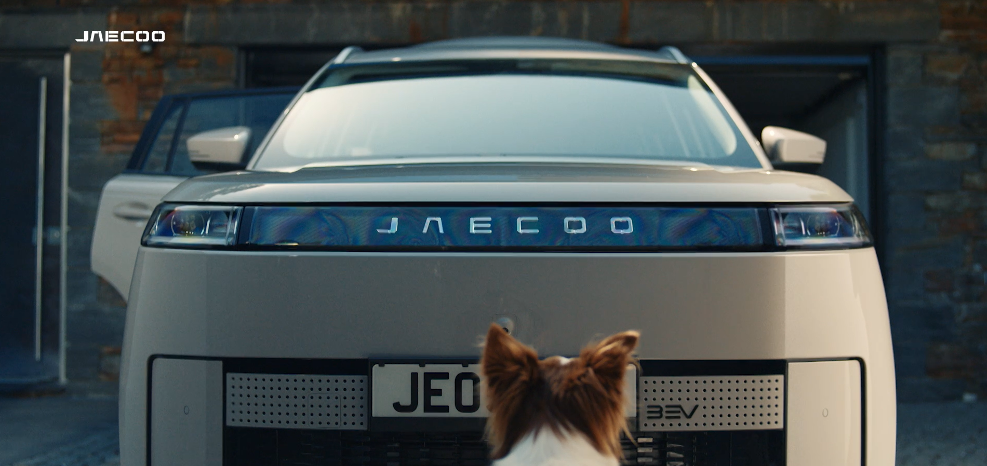
JAECOO: TV drives success at launch
The Challenge:
Chinese auto brand JAECOO were looking to launch in the UK market in early 2025. Parent company Chery Group are China’s biggest vehicle exporter, with 15 million sold globally, but JAECOO hadn’t sold a car in the UK yet. They tasked media agency, Wavemaker with growing awareness, trust and consideration for the brand.
The Solution:
After leveraging Thinkbox research to highlight TV as the lead channel, JAECOO engineered ubiquity and showed up in 7 of the top 10 programmes across 2 weeks, with live sport helping to reach 39% of all adults in the UK.
The Results:
Awareness grew by 240% in just 5 months, delivered a 174% uplift in search activity and ultimately became the number 1 selling car brand in the UK in January 2026.
Notes:
Key Points
Chinese auto brand JAECOO were looking to launch in the UK market in early 2025. Parent company Chery Group are China’s biggest vehicle exporter, with 15 million sold globally, but JAECOO hadn’t sold a car in the UK yet. They tasked media agency, Wavemaker, with growing awareness, trust and consideration for the brand.
After leveraging Thinkbox research to highlight TV as the lead channel., JAECOO engineered ubiquity and showed up in 7 of the top 10 programmes across 2 weeks, with live sport helping to reach 39% of all adults in the UK.
Awareness grew by 240% in just 5 months, delivered a 174% uplift in search activity and ultimately became the number 1 selling car brand in the UK in January 2026.
The Challenge
Early in 2025, Chinese car maker Chery Group launched JAECOO, a cutting-edge hybrid SUV brand, into the UK’s challenging automotive market, a market littered with failed brands. Despite Chery Group being China’s biggest vehicle exporter with 15 million cars sold globally, JAECOO had no established presence in the UK market. With massive competitors dominating mental availability and share of voice, JAECOO were facing a formidable challenge.
As a result, JAECOO tasked media agency Wavemaker with a clear set of objectives. The campaign would need to establish rapid credibility and trust, grow awareness to secure consideration and finally, make JAECOO feel like an established, trusted presence right from launch.
The TV Solution
In the eyes of Wavemaker, TV’s role in driving business results was so strong that it was always going to be the lead channel for the campaign. By leveraging ‘Adnormal Behaviour’ research from Thinkbox, Wavemaker were able to showcase that TV would build trust, a critical element for business success.
Along with this, TV would drive a long-term ROI, as shown with Profitability 2. And ‘Staying Power’ showed that TV delivered the weakest decay in purchase intent, a key consideration as JAECOO didn’t have the budget for an always-on approach.
With a lead channel firmly cemented, Wavemaker needed to overcome the fact that the key primer for the automotive market was ‘seeing the car on the road’, something that JAECOO wouldn’t be able to overcome as they hadn’t sold any cars yet.
The brand couldn’t wait for JAECOO to be seen on the road; they needed to engineer a way for the car to be seen. That idea delivered the key strategic approach, making the brand ubiquitous and making the brand feel like it had always been there.
They defined their bullseye audience as ‘Hunters’, a group likely to be in the market for a new car in the next two years, who were upmarket, young and risk-taking individuals.
Delivering mass reach to the audience would be key to success. Wavemakers aimed to make JAECOO feel like it had always been there by making the communication simple and unmissable.
The Plan
With an approach in place, Wavemaker put its plan into action. This work started with Wavemaker spotting that they could reach a high level of the target ‘Hunters’ audience by focusing on the audience's favourite shows, which fell between Friday and Sunday. As a result of this, Wavemaker focused 96% of its linear airtime across two key long weekends. This ensured JAECOO showed up in 7 out of the 10 top-rated programmes for the target audience in February, showing up in big hitters like The 1% Club, Gogglebox, Love Island: All Stars and The Great Pottery Throw Down, presenting the challenger autos brand as a market leader across the two key weekends.
To make the brand truly unmissable for the Hunters audience, JAECOO leveraged their held association with former England rugby captain, Chris Robshaw and global sponsorship of Investec Champions Cup Rugby by continuing their associations with live sport. This saw JAECOO capitalising on the Six Nations coinciding with the February launch. Wavemaker ensured they aligned active weekends with ITV’s coverage of the Six Nations. The link with live sport was extended into other sports as well, with spots in the Super Bowl, cricket and major football fixtures like the FA Cup. This immersive approach, which, coupled with the emotive creative, allowed viewers, in the eyes of Wavemaker, to feel the car within the adrenaline-fuelled nature of the live sport content.
While linear TV drove national fame for JAECOO, Wavemaker leveraged BVOD to create a local impact and drive conversion. BVOD was deployed at a local level using geo-targeting. The bullseye Hunters' audience was targeted within a 45-minute drive time of each of the dealerships. With only 71 national dealerships across the country at launch, Wavemaker continually tweaked its targets whenever a new dealership opened up, reaching 101 by the end of the year. This targeted BVOD approach further leaned into the engineered ubiquity that JAECOO were aiming for, ensuring increased exposure to the audiences most likely to convert in key locations.
Results
The campaign was a huge success for JAECOO. Across just 2 weekends, the campaign reached 39% of the target audience, and in just 5 months, awareness grew by a massive 240%, the highest in the category.
This jump in awareness drove action in search, with the brand seeing a massive 177% increase in search activity on the days when the campaign was live. Search and awareness spikes, in turn, led to business results with Chery Group’s market share hitting 4% in under 12 months, something that took competitor Hyundai 40 years to reach and Tesla 10 years.
Ultimately, by January 2026, JAECOO became the number 1 selling retail car brand in the UK, making it the fastest growing car brand of the past decade. The campaign won Best TV Newcomer at the TV Planning Awards 2026.

