Slide 1


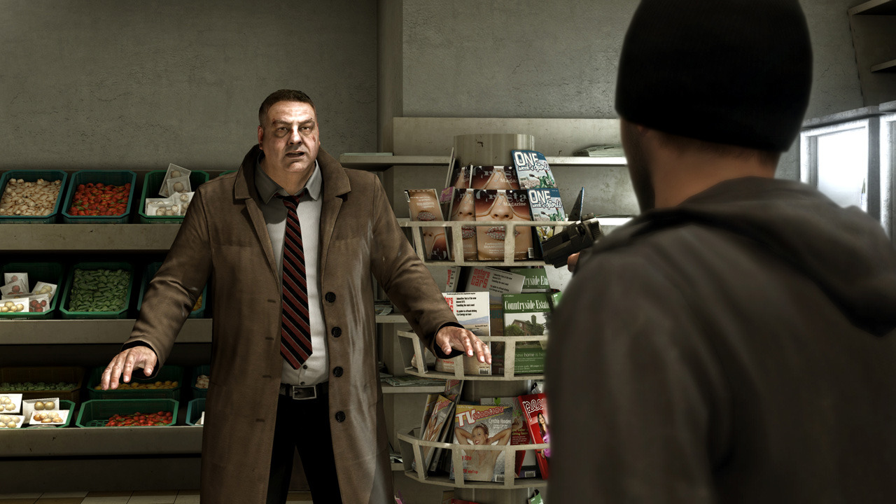
Heavy Rain’s creative TV campaign leads to a deluge of sales
Challenge
Sony PlayStation wanted to attract a broader 16-34 audience for their new interactive game ‘Heavy Rain’.
Solution
Conveyed the game on TV as a cult classic, showcasing high octane events and then invited viewers to choose the ending
Various executions were used to present the situations from different angles
Bought spots in gritty dramas, psychological series and thrillers to reach the right audience
Results
95,000 units were sold in the first week meaning the game was sold out in the UK
Notes:
Challenge
A new type of interactive movie, Heavy Rain did not sit in one of the traditional gaming ‘genres’.
With accessible intuitive game play, an emotionally gripping storyline and cinematic visuals, Heavy Rain had the content to appeal to a broader 1634 audience and attract new players to the PS3. MGOMD needed to take a completely new approach to planning TV in order to get a broad 16-34 audience interested in Heavy Rain.
The key was to get 16-34s en masse to experience Heavy Rain, by locking them into the story and then getting them to realise how easy the game play is.
The Solution
MGOMD identified thriller movies as a key touchpoint for 16-34s. Aiming to appeal to men and women, their objective was to position Heavy Rain as a new form of cult entertainment. Creatively employing the codes and visual language of cinema to cultivate a sense of mystery, edginess, suspense and drama – in the most stylistic way possible!
The central theme of Heavy Rain is ‘how far would you go to save a loved one?’ In scenes as realistic and emotionally gripping as a thriller movie, characters are trapped in hard dilemmas. For example, one scene is set in a corner shop. A robber runs in and holds up the shop keeper with a gun, threatening to kill him if he doesn’t open the till. You are down a side aisle and are presented with four different options – Run, Attack, Reason or Hide? What would you do? The game’s outcome changes depending on the path you take.
MGOMD used multiple second lengths to present this situation and trigger a gut reaction. 60” and 30” painted the overall scene from different angles, whilst top and tail 20” and 10” (with 4 x different 10” on rotation) showed what happened depending on the option you took. TV was used as a signpost to a richer experience online. Viewers were challenged to think ‘what would you do’ by the TV spots, and then invited to finish the story via an interactive YouTube video online. This enabled viewers to experience the actual game play, and the never ending possibilities that the new interactive thriller Heavy Rain presented.
To attract a wider audience, the campaign was built around targeting 1634Adults using channels which converted well for fans of thriller films. The launch of the game was phased like a film launch, the pre-release period was upweighted to maximise reach and impact using the longer 60” copy.
Manning Gottlieb OMD liaised with TV stations to ensure that viewers saw at least three of the four possible top n tail endings. They did this by buying multiple spots across the three week period in sets of TV series – e.g. 24, Lost, The Wire, etc. They also bought back to back spots in programmes that appealed to thriller fans e.g. CSI and CSI Miami on Channel 5. By buying a tightly targeted TV campaign with spots in gritty dramas, psychological series and thriller movies they ensured that the advert would be seen by the right audience and positioned as a new form of cult entertainment.
Results
In terms of sales, Heavy Rain was the no.1 computer game across all consoles in its first week.
It sold 95,000 units in this first week – it was sold out in the UK.
TV provided a high reach figure of 68% of 16-34 Adults with a frequency of 3.9 OTS.
TV drove people to YouTube where there have been 296,000 views of game content on the dedicated channel.
To read the full case study and access the creative visit: https://www.thinkbox.tv/Case-studies/Heavy-Rain

