Slide 1


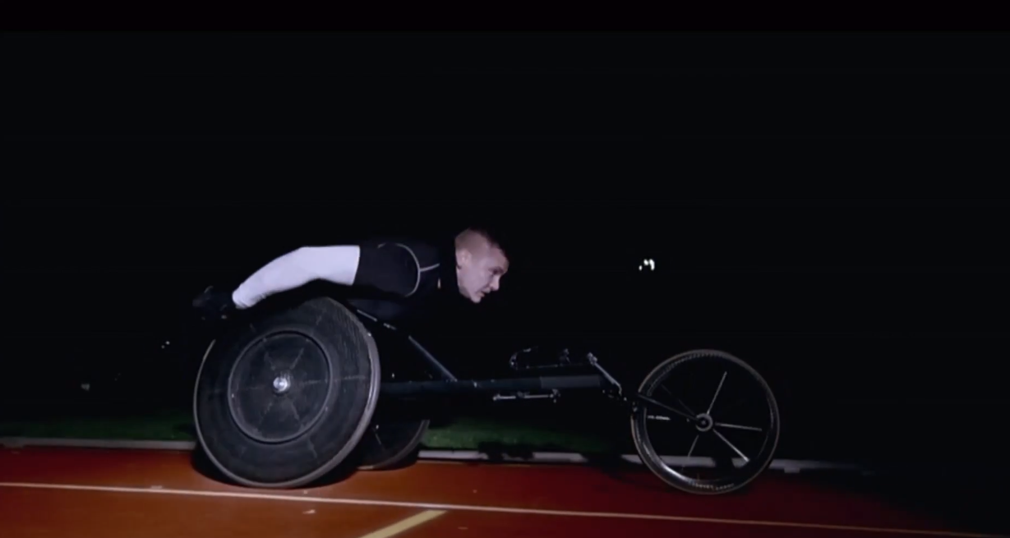
BMW used TV to supercharge Olympic story
Challenge
BMW wanted to strengthen their association with the Olympics and Paralympics through compelling content
Solution
Films were created, called BMW Presents, that showcased the ability needed by the athletes to put in the ultimate performance, aligning their achievements with comparable insights from BMW’s world of engineering and design
David Weir’s Man and Machine film was showcased on Channel 4 during coverage of the Paralympics
Results
By the end of the games, unprompted awareness of BMW’s London 2012 partnership was up to 32% (from 4% at the start).
This contributed to a peak in UK sales which were up 9% year on year
Notes:
The Challenge
BMW is the ‘Ultimate Driving Machine’ and the car’s performance is at the heart of this claim. BMW were the official automotive partner of the 2012 Olympic and Paralympic Games. They felt that the human stories behind Britain’s Olympic and Paralympic athletes offered BMW the chance to make a connection between their own approach to car making and the commitment required to produce the ultimate in human performance. The challenge was to create some compelling content that could highlight this connection and to get it noticed and talked about. An additional challenge was to increase awareness of BMW’s association with The Olympics.
The Solution
Research showed that BMW’s audience was particularly tuned into the personal stories of the athletes. It was felt that the athletes themselves were best placed to tell the story of what it takes to produce the ultimate in performance. BMW’s agencies: Engine, WCRS and Vizeum produced a series of short films called BMW Presents starring Swimmer Rebecca Adlington, Gymnast Louis Smith and Paralympian runner David Weir. In each film, the athlete presented their specific achievements alongside comparable insights from BMW’s world of engineering and design. Initially, due to limited budgets, the films were launched, housed and seeded online.
As the drama of the Games unfolded, with Olympic and Paralympic fever rising generating plenty of social media buzz, the decision was made to place the David Weir ‘Man and Machine’ film on television, within the Paralympics transmission. It was felt that the emotional power of TV could be used to showcase the story and get the message across. By using television, the content would be seen by a much wider audience and would be more likely to get talked about. Also, as Weir’s chances of a gold medal were solidifying, this move would align the ultimate performance of BMW with a national hero just moments after his own winning performance. This story would unfold to an engrossed viewing audience in what could be one of the blockbuster TV moments of the year and so giving the incredible story the bigger platform it deserved.
The brand film was placed at key times during Channel 4’s coverage of the Paralympics in September 2012.
Results
2m of BMW’s audience (ABC1 Men) saw the brand films
Social media buzz following the film broadcast was huge – Google searches for BMW around the time of the film’s transmission peaked higher than at any other time during the Olympics. This in turn increased the number of views online for the BMW Presents series.
The activity helped BMW cement its partnership with the Olympics. By the end of the games, unprompted awareness of BMW’s London 2012 partnership was up to 32% (from 4% at the start)
All this contributed to a peak in UK sales which were up 9% year on year, well ahead of the market
To read the full case study and access the creative visit: https://www.thinkbox.tv/Case-studies/BMW

