Slide 1
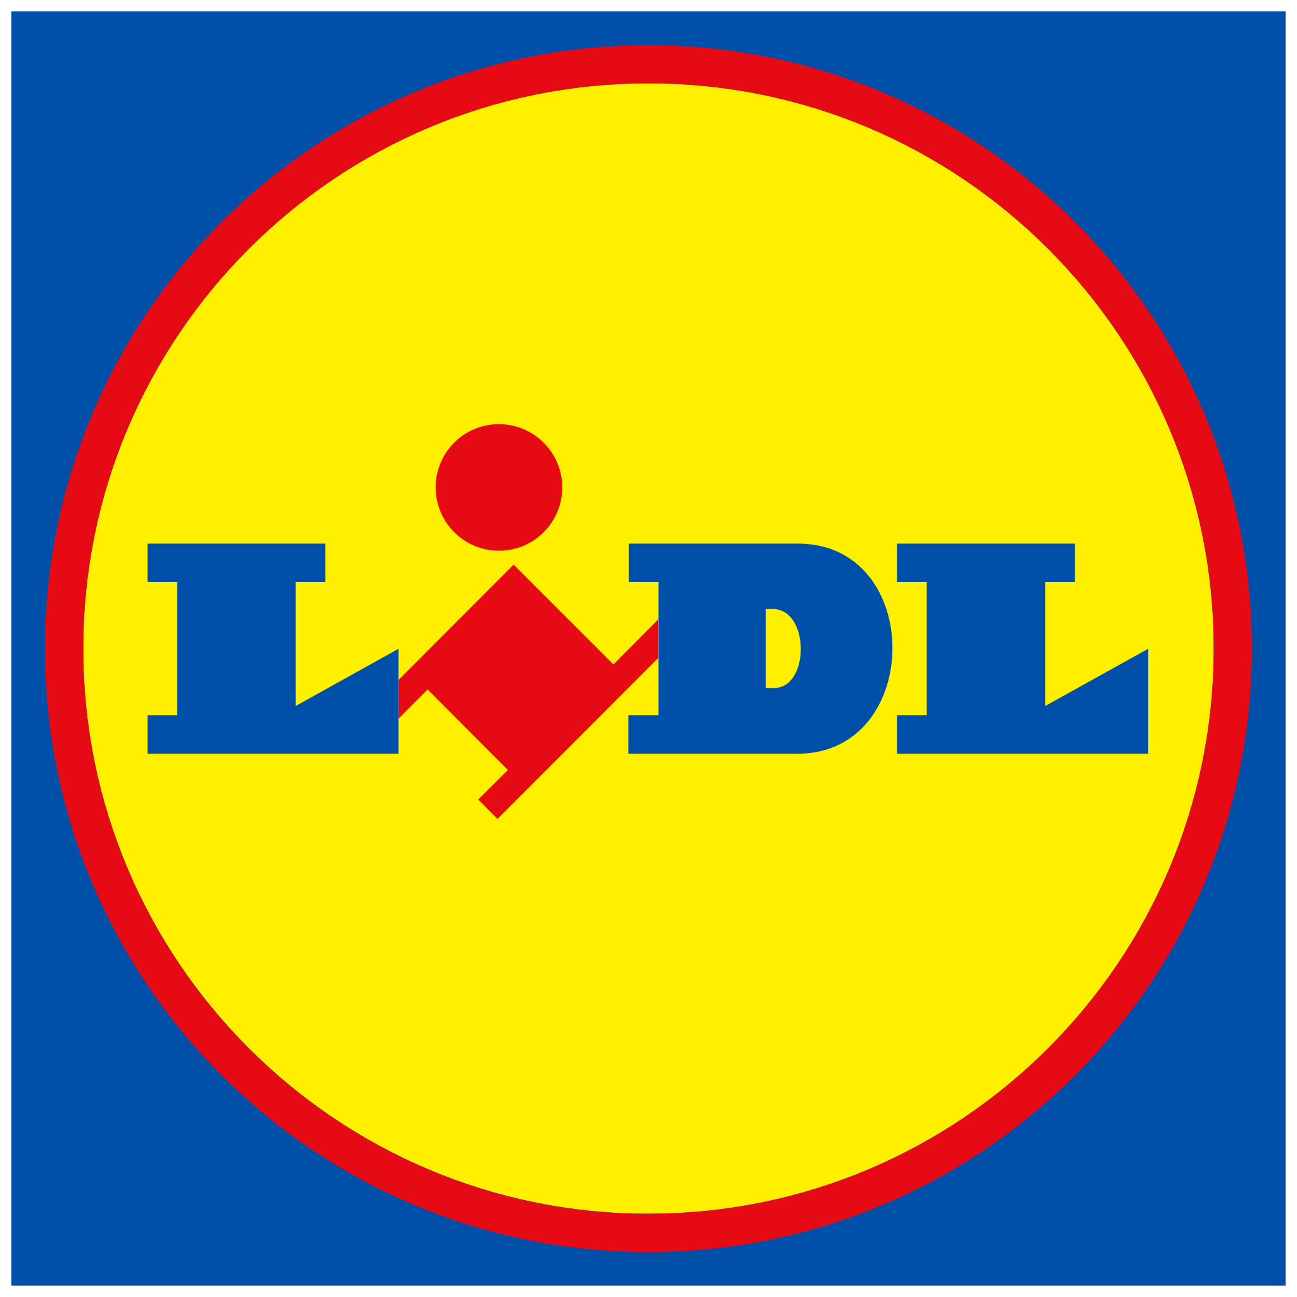
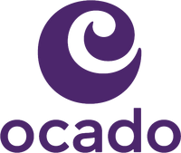
Sustaining ESOV essential for brands
Q1 2023
Avg. 2018 to 2022 (Q1 only)
Source: BARB / ESM magazine / company financial reports
Notes:
Price sensitivity and Excess Share of Voice (ESOV) are important factors to consider, especially with the economic climate in 2023. Price sensitivity is crucial; with inflation driving up business costs companies may have to raise prices to protect their margins. Products or brands highly sensitive to price fluctuations may experience reduced sales volumes.
A brand’s share of voice (SOV) also plays a vital role. Econometric agency Gain Theory suggests a close relationship between SOV and reduced price sensitivity where a 10% increase in a brand’s SOV can result in a 5-20% reduction in its price sensitivity. This happens because strong brands, supported by advertising, can maintain market share and profit margins even with higher prices.
The supermarket category is an example of how sustaining excess SOV can lead to potential market share gains. This month’s Chart of the Month shows the major supermarkets’ linear TV share of voice for 2023 Q1 (green dots), compared with the first quarter of the previous five years (red dots) and plots this against their 2022 market shares. Analysis shows that bigger supermarkets tend to have a higher TV share of voice, but there are notable changes this year. Lidl and Ocado are investing in increasing Excess SOV on TV, Aldi is maintaining a high ESOV, Tesco also has an increased SOV but has a lower SOV than SOM, while Asda has seen a significant reduction in SOV relative to its market share.
Given the current economic climate, being bold and strategic in pursuing excess share of voice could offer significant advantages for businesses.

