Slide 1

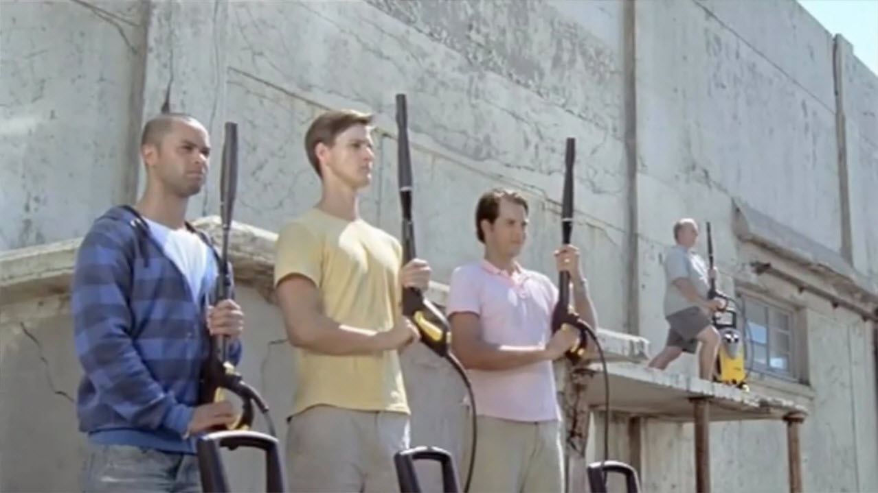
Kärcher Pressure Washers have fun on TV
Challenge
Kärcher needed to reignite a consumer power tool market which was down 10-15% in 2008. Their mission was to drive sales by increasing awareness and consideration of the brand
Solution
They targeted men aged 25-55 and clustered their campaign around certain programming – live sport, comedy, crime shows and documentaries – with peak-time 30 second spots
184 TVRs were bought across the key holiday periods – Easter and May Bank Holidays
Results
Kärcher accounted for 129% of volume growth and 92% of value growth of the pressure washer market
Sales were up 38% year on year and recognition of the campaign reached 37%
A gross ROI of almost £6 for every £1 spent on TV advertising, thanks to an incremental gross profit of £3.4m against the campaign cost
Notes:
Challenge:
Despite being available in the UK for many years, high-pressure washers remain a relatively under-developed category – the tool men don’t know they need. UK penetration is only 20% of home owning households, whereas in Germany this figure is nearer 50% indicating the potential for growth.
Kärcher were the market leader but not yet the brand leader. Coupled with this, consumer power tool sales were down between 10 and 15% in 2008 and the pressure washer market volumes were declining. Kärcher needed to do something big to bring about a change in fortunes.
The mission was to drive sales by increasing awareness and consideration of Kärcher. What stood in their way was “that most sensitive creature, the mature human male”. Through research, it became clear that using a Kärcher high-pressure washer was really, really fun.
How could Kärcher translate having fun into sales? This was the challenge facing them. They needed to create a TV campaign that would demonstrate how much fun could be had with a pressure washer that would leave their target audience of men aged 25-55 asking where they could get one from.
Solution:
Kärcher needed to make an impact. In their case, there was only one option – peak-time 30-second spots. HMDG created an advert highlighting how much fun could be had with the pressure-washers, and Kärcher knew the audience they were targeting – Men aged 25-55 so they needed to ensure as many of the 6.5 million men in this bracket would see the advert as possible. This audience fitted the template of light TV viewers that cluster their viewing around certain peak time programming – live sport, comedy, crime shows and documentaries.
Zed Media put together a plan concentrating their TV spend across 15 days in cherry picked programming across all channels. The TV spots included Live Premiership Football on Sky Sports, Live Champions League Football on ITV1, Red Dwarf on Dave, as well as NCIS and CSI New York on Channel 5. The 184 TVRs were bought across the key holiday periods – Easter and May Bank Holidays.
Results:
Kärcher accounted for 129% of volume growth and 93% of value growth of the pressure washer market.
Kärcher sales were up by 38% year on year (Source: GFK)
Recognition of the campaign reached 37% (Source: HPI)
On exposure, the top three communications points were:
Powerful and effective machine (80% agree)
Enjoyable to use (75%)
Kärcher expertise (71%)
These were all aims of HMDG’s creative TV advert
With an incremental gross profit of £3.4m against the campaign cost, this resulted in a gross ROI of almost £6 for every £1 spent on TV advertising. (Source: HMDG; based upon known average sector gross profit)
As a result of the campaign, Kärcher has almost doubled its investment in advertising.
For the full case study and to view the ad campaigns visit: https://www.thinkbox.tv/Case-studies/Karcher

