Slide 1


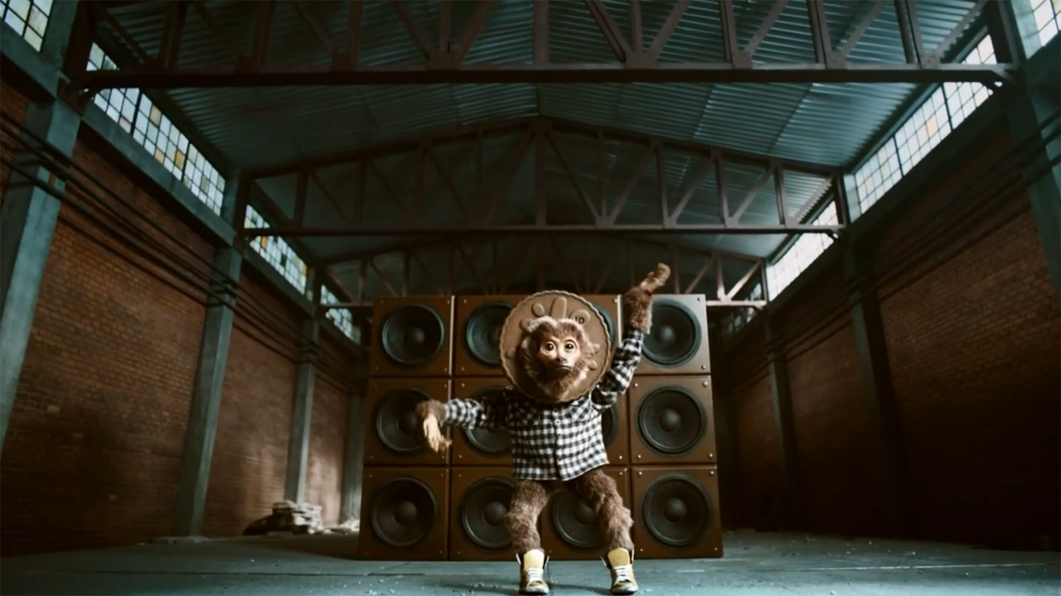
Dodger’s Got Talent - how collaboration and innovation launched Choccie Dodgers
Challenge
Burton’s was preparing to launch Choccie Dodgers to UK families, and needed to find a way to make the Dodgers monkey fun and relevant
Solution
Partnership with Britain’s Got Talent: A collaborative partnership between UM London, ITV, ITN & VCCP. Consecutive ad break placements, bespoke content on dedicated site, ITV talent used for voice overs and ITN-produced ‘news bulletins’
Result
Over 1m views of Dodger video content driven by the TV exposure indicated huge levels of engagement
Perception and awareness of the brand increased across all metrics, and sales increased 22%
Notes:
Challenge:
Burton’s Biscuits was preparing to launch a new biscuit into the Dodgers family: Choccie Dodgers. Awareness of the ‘fun’ brand was fairly high amongst our target audience (families with kids aged 6-10), particularly since the introduction of monkey characters for ‘Jammie’ and ‘Toffee’ last year. But engagement was dropping. They needed to get families involved with the brand again, and make the monkeys more accessible.
A Tasty Insight: Seeing their children enjoying a product is a great incentive for parents to buy it. It was crucial the campaign embraced ‘family moments’.
Solution:
Burton’s was introduced to a completely new way of working, with a truly collaborative partnership between UM London, ITV, ITN & VCCP.
Cue Choccie: ‘Dodger Number 1’ was created - an exciting sing-off that introduced ‘Choccie’ and pitched the three monkeys against one another in an epic music battle in the style of Britain’s Got Talent (BGT).
Having identified BGT as the biggest family moment in media, UM created an exclusive, first-of-a-kind TV partnership that not only put ‘Dodger Number 1’ smack bang in the middle of the show but actually enhanced the audience’s viewing experience by letting them get more involved. The commercial was placed first in three consecutive BGT breaks to follow the narrative of the show, and created a campaign that followed the monkeys through audition stages and a nail-biting sing-off, before directing viewers to a bespoke Dodgers website where they could watch the audition videos in full and vote for their favourite act.
The web and mobile sites allowed families to get completely immersed in the contest and the Dodgers brand, with bespoke video content, interviews with Choccie and his rivals, a Dodgers playlist, and ITN-produced ‘news bulletins’. Two weeks later, the winning monkey was crowned during the break of the BGT final.
The whole team worked tirelessly to ensure the ads followed BGT’s script to a tee. BGT’s famous voice-over artist Peter Dickson even introduced the monkey acts – providing a truly authentic experience.
Results:
Over 1m views of Dodgers video content across ITV’s platforms
31,000 monkey votes
55,688 Dodger No.1 website visits
Jammie Dodgers topped Twitter trends on launch and final night (above Ant & Dec and Will.i.am)
Qualitative research was conducted and the campaign scored highly across all metrics:
The campaign struck a fun-loving chord, with 67% agreeing that Dodgers is a fun brand
There was a 21% uplift in brand advocacy amongst those who had seen Dodger Number 1
Over the campaign period there was a 19% uplift in consideration for Dodgers and a 38% uplift in consideration for Choccie Dodgers.
Sales:
Choccie Dodgers became a top 5% brand in terms of trial with 50% repeat rate (IRI)
Jammie Dodgers value sales increased 22% period on period, volume increased 19% (IRI)
For the full case study and to view the ad campaigns visit: https://www.thinkbox.tv/Case-studies/Burtons-Biscuits-Choccie-Dodgers

