Slide 1
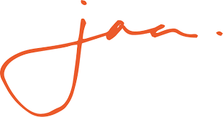
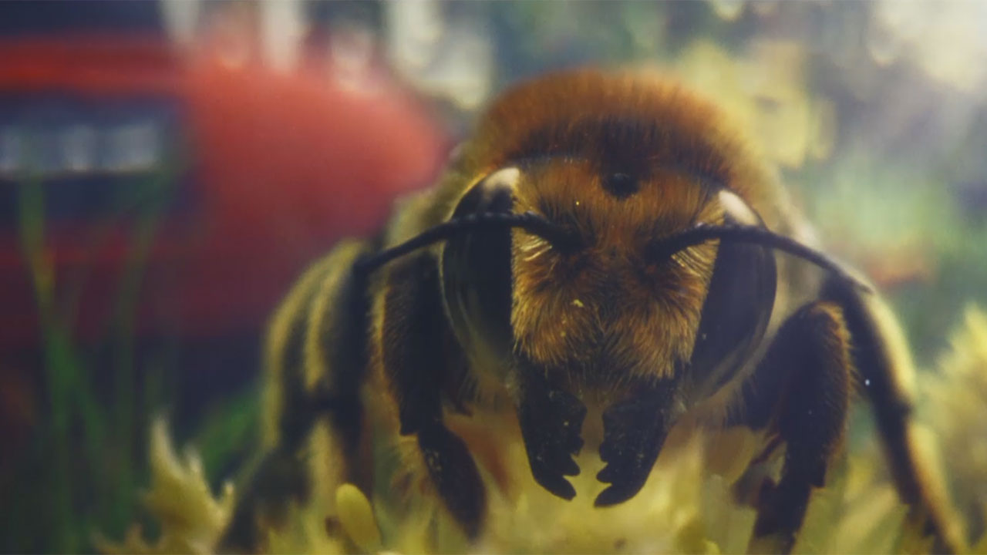
RSPCA promotes respect and kindness for every kind of animal
The Challenge:
The RSPCA had been losing share to their competitors and people didn’t fully understand the breadth of the work they do for all kinds of animals
They needed to drive awareness of their purpose and launch their revised brand
The Solution:
They partnered with Channel 4 and Gogglebox, with a 2-minute launch ad, discussed by the cast of the show
The warmth and humour from the armchair critics helped create trust, authenticity and got everyone to think about the RSPCA
The Results:
Consideration rose to over 30%
Cash donations increased to their highest in four years
RSPCA had their most impressive Summer Appeal ever
Notes:
The Challenge
The RSPCA is a 200-year-old brand with very high awareness, but in recent years, it has been losing share to its competitors. It also had to contend with the issue that people perceived them to be an organisation who only rescued cats and dogs and prosecuted cruelty.
In 2024, the charity underwent a re-brand, the first in 50 years, to change this perception. Their refined purpose is “to inspire everyone to create a better world for all animals” and they needed to re-immerse themselves into the community - and put SOCIETY back into the RSPCA.
Their key objectives were to:
Increase consideration to donate up to 30%
Increase ad awareness to 15% and spontaneous brand awareness to 28%
Increase donations and drive search volumes
It was crucial that they didn’t alienate their existing supporters, but at the same time they needed to encourage new customers to reappraise the RSPCA and animal welfare and then consider becoming supporters themselves.
The TV Solution
JAA knew they would need the scale of TV to deliver the mass reach they needed and TV’s storytelling power to encourage reappraisal. They wanted the campaign to deliver impact above its ad spend so looked for a big, innovative idea.
They opted for a partnership with Gogglebox and Channel 4. Gogglebox was the ideal communications vehicle because not only did it offer scale with an audience of 4.5 million, but the programme is a window on the nation, reflecting every kind of home across every kind of community in a relevant and relatable setting. The warmth and humour from the armchair critics would help to create trust and authenticity and get everyone to rethink their relationship with animals and the RSPCA
AMVBBDO created a compelling TV ad, ‘RESPECT for all kind’, that showcased the breadth of work undertaken by the charity.
The Plan
To kick off the campaign, they ran a 120” ad in Gogglebox and various members of the cast watched and responded to the content, framing the narrative. To ensure mass simultaneous reach, they also bought a 60” spot in The Twelve on ITV1. This combination drove great search results on day one.
The campaign continued with spots that ran across Channel 4 channels and Channel 4 Streaming – the 60” for the first two weeks and then a 30” cutdown. ITVX was added into the mix to extend reach.
JAA selected contextually relevant programming such as ‘For the Love of Dogs’, ‘Wildlife Rescue’ and ‘The Dog House’ to maximise impact.
The TV activity was supported by spots in cinema – family movies; OOH – with sites in proximity to branches and social.
Results
Ad awareness increased to 16.4% (source: YouGov)
The campaign drove big uplifts in search – 40% higher on launch day and 250% higher at the time of the Gogglebox ad (source: Google Search Trends)
Consideration rose to over 30%
Cash donations increased to their highest in four years
RSPCA had their most impressive Summer Appeal, generating over £1m from new donors and marking a 400% increase from the previous year

