Slide 1
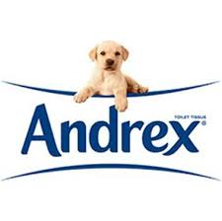

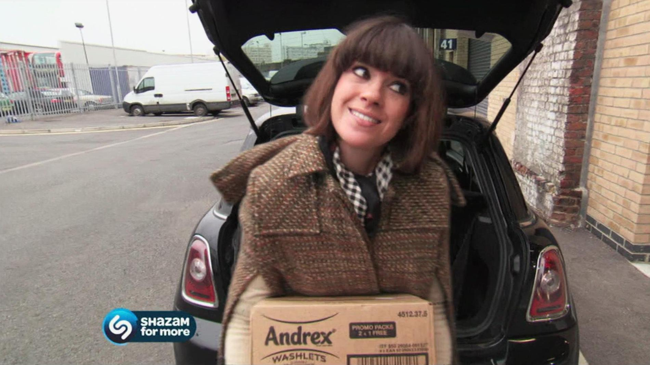
Andrex Washlets use advertorials to increase sales in the UK
Challenge
Andrex wanted to triple the growth rate of Andrex Washlets by recruiting 750k new committed users
Solution
They created ‘The Clean Campaign’ - a series of six TV advertorials following Dawn Porter’s mission to get the UK population using the wet toilet tissue product
Results
They met the 12 month 750k target penetration goal within 12 weeks
39% of people wanted to try Andrex Washlets having watched the TV adverts
Notes:
The Challenge
Andrex wanted to triple the growth rate of Washlets from 6-8% to 20-24% in a year. This meant it needed to recruit 750k new committed users of Andrex Washlets. Research into wet toilet paper shows that it is widely used in continental Europe, highlighting that this challenge was achievable in the UK.
The two main challenges with Andrex Washlets were: people associated wet toilet tissue with everyone but themselves, and most people did not initially like the cold wet sensation.
Andrex wanted to target its product at a young, urban, professional and mainly female audience. Its aim was to get people to overcome their misconceptions and commit to trying a whole pack. This was key for Andrex as research had shown that once people had used an entire pack of Washlets, they never went back to dry traditional toilet roll alone.
The Solution
Andrex decided to create an entertaining and credible campaign to get people talking about Washlets and also cut through commercial airtime. To do this the perfect TV solution was to turn to investigative documentaries and who best to involve but the queen of taboo, Dawn Porter. Dawn has a genuine warmth and empathy which makes people believe what she is saying, great for a credible documentary. She is also a good fit for Channel 4 and related very much to the young target audience.
Working closely with Mindshare and content development company The Outfit, Channel 4 Sales created 'The Clean Campaign’: a cross between a series of mini-documentaries and adverts which blurred the lines between programming and advertising. There were six documentary-style advertorials that told the story of Dawn’s mission to get the UK population using Andrex Washlets, airing on Channel 4, UKTV and 4OD.
It was important to sustain a documentary style during the commercials so it was decided not to use any written script to make the advertorials as entertaining and real as possible. To keep the popular documentary feel, each advertorial had a teaser of what would happen in the next, leading to a grand finale that incorporated all the key characters that had appeared.
Along with TV, Andrex Washlets optimised social media and allowed the audience to further engage on Twitter and Facebook as Dawn updated them on the commercial shoots and with information about Washlets.
Results
The growth rate of Washlets was five times higher than the previous year
In twelve weeks they managed to meet the 750k estimated target penetration they had for twelve months
57% of the first time buyers have repeated their use of Andrex Washlets
39% of people wanted to try Andrex Washlets after watching the TV adverts
To read the full case study and access the creative visit: https://www.thinkbox.tv/Case-studies/Andrex

