Slide 1
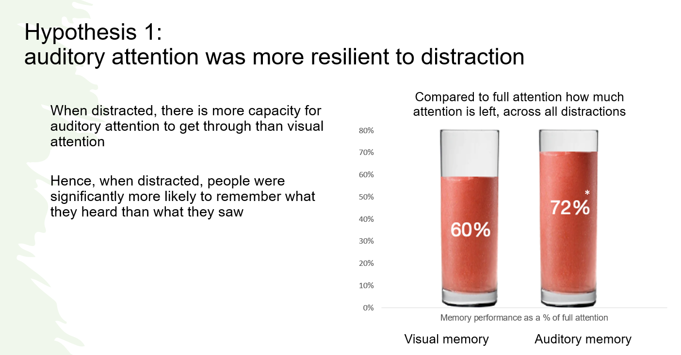
Auditory attention more resilient to distraction than visual attention
Source: Competing for Attention, GITR / Thinkbox, 2023, n=305
Notes:
This month’s Chart of the Month draws on findings by Dr Ali Goode (Gorilla in the room) showcased at Thinkbox’s recent ‘Earning Attention’ event. The study (Competing for attention) explored the role of auditory and visual attention in driving memories and showcased the importance of audio.
The research suggests that when people had been distracted, they were more likely to recall things they heard rather than what they had seen. Sound plays an important part in the TV ad experience with its ability to communicate in its own right, mediate attention, draw eyes to the screen, and fill in the gaps when there is no visual attention.
Audio stimuli are important in human behaviour as ears are ‘open’ permanently - we don’t look around for things to listen to, instead our ears tell us where to look.

Slide 2

Creativity is the biggest advertising profitability multiplier within our control
Potential multipliers of advertising profitability - (2023)
X 20
X 12
X 5
X 2.5
X 3
X 1.6
X 1.7
X 2.0
X 1.1
X 1.2
Cost / Product seasonality
Budget setting across variants
Brand : Performance
Multi-media
Budget setting across portfolios
Budget setting across geographies
Target audience
Laydown / Phasing
Creative quality
Brand size
Source: The Drivers of Profitability, 2023, Paul Dyson - accelero, ROI multiplier = area of the circle
Notes:
What drives advertising profitability?
Back in 2014, Paul Dyson, founder of the econometric consultancy Data2Decisions, conducted an analysis which revealed the advertising drivers of profitability (itself an update of work done in 2006). The data showed that brand size was the biggest driver. Second came creative execution, which was by far the single most important element of advertising under a marketer’s direct control when it comes to delivering return on investment.
Since the media landscape has changed dramatically since 2014, we wanted to see whether the list had changed. As a result, we approached accelero to do just this.
This month’s Chart of the Month identifies and ranks the ROI multiplier effects of different advertising levers. This time, rather than using a databank from just one modelling agency, the updated analysis used a range of sources – all available in the public domain – to unpick the variables that most influence advertising profitability. Analysis shows that factors such as target audience and laydown or phasing will deliver multiplier gains of 1.1 and 1.2 respectively whilst budget setting by geography has a multiplier of 5.
However, just like 2014, brand size comes in at number one – the biggest single factor influencing the potential advertising driven return. However, we have little short-term control over the size of the brand we’re working for. This makes the role of creative, still the second biggest driver of advertising profitability, even more important. It’s an element that marketers very much do have control over and has huge potential to supercharge advertising driven profitability with a multiplier of 12.

Slide 3




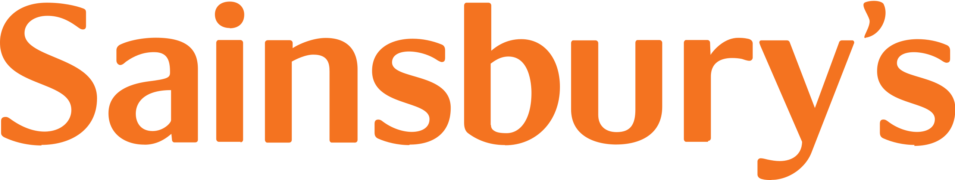


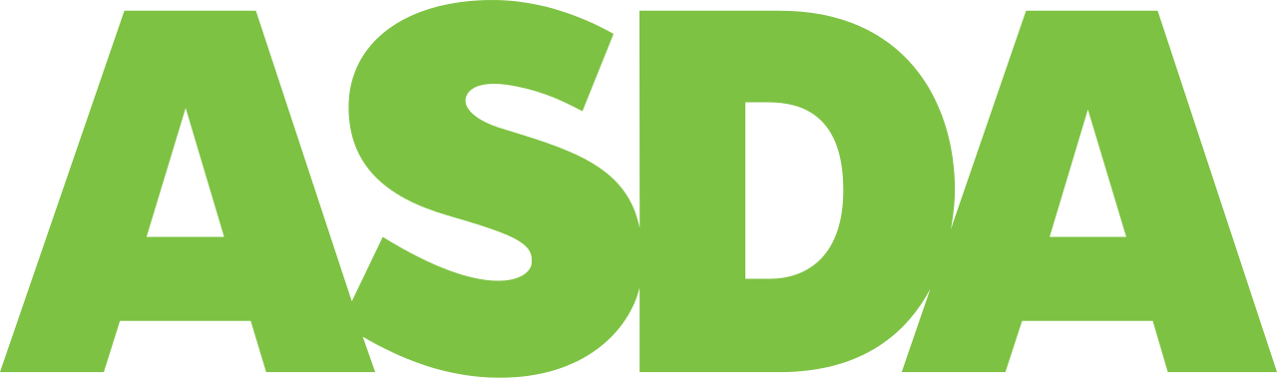



Sustaining ESOV essential for brands in 2023
Q1 2023
Avg. 2018 to 2022 (Q1 only)
Source: BARB / ESM magazine / company financial reports
Notes:
Price sensitivity and Excess Share of Voice (ESOV) are important factors to consider, especially with the economic climate in 2023. Price sensitivity is crucial; with inflation driving up business costs companies may have to raise prices to protect their margins. Products or brands highly sensitive to price fluctuations may experience reduced sales volumes.
A brand’s share of voice (SOV) also plays a vital role. Econometric agency Gain Theory suggests a close relationship between SOV and reduced price sensitivity where a 10% increase in a brand’s SOV can result in a 5-20% reduction in its price sensitivity. This happens because strong brands, supported by advertising, can maintain market share and profit margins even with higher prices.
The supermarket category is an example of how sustaining excess SOV can lead to potential market share gains. This month’s Chart of the Month shows the major supermarkets’ linear TV share of voice for 2023 Q1 (green dots), compared with the first quarter of the previous five years (red dots) and plots this against their 2022 market shares. Analysis shows that bigger supermarkets tend to have a higher TV share of voice, but there are notable changes this year. Lidl and Ocado are investing in increasing Excess SOV on TV, Aldi is maintaining a high ESOV, Tesco also has an increased SOV but has a lower SOV than SOM, while Asda has seen a significant reduction in SOV relative to its market share.
Given the current economic climate, being bold and strategic in pursuing excess share of voice could offer significant advantages for businesses.

Slide 4
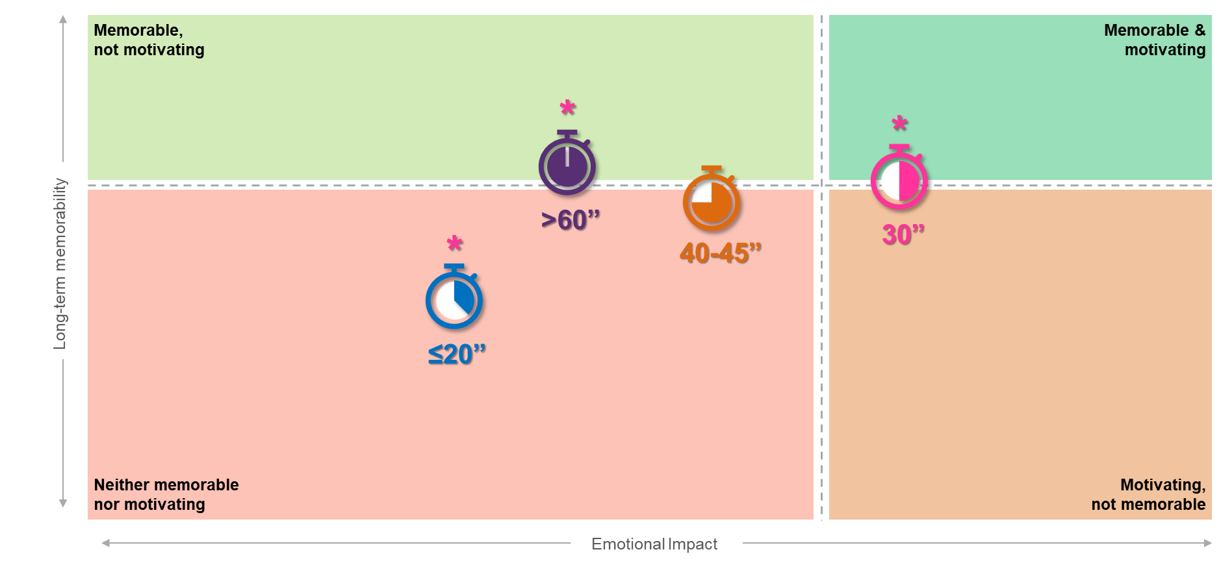
30 second ads deliver the greatest impact
Source: Creative Drivers of Effectiveness, 2023, Neuro-Insight/Thinkbox
Notes:
Thinkbox’s ‘Creative Drivers of Effectiveness’ study explores the factors most strongly linked to long-term memory encoding (LTME), a proven metric in driving decision making and future behaviour.
As one part of the study, research agency Neuro-Insight explored whether the duration of TV ads within their databank influenced both LTME and the emotional impact achieved. This month’s Chart of the Month shows that 30 seconds is the optimal time to develop a narrative and build a strong connection with your audience and therefore deliver the greatest impact.
Ads under 30 seconds often fail to create a strong connection with the audience and develop a compelling narrative, causing the audience to be less involved emotionally and therefore less likely to store these stories into memory. Ads over 30 seconds were still memorable, however they lose their emotional impact slightly. LTME can be driven by pace, music and developing excitement but after 30 seconds these mechanisms can start to lose their strength.
For more insight into what factors to consider when it comes to creative executions, check out ‘Creative Drivers of Effectiveness’.

Slide 5
Late evenings and weekends are valuable dayparts when targeting ‘Reach Extenders’
‘Reach Extenders’ index by daypart
 | 6am | 7am | 8am | 9am | 10am | 11am | 12pm | 1pm | 2pm | 3pm | 4pm | 5pm | 6pm | 7pm | 8pm | 9pm | 10pm | 11pm | 12am | 1am | 2am | 3am | 4am | 5am
Monday | 58 | 71 | 71 | 63 | 71 | 79 | 77 | 74 | 70 | 68 | 65 | 68 | 81 | 103 | 130 | 165 | 136 | 98 | 69 | 56 | 46 | 40 | 32 | 40
Tuesday | 57 | 72 | 67 | 64 | 60 | 53 | 67 | 68 | 62 | 54 | 59 | 66 | 79 | 112 | 145 | 170 | 135 | 99 | 71 | 61 | 50 | 38 | 27 | 52
Wednesday | 63 | 77 | 63 | 57 | 59 | 60 | 66 | 70 | 59 | 57 | 58 | 68 | 83 | 111 | 137 | 169 | 136 | 104 | 82 | 65 | 52 | 34 | 23 | 38
Thursday | 62 | 73 | 73 | 58 | 57 | 57 | 66 | 71 | 63 | 60 | 64 | 66 | 81 | 115 | 134 | 160 | 139 | 112 | 88 | 78 | 60 | 46 | 34 | 41
Friday | 57 | 73 | 70 | 67 | 64 | 63 | 70 | 72 | 62 | 60 | 60 | 64 | 80 | 104 | 128 | 155 | 151 | 128 | 101 | 75 | 54 | 40 | 39 | 38
Saturday | 48 | 72 | 78 | 78 | 78 | 73 | 82 | 88 | 87 | 80 | 77 | 83 | 96 | 108 | 124 | 141 | 133 | 114 | 88 | 68 | 54 | 45 | 43 | 41
Sunday | 53 | 68 | 77 | 78 | 73 | 70 | 74 | 77 | 92 | 97 | 94 | 98 | 101 | 106 | 122 | 140 | 122 | 97 | 71 | 60 | 46 | 29 | 23 | 42
Monday | Tuesday | Wednesday | Thursday | Friday | Saturday | Sunday
103 | 98 | 95 | 92 | 96 | 105 | 110
Source: Barb Q3 2022, commercial linear & BVOD, ‘Reach Extender’ index vs all adults.
Notes:
‘BVOD Almighty: Reach and Return’ (2022) identified a segment which is key to BVOD’s incremental reach. This ‘middle tier’ of viewers accounts for 7% of linear TV viewing, but makes up 28% of BVOD consumption, making them a vital audience to extend campaigns through BVOD. As a result, we call them the ‘Reach Extenders’.
This month’s Chart of the Month looks into this valuable audience further and shows the times that you are most likely to reach them. Analysis from Barb shows that the Reach Extenders’ peak viewing hours are 8-11pm, with a higher likelihood of viewing occurring at the weekend.
For more information on Reach Extenders and the key genres and shows that over index for this audience, check out our new Future Focus Report.

Slide 6
Electric/hybrid vehicles are motoring ahead in TV advertising
Source: Nielsen Ad Intel, linear TV expenditure, Advertisers and brands included in this analysis are a Thinkbox created category specifically in relation to cars (and includes brand building), and does not include other vehicles, car dealers or motor accessories etc. ‘Other’ includes all other categories in product / advertiser mid category
Notes:
This month’s Chart of the Month shows how TV has the ability to help drive societal change.
Looking more closely at the motor sector, analysis from Nielsen Ad Intel shows the movement of TV expenditure towards the promotion of electric vehicles/hybrid cars and away from 4x4/SUV (sports utility vehicle)/Crossovers. Data shows that in 2022, electric vehicle/hybrid advertising was three quarters of the motors category’s linear TV investment compared to just 8% in 2018.

Slide 7
B2B TV advertising spend has doubled since 2018
9%
27%
+£9m
+£21m
46%
5%
+£23m
+£3m
Source: Nielsen Ad Intel, 2018-2022, TV Spend, %’s show YoY Increase, Thinkbox-created category of B2B businesses
Notes:
This month’s Chart of the Month looks at the growth in TV expenditure in the B2B sector. According to Nielsen Ad Intel, B2B brands have more than doubled their investment in TV advertising over the past four years, reaching £108m in 2022.
Analysis shows that there has been growth in TV expenditure from B2B advertisers each year across 2019 – 2021. This growth was also seen in 2022, a 9% increase from the previous year, with the largest spend attributed to web hosting firm Ionos By 1&1, spending £13.5m in total (+194% vs. the previous year). Other top advertisers within the B2B sector include financial services company Sage Group (£13.4m), Intuit (£11.2m), accounting software service Xero (£8.4m), followed by NatWest who increased their spend by 326% to £7.2m.

Slide 8
Commercial broadcasters are unrivalled for scale
All Individuals – All devices
Bubble area represents total volume of daily viewing
Source: Barb / All devices – 2022
Notes:
Barb data allows us to dive into the detail of viewing patterns with great granularity. This month’s Chart of the Month breaks down viewing to the various platforms in terms of the average number of people watching per day (for at least 3 minutes) compared with the average time spent watching per viewer (i.e. only counting those who watched on that day).
Analysis across 2022 shows that the commercial broadcasters (linear and on demand) collectively reach just over 33 million viewers every day, with each of those viewers watching for an average of 3hrs, 25 mins a day. The combined portfolio of BBC channels (linear and on demand) attracts the second largest volume of viewing, with 27 million daily reach and an average view time of just over 2 hours. YouTube is next, with a daily reach of 20 million people and a view time of 1hr 42 mins (Barb only measure in-home viewing, we estimate that YouTube would be circa. 25% larger in viewing time if out of home viewing was included).
SVOD services such as Netflix has a daily reach of 12.4 million people and a view time of 1hr 47 mins, whilst other AVOD services (covering Chili, Rakuten TV, Samsung TV Plus, Red Bull TV, TVPlayer, Vevo, W4FREE, and YuppTV) have a collective average daily reach of 83,000 viewers and a view time of 38 mins a day.

Slide 9
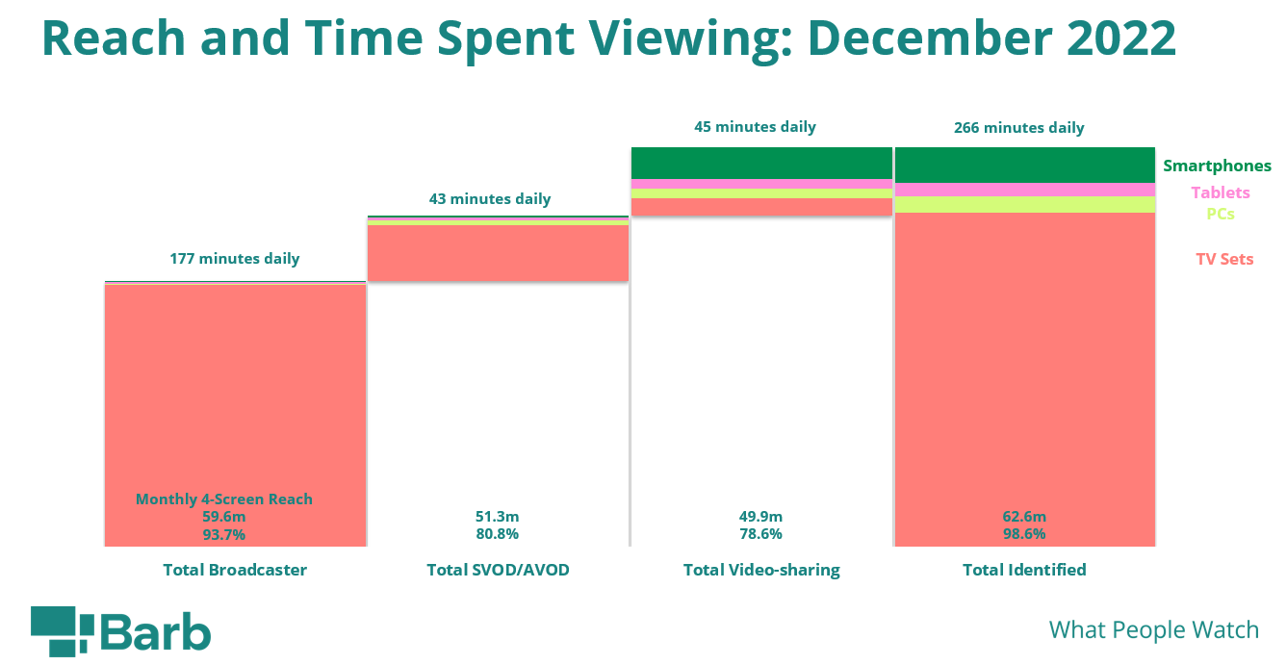
Broadcaster TV was two thirds of Barb’s identified viewing in Dec 2022
Source: BARB, Individuals 4+, Barb Online Multiple Screens Network, 1st – 31st December 2022
Notes:
Analysis from Barb shows that people in the UK spent an average of 4 hours, 26 minutes a day viewing content during the final month of 2022. Using Barb’s definition of ‘total identified viewing’*, this month’s Chart of the Month shows that the majority of this viewing (2 hours, 57 minutes) was spent watching broadcaster channels and VOD services. Broadcaster TV also accounted for the highest monthly 4-screen reach (93.7%).
In terms of devices, the TV set is the most popular screen for broadcaster viewing (2 hours, 54 minutes) and SVOD/AVOD viewing (37 minutes). For video-sharing services like YouTube, TV set viewing accounts for the smallest proportion (11.4 minutes), with three times as much video-sharing viewing taking place on other devices (34 minutes).
* Total identified viewing includes:
Total broadcaster viewing – this represents the time spent watching linear broadcast TV channels and broadcaster-owned VOD services (BVOD). This includes live viewing, as well as pre- and post-broadcast viewing, and viewing to archive box-sets on a BVOD service. This is reported across four screens — TV sets, tablets, PCs, and smartphones — by gathering information about what is streamed through the home Wi-Fi network. For tagged services that share their own census level data with Barb, this includes any streaming regardless of whether it was through the home Wi-Fi network or not.
Total SVOD/AVOD viewing – this covers 19 VOD services, notably Amazon Prime Video, Disney+, and Netflix. Viewing is reported on all four screens, although this only includes viewing through a home’s Wi-Fi network as these services are not tagged.
Total video-sharing – this covers the use of platforms such as TikTok, Twitch, and YouTube. As with SVOD/AVOD viewing, reporting for video-sharing platforms only includes viewing through a home Wi-Fi network on all four screens.

Slide 10
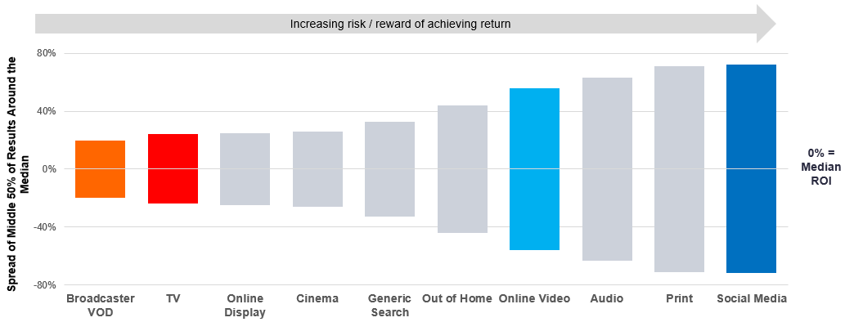
Different video channels sit at different ends of predictability spectrum
Source: Media Mix Navigator, Sep. 2022, MediaCom / Wavemaker / Mindshare / Gain Theory
Notes:
This month’s Chart of the Month draws on findings from ‘BVOD Almighty: Reach and Return’, showcased at Thinkbox’s recent ‘BVOD in Focus’ event. Using the Media Mix Navigator, it’s based on data from Gain Theory, MediaCom, Wavemaker, and Mindshare which covers 52 brands and £2.2 billion of media spend over 3 years.
The charts shows how the variability of returns differs significantly across different forms of advertising. This essentially indicates the risk of investing in different channels based on the predictability of their returns.
The median brand ROI in the databank for each channel is represented by the zero across the middle. To assess the predictability of each channel, the analysis looks at how spread out the different brand ROIs are for each channel in comparison to that middle brand. Basically, the bigger the bar, the bigger variance there is between the best performer and the worst performer – so the greater degree of risk. Outliers have been removed.
As you can see, BVOD is the most predictable (therefore least risky) channel, delivering 20% of variance compared with the median return. This was closely followed by linear TV with a variability of 24%.
It’s worth noting that high variability works both ways: although it involves greater risk, there is the possibility of achieving a much higher than average ROI (as well as a much lower one).

