Slide 1
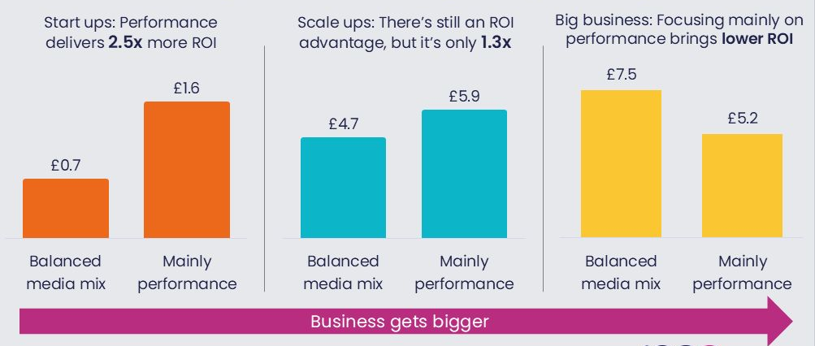
As your business grows, the ROI from a more balanced mix gets better
Source: Incremental ROI from Magic Numbers, Circana, D2D. VCCP, OMG, Ekimetrics via IPA ARC
Notes:
As your business grows, the ROI from a more balanced mix gets better
Analysis of the IPA ARC database by Magic Numbers reveals that while a performance-heavy media mix drives the best returns in the early stages of growth, the picture changes as businesses scale.
The month’s Chart of the Month shows that as businesses mature, a more balanced mix of brand and performance channels begins to outperform a solely performance-driven strategy, delivering a higher ROI.
This suggests that larger businesses may be missing out on significant value by underinvesting in reach-driven channels and richer creative formats.
Download the chart to explore the full analysis.

Slide 2
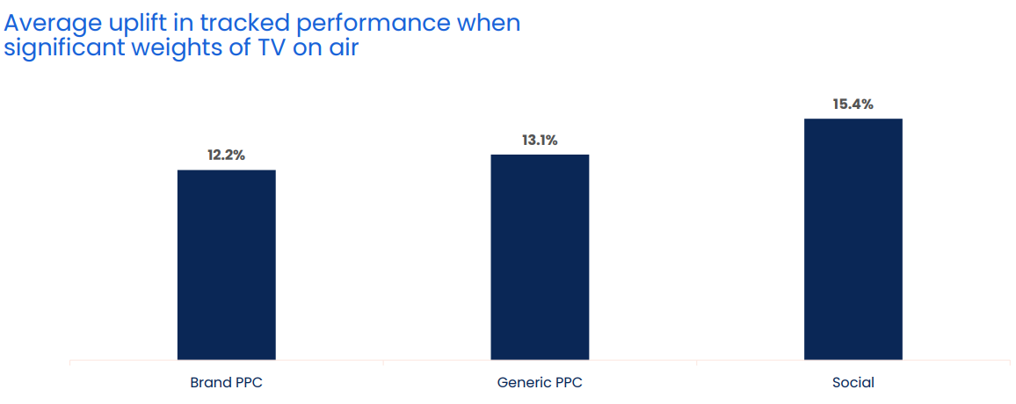
When TV is on air, digital channel performance is uplifted by 13.7%
Source: Why the Eff would you cut TV? GroupM, 2025
Notes:
When TV is on air, digital channel performance is uplifted by 13.7%
One of TV advertising’s most underestimated strengths is its halo effect — the way it boosts the performance of other media channels. While often misattributed, this cross-channel impact is both real and measurable.
According to GroupM analysis in ‘Why the Eff would you cut TV?’ presented at Thinkbox Trends in TV 2025, digital response channels see a clear uplift when TV is live. The study analysed the performance of TV, brand PPC, generic PPC and social across 14 brands, which included 1,489 weeks, and £283m total performance media spend.
Analysis found that on average, the performance of lower-funnel response channels improves by 13.7% when TV is part of the media mix.
More specifically, brand PPC, generic PPC and social saw an average uplift of 12.2%, 13.1% and 15.4% respectively in tracked performance when significant weights of TV were on air. This shows how TV makes digital channels work harder.
For a deeper dive on the consequences of taking TV out of the plan, watch ‘Why the Eff would you cut TV?’ on demand.

Slide 3
Ads benefit from a premium environment
Source: Unlocking The Power of Premium, Vevo, Channel 4, Flood, 2025
Notes:
The context within which you see something impacts how you receive, process and remember things. This concept was explored by Thinkbox in ‘Context Effects’, which investigated the nuances of in-home advertising exposure and what contextual factors contribute to create the best (and the worst) occasions for effective advertising. More recently, ‘Unlocking the Power of Premium ‘ conducted by Vevo, Channel 4 and Flood, delved into the value of advertising around premium content.
Analysis found that ads placed in a premium environment were three times more likely to be perceived positively. This is in comparison to non-premium environments where ads are five times more likely to be perceived negatively.
This highlights the opportunity for brands, as ads benefit from a superior viewing environment which not only enhances ad perception but also creates a ‘halo effect’ for the brand. Premium content is closely associated with positive ad receptivity, making it a powerful context for advertising.
For more insights on the importance of context, explore Context Effects.

Slide 4
Viewing to ad-supported quality content grows
All Adults
16-34 Adults
Source: Barb – TV set viewing
Notes:
This month's Chart of the Month highlights the rise in viewing of ad-supported quality content.
As shown at Trends in TV 2025, data from Barb reveals that the share of viewing to ad-supported content has grown from 58% to 62% for adults. Notably, this growth is even more significant among younger audiences, increasing from 38% to 59%. This is specifically in reference to TV set viewing, supported by analysis from Context Effects that showcased the importance of the TV set (and subsequently the environment) in its ability to drive ad recall.
This trend comes as SVOD services introduce ad-supported tiers, such as the likes of Netflix and Amazon Prime Video, presenting new opportunities for advertisers as the growth of ad-supported content continues to rise.
For more insights, watch Trends in TV 2025, now available on demand.

Slide 5
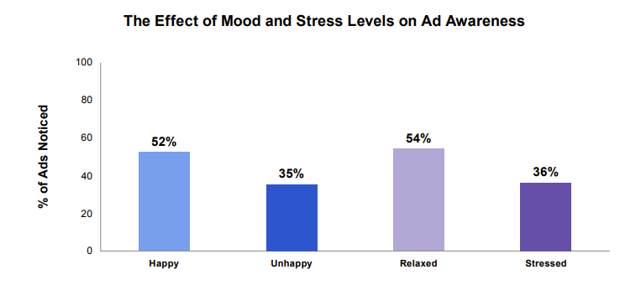
Ads are more noticed when people are relaxed and/or in a good mood
Source: Bronner (2007), reported by Richard Shotton (The Value of TV: A Behavioural Science Perspective, 2024)
Notes:
This month’s chart of the month features in Richard Shotton’s recent ‘The Value of TV: A Behavioural Science Perspective’. It shows how reaching people during positive moments increases the likelihood of an ad being noticed.
The chart is from a study by Fred Bronner, a professor of advertising at the University of Amsterdam. Bronner asked 1,287 participants to flick through a newspaper and then answer questions about the ads they remembered.
This data was then split by reader’s mood, with results showing that those who were happy recalled 52% of ads, whereas those who were unhappy noticed just 35%. Additionally, stress levels were also important as relaxed participants noticed 54% of ads whereas those who were stressed remembered just 36%.
This shows…well, it’s pretty obvious what it shows, but we’ll spell it out anyway: there’s huge potential in targeting consumers’ moods.
For more information on the behavioural science perspective of the value of TV, download the report here: https://www.thinkbox.tv/research/reports/the-value-of-tv-a-behavioural-science-perspective

Slide 6
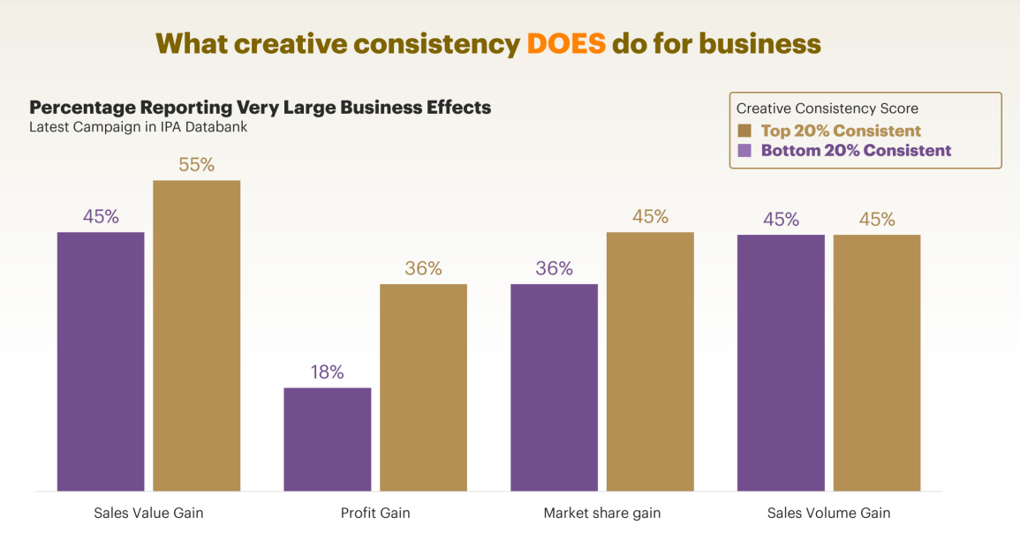
Creatively consistent brands report more very large business effects
Source: System 1 / IPA, The Magic of Compound Creativity, 56 brands across 44 categories analysed between 2018 and 2024 for 13 different Creative Consistency Features, split into thirds. comparing the most to the least consistent brands. 4,164 TV ads with £3.3bil media spend. Matched with IPA awards cases.
Notes:
Creatively consistent brands report more very large business effects
This month’s Chart of the Month show the impact of creative consistency on business effects.
Showcased at the IPA Effectiveness Conference, System 1, in partnership with the IPA, explored how consistency leads to higher creative quality, stronger brands and greater profits. The study analysed 56 brands across digital and TV for 13 different creative consistency features – e.g. Consistent Positioning, Agency Tenure, Consistent Tone of Voice, Soundtrack Commitment, Fluent Device Tenure.
When comparing the most to the least consistent brands, analysis found that a higher proportion of consistent brands reported large business effects. More specifically, 55% of the top consistent brands saw an effect on sales value gain, in comparison to 45% for the bottom 20%. This trend was also seen in market share gain, and profit gain where the difference is double.
This data shows how creative consistency is essential for business growth.
For more information on Compound Creativity and insights on creative consistency, download the research here: https://system1group.com/compound-creativity-system1-ipa

Slide 7
Optimal ad mix varies dramatically by product sector
Optimal media mix
Source: Media Mix Navigator, 2024. Based on a mass market brand, 11-20% online sales (finance 71-80%), high risk, further details for each category is included in the notes
Notes:
Optimal ad mix varies dramatically by product sector
This month’s Chart of the Month shows how there are big variances in the optimal media mix between different product sectors.
It is based on data from the ‘Media Mix Navigator’, which lets brands easily explore the impact on revenue and profit that different budget levels have on budget allocation across channels.
The Media Mix Navigator tool has been engineered by EssenceMediacom and is powered by the blockbuster Profit Ability 2 databank, which takes in £1.8 billion of media spend across 141 brands during 2021-23. The brands included were carefully chosen to represent as many business types as possible. Each brand commissioned and paid for their own econometric analysis; the databank aggregated this existing data.
Media Mix Navigator enables analysis bespoke to a brand’s specific situation and attitude to risk. For this analysis, we have used an ‘average’ brand position.
This chart shows how the optimal media mix differs by category, and there are some interesting variances. For example, looking specifically at Generic PPC, the investment allocation is particularly high for sectors such as Finance, Travel and Automotive. This is explained by the fact that these sectors often deal with higher priced items which are usually ‘considered purchases – ones where consumers are likely to conduct online research before making a purchase decision. Similarly, Print is an important channel for Automotive and Travel, both of which benefit from extensive specialist titles that provide the opportunity to reach key audiences.
The one consistent factor throughout all the scenarios is that Linear TV is the largest single channel, although the extent to which it is the largest channel can vary greatly – e.g. higher in Retail, FMCG and Automotive but lower in Finance.
For more information, visit: https://www.thinkbox.tv/training-and-tools/media-mix-navigator/media-mix-navigator
Category input details:
All – Brand size (£m): 10,000, Annual Media Spend (£m): 50
Automotive - Brand size (£m): 2,600, Annual Media Spend (£m): 17
Finance - Brand size (£m): 10,000, Annual Media Spend (£m): 20
FMCG - Brand size (£m): 60, Annual Media Spend (£m): 6
Retail - Brand size (£m): 9,000, Annual Media Spend (£m): 25
Travel - Brand size (£m): 5,200, Annual Media Spend (£m): 19
Telecoms - Brand size (£m): 7,000, Annual Media Spend (£m): 45
Output: Revenue
The brand size for each product category has been calculated by taking 20% of the maximum brand size whilst the annual media spend is an estimate of the average spend for that category.

Slide 8
Linear TV creates nearly half of all ad-generated profit
Source: Profit Ability 2, April 2024 – Short term benchmarks: Ebiquity, EssenceMediacom, Gain Theory, Mindshare, Wavemaker UK. Long Term Multipliers: EssenceMediacom, Gain Theory, Mindshare, Wavemaker UK. Immediate contribution = same week as advertising, Carryover = within 13 weeks, Sustained = within 2 years
Notes:
Linear TV creates nearly half of all ad-generated profit
This month’s Chart of the Month draws on findings from our most recent study, ‘Profit Ability 2: the new business case for advertising’, which shows that Linear TV is unmatched as the profit volume driver when considering all three speeds of payback.
Profit Ability 2 analysed the profit generated by advertising at different stages as its effects build over time. It examined four speeds of payback: immediate payback (within one week), short-term payback (up to 13 weeks), sustained payback (week 14 through to 24 months) and full payback (total payback over a 24-month period). The study brings together the vast econometric databases of client data from Ebiquity, EssenceMediacom, Gain Theory, Mindshare and Wavemaker UK, covering £1.8 billion of media investment in the UK across 10 media, 141 brands, and 14 product sectors. It is an update of Ebiquity and Gain Theory’s Profit Ability study from 2017 and offers the first post-Covid/Brexit view of advertising’s business performance.
When looking at the full advertising profit return by channel, it found that Linear TV emerges as the biggest driver of full profit volume (47%), outperforming all other channels. This is followed by Generic PPC, which performs favourably when accounting for immediate payback, however, cannot compete with the scale that Linear TV offers beyond the first week after the advertising.

