Slide 1
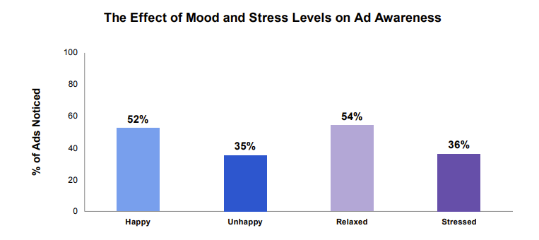
Ads are more noticed when people are relaxed and/or in a good mood
Source: Bronner (2007), reported by Richard Shotton (The Value of TV: A Behavioural Science Perspective, 2024)
Notes:
This month’s chart of the month features in Richard Shotton’s recent ‘The Value of TV: A Behavioural Science Perspective’. It shows how reaching people during positive moments increases the likelihood of an ad being noticed.
The chart is from a study by Fred Bronner, a professor of advertising at the University of Amsterdam. Bronner asked 1,287 participants to flick through a newspaper and then answer questions about the ads they remembered.
This data was then split by reader’s mood, with results showing that those who were happy recalled 52% of ads, whereas those who were unhappy noticed just 35%. Additionally, stress levels were also important as relaxed participants noticed 54% of ads whereas those who were stressed remembered just 36%.
This shows…well, it’s pretty obvious what it shows, but we’ll spell it out anyway: there’s huge potential in targeting consumers’ moods.
For more information on the behavioural science perspective of the value of TV, download the report here: https://www.thinkbox.tv/research/reports/the-value-of-tv-a-behavioural-science-perspective

Slide 2
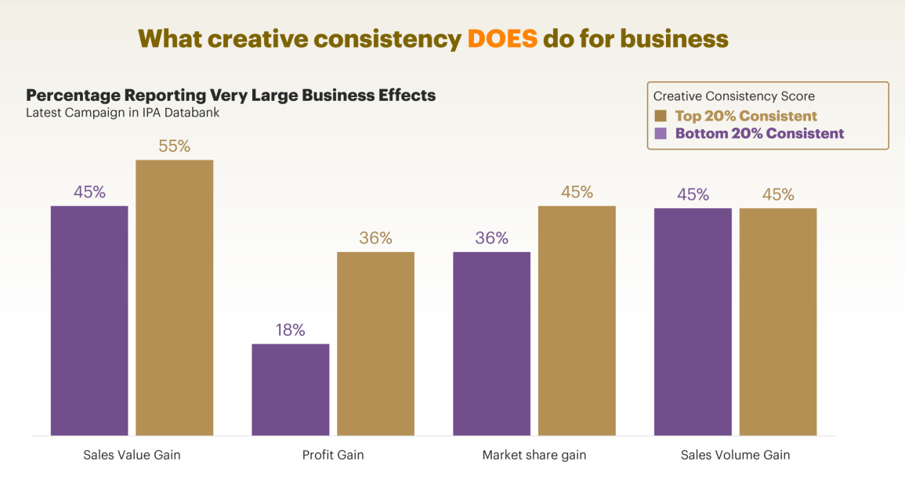
Creatively consistent brands report more very large business effects
Source: System 1 / IPA, The Magic of Compound Creativity, 56 brands across 44 categories analysed between 2018 and 2024 for 13 different Creative Consistency Features, split into thirds. comparing the most to the least consistent brands. 4,164 TV ads with £3.3bil media spend. Matched with IPA awards cases.
Notes:
Creatively consistent brands report more very large business effects
This month’s Chart of the Month show the impact of creative consistency on business effects.
Showcased at the IPA Effectiveness Conference, System 1, in partnership with the IPA, explored how consistency leads to higher creative quality, stronger brands and greater profits. The study analysed 56 brands across digital and TV for 13 different creative consistency features – e.g. Consistent Positioning, Agency Tenure, Consistent Tone of Voice, Soundtrack Commitment, Fluent Device Tenure.
When comparing the most to the least consistent brands, analysis found that a higher proportion of consistent brands reported large business effects. More specifically, 55% of the top consistent brands saw an effect on sales value gain, in comparison to 45% for the bottom 20%. This trend was also seen in market share gain, and profit gain where the difference is double.
This data shows how creative consistency is essential for business growth.
For more information on Compound Creativity and insights on creative consistency, download the research here: https://system1group.com/compound-creativity-system1-ipa

Slide 3
Optimal ad mix varies dramatically by product sector
Optimal media mix
Source: Media Mix Navigator, 2024. Based on a mass market brand, 11-20% online sales (finance 71-80%), high risk, further details for each category is included in the notes
Notes:
Optimal ad mix varies dramatically by product sector
This month’s Chart of the Month shows how there are big variances in the optimal media mix between different product sectors.
It is based on data from the ‘Media Mix Navigator’, which lets brands easily explore the impact on revenue and profit that different budget levels have on budget allocation across channels.
The Media Mix Navigator tool has been engineered by EssenceMediacom and is powered by the blockbuster Profit Ability 2 databank, which takes in £1.8 billion of media spend across 141 brands during 2021-23. The brands included were carefully chosen to represent as many business types as possible. Each brand commissioned and paid for their own econometric analysis; the databank aggregated this existing data.
Media Mix Navigator enables analysis bespoke to a brand’s specific situation and attitude to risk. For this analysis, we have used an ‘average’ brand position.
This chart shows how the optimal media mix differs by category, and there are some interesting variances. For example, looking specifically at Generic PPC, the investment allocation is particularly high for sectors such as Finance, Travel and Automotive. This is explained by the fact that these sectors often deal with higher priced items which are usually ‘considered purchases – ones where consumers are likely to conduct online research before making a purchase decision. Similarly, Print is an important channel for Automotive and Travel, both of which benefit from extensive specialist titles that provide the opportunity to reach key audiences.
The one consistent factor throughout all the scenarios is that Linear TV is the largest single channel, although the extent to which it is the largest channel can vary greatly – e.g. higher in Retail, FMCG and Automotive but lower in Finance.
For more information, visit: https://www.thinkbox.tv/training-and-tools/media-mix-navigator/media-mix-navigator
Category input details:
All – Brand size (£m): 10,000, Annual Media Spend (£m): 50
Automotive - Brand size (£m): 2,600, Annual Media Spend (£m): 17
Finance - Brand size (£m): 10,000, Annual Media Spend (£m): 20
FMCG - Brand size (£m): 60, Annual Media Spend (£m): 6
Retail - Brand size (£m): 9,000, Annual Media Spend (£m): 25
Travel - Brand size (£m): 5,200, Annual Media Spend (£m): 19
Telecoms - Brand size (£m): 7,000, Annual Media Spend (£m): 45
Output: Revenue
The brand size for each product category has been calculated by taking 20% of the maximum brand size whilst the annual media spend is an estimate of the average spend for that category.

Slide 4
Linear TV creates nearly half of all ad-generated profit
Source: Profit Ability 2, April 2024 – Short term benchmarks: Ebiquity, EssenceMediacom, Gain Theory, Mindshare, Wavemaker UK. Long Term Multipliers: EssenceMediacom, Gain Theory, Mindshare, Wavemaker UK. Immediate contribution = same week as advertising, Carryover = within 13 weeks, Sustained = within 2 years
Notes:
Linear TV creates nearly half of all ad-generated profit
This month’s Chart of the Month draws on findings from our most recent study, ‘Profit Ability 2: the new business case for advertising’, which shows that Linear TV is unmatched as the profit volume driver when considering all three speeds of payback.
Profit Ability 2 analysed the profit generated by advertising at different stages as its effects build over time. It examined four speeds of payback: immediate payback (within one week), short-term payback (up to 13 weeks), sustained payback (week 14 through to 24 months) and full payback (total payback over a 24-month period). The study brings together the vast econometric databases of client data from Ebiquity, EssenceMediacom, Gain Theory, Mindshare and Wavemaker UK, covering £1.8 billion of media investment in the UK across 10 media, 141 brands, and 14 product sectors. It is an update of Ebiquity and Gain Theory’s Profit Ability study from 2017 and offers the first post-Covid/Brexit view of advertising’s business performance.
When looking at the full advertising profit return by channel, it found that Linear TV emerges as the biggest driver of full profit volume (47%), outperforming all other channels. This is followed by Generic PPC, which performs favourably when accounting for immediate payback, however, cannot compete with the scale that Linear TV offers beyond the first week after the advertising.

Slide 5
TV has the highest weekly saturation point
Saturation point based on all category average. Saturation ranking & values will vary sector to sector
Source: Profit Ability 2, April 2024 – Short term benchmarks: Ebiquity, EssenceMediacom, Gain Theory, Mindshare, Wavemaker UK. Immediate effect = profit volume in week of advertising spend
Notes:
This month’s Chart of the Month draws on findings from our most recent study, ‘Profit Ability 2: the new business case for advertising’, which shows that Linear TV has the highest weekly ‘saturation point’ – the last point where every pound invested in a channel generates at least £1 profit.
Profit Ability 2 brings together the vast econometric databases of client data from Ebiquity, EssenceMediacom, Gain Theory, Mindshare and Wavemaker UK, covering £1.8 billion of media investment in the UK across 10 media, 141 brands, and 14 product sectors. It is an update of Ebiquity and Gain Theory’s Profit Ability study from 2017 and offers the first post-Covid/Brexit view of advertising’s business performance.
It found that Linear TV has the highest saturation point, meaning that advertisers can increase their investment in Linear TV to a higher level than other media and it will continue to generate a profitable return.
Based on immediate payback (payback within one week of investment), Linear TV advertising on average hits saturation at an investment of £330,000 – nearly triple the equivalent scale of the next largest channel (Print) and over 8-times the scale of Online Video. This shouldn’t be a surprise as TV’s broad reach and its ability to drive scale helps deliver this result in contrast to digital channels like Paid Social and Online Display.
For more advertising effectiveness insight, read ‘Profit Ability 2: The new business case for advertising’.

Slide 6
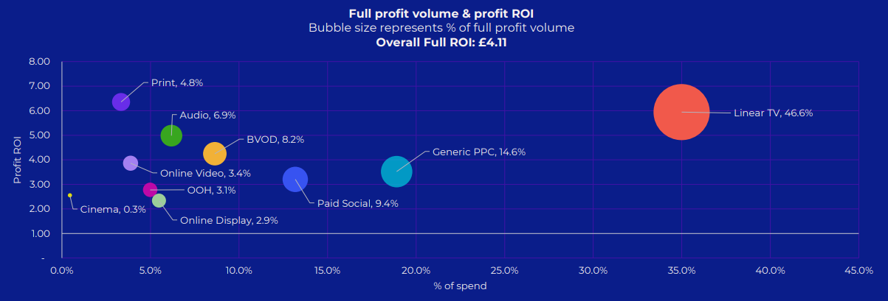
TV (Linear and BVOD) accounts for over half of all ad-driven profit
Source: Profit Ability 2, April 2024 – Short term benchmarks: Ebiquity, EssenceMediacom, Gain Theory, Mindshare, Wavemaker UK.
Long Term Multipliers: EssenceMediacom, Gain Theory, Mindshare, Wavemaker UK
Notes:
This month’s Chart of the Month draws on findings from our most recent study, ‘Profit Ability 2: the new business case for advertising’, which shows that TV (Linear and BVOD) accounts for 54.7% of advertising-driven profit (within 0-24 months) but only accounts for 43.6% of total advertising investment.
The study brings together the vast econometric databases of client data from Ebiquity, EssenceMediacom, Gain Theory, Mindshare and Wavemaker UK, covering £1.8 billion of media investment in the UK across 10 media, 141 brands, and 14 product sectors. It is an update of Ebiquity and Gain Theory’s Profit Ability study from 2017 and offers the first post-Covid/Brexit view of advertising’s business performance.
Profit Ability 2 analysed the profit generated by advertising at different stages as its effects build over time. It examined four speeds of payback: immediate payback (within one week), short-term payback (up to 13 weeks), sustained payback (week 14 through to 24 months) and full payback (total payback over a 24-month period).
It found that, on average, a pound invested in advertising returns £4.11 in profit (when sustained effects are included). Crucially, all the sectors analysed in the study generated a positive payback from advertising when sustained effects are accounted for.
This chart shows how TV accounts for 54.7% of advertising’s full payback but only accounts for 43.6% of total advertising investment. Within this, Linear TV accounts for 46.6% of full payback and BVOD accounts for 8.2%.
For more advertising effectiveness insight, watch ‘The new business case for advertising’ on demand.

Slide 7
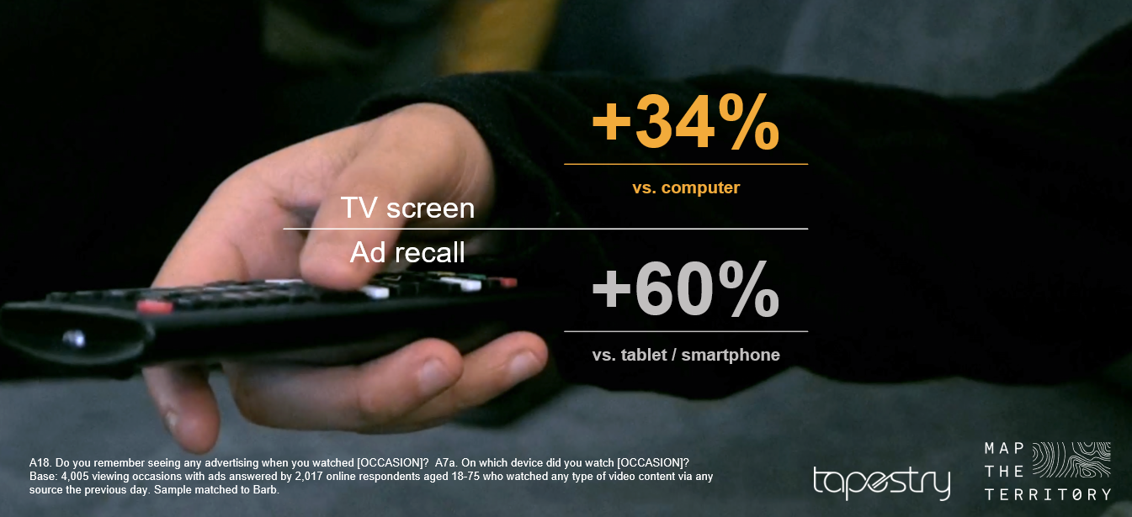
The TV screen drives the highest ad recall of all devices
Source: Context Effects, Map the Territory & Tapestry Research, 2024
Notes:
This month’s Chart of the Month draws on findings from ‘Context Effects’ showcased at Thinkbox’s recent ‘In Sight: new trends in TV’ event.
The ‘Context Effects’ study, conducted by Map The Territory and Tapestry Research, is based on qualitative and videographic methodology to observe viewing habits, combined with quantitative research and statistical analysis. The study identified the key factors that drive ad recall at home such as professional video content, a big screen, being with company and the mood of those watching. The study also found that being in the living room facilitated these factors most effectively making it the perfect place for advertising.
Looking specifically at the impact of the size of the screen, analysis found that TV screens drove 60% higher ad recall than tablets or smartphones and 34% higher than computers.

Slide 8
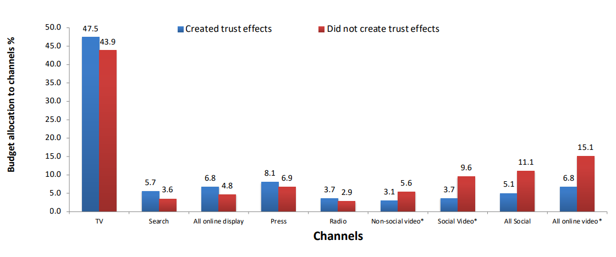


TV is a trusted medium
Source: IPA Databank 2014-2022 for profit cases *data available from 2016
Notes:
Recent years have seen a strengthening relationship between advertising trust and advertising driven profit. Comparing IPA survey data from 2014-2022 with data from 2000-2012, trust jumped from the seventh-highest brand metric linked to profit to the second-highest, just below quality.
Trust is often correlated with quality and has become increasingly important. Consumers are continuously forming assessments of the quality of the brands they may buy, based on whether they trust the brand (and its advertising).
Data showcased by effectiveness expert Peter Field at The Future of TV Advertising Global 2023 suggests that there seems to be a relationship between campaigns that created trust effects and their budget allocation to different media. Field’s work shows that campaigns using TV, search, online display, press, and radio achieved enhanced trust effects; whilst social media, social video, and online video were much less likely to deliver positive trust effects.
Additionally, many previous research studies have emphasised the importance of trust – not least Thinkbox’s ‘Adnormal Behaviour’ (conducted by Ipsos), which revealed how TV outperformed all other media as the leading source of advertising that people trust.

Slide 9

Ads that conveyed information in both a visual and auditory way performed better
% responses at high attention but low confidence
JD Sports, The Bag For Life
Source: Competing for Attention, GITR / Thinkbox 2023, n=305. Full attention state only
Notes:
This month’s Chart of the Month draws on findings from our most recent study, ‘Earning Attention’ – a large-scale academic study exploring how advertising competes for our attention.
The study explored the role of auditory and visual attention in driving memories and whether a multisensory experience had an impact on attention. In order to test both visual and auditory performance:
Respondents were shown one of the ads at high attention (i.e. no distractions) and were asked whether they had seen a particular image from that ad. If they had low confidence about what they had seen, they were further prompted about whether they had heard something that would have looked like that image.
Conversely, if respondents had low confidence about what they had heard, they were prompted about whether they had seen something that looked like the sound that was played.
This recognition technique was used in order to gain a better understanding of whether people use both senses to understand advertising.
We found that ads conveying information in both a visual and auditory way performed better than ads that were visually dominant as it produced more of these responses. This suggests that when the respondents were not sure if they had seen or heard an ad, they used another sense to assist in establishing whether it had been experienced.
In a nutshell, there’s an advantage when ads communicate in a multisensory way. We combine what we see and hear to process an ad and use sound and vision to fill in for each other to subsequently form a narrative.

Slide 10
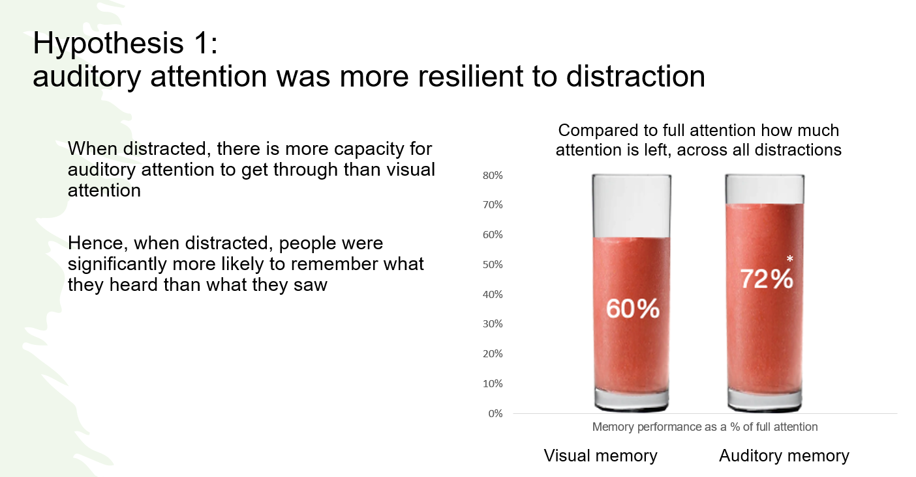
Auditory attention more resilient to distraction than visual attention
Source: Competing for Attention, GITR / Thinkbox, 2023, n=305
Notes:
This month’s Chart of the Month draws on findings by Dr Ali Goode (Gorilla in the room) showcased at Thinkbox’s recent ‘Earning Attention’ event. The study (Competing for attention) explored the role of auditory and visual attention in driving memories and showcased the importance of audio.
The research suggests that when people had been distracted, they were more likely to recall things they heard rather than what they had seen. Sound plays an important part in the TV ad experience with its ability to communicate in its own right, mediate attention, draw eyes to the screen, and fill in the gaps when there is no visual attention.
Audio stimuli are important in human behaviour as ears are ‘open’ permanently - we don’t look around for things to listen to, instead our ears tell us where to look.

