Slide 1
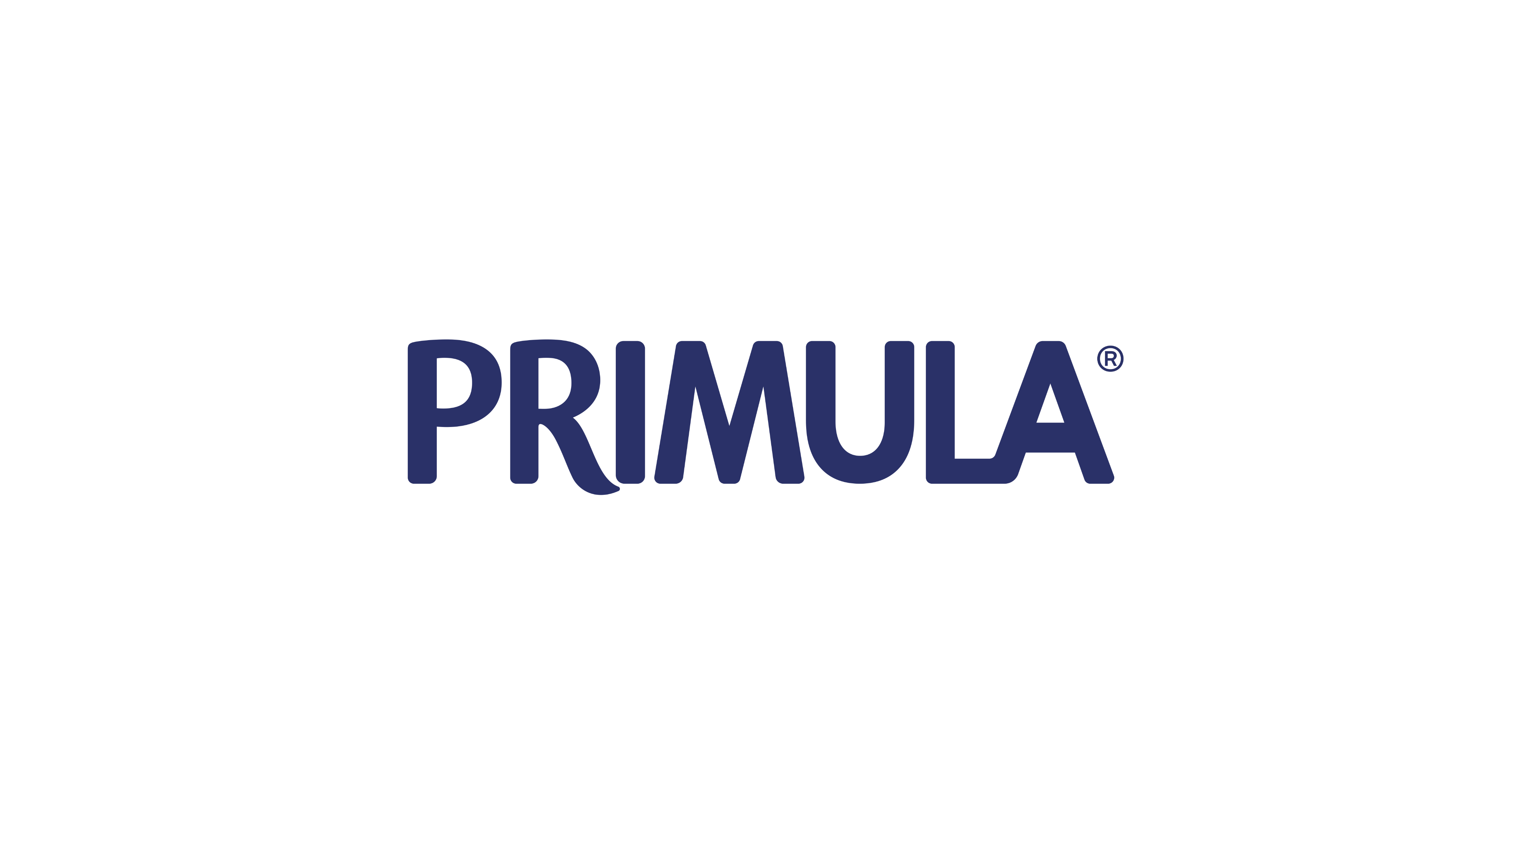

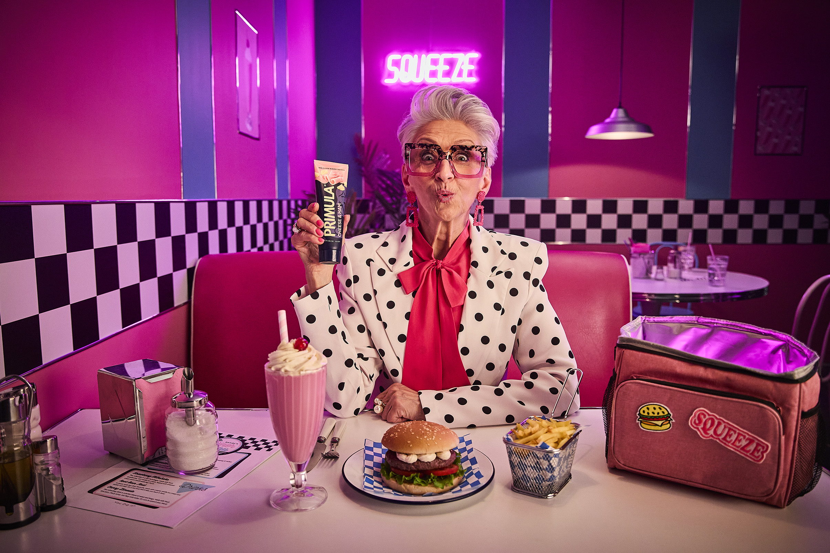
Primula Cheese - Squeezing the most out of TV
The Challenge:
Celebrating their 100th anniversary, Primula wanted to refresh the brand, address misconceptions and firmly position themselves as a compelling challenger in a crowded marketplace. They needed their marketing activity to drive consideration, increase share, grow unprompted awareness and ultimately increase year on year sales.
The Solution:
By partnering with ITVs ‘Business for All’ initiative, Primula used TV to increase brand fame, placing the brand in channels and programmes which their audience love the most.
The Results:
Post-campaign sales data showed a double-digit uplift for Primula, whilst the rest of the category remained flat. Brand tracking highlighted strong uplifts across unprompted brand awareness, ad recall and purchase consideration.
Notes:
The Challenge
To celebrate their 100th anniversary, Primula wanted an ambitious campaign to refresh the brand, and drive growth against stiff competition from the likes of Seriously Spreadable, Dairylea and The Laughing Cow. However, Primula were facing a problem. There was a lingering misconception from customers about the real cheese levels in the product. The brand had become reliant on functional messaging which was failing to create an emotional connection with consumers, leading to a plateau in share in a highly competitive marketplace.
Primula handed media agency Alchemy Media a clear set of objectives for their 2024 campaign. They would need to drive consideration, increase brand share, grow unprompted brand awareness and increase sales year on year.
The TV Solution
With an overarching goal of making Primula famous again, Alchemy got to work in crafting an approach that would deliver against the objectives. The solution needed to deliver high impact and scale to get the brand into more shopping baskets. This started with defining the audiences for the campaign. Primula shoppers embrace the joy in life and in food, using quick and fun solutions to create meals they love, effortlessly. Alchemy defined the primary audience as women 35+ who juggle family and personal time, highlighting their interest in seeking out quick, versatile and tasty meal solutions. A secondary audience of older loyalists 55+ were already aware of Primula and some usage occasions, so reminding this group of the brand and reasons to buy would encourage repeat purchase. Analysis of their media habits highlighted heavy consumption of all media, and a variety of ways to reach them each day through multiple touchpoints. However, there was only one channel able to deliver the scale and impact needed to drive brand fame for this campaign: TV. So Alchemy championed a return to TV for Primula as the lead medium, developing a campaign which would harness and drive the emotional connection needed to shift perceptions.
A national solution was cost-prohibitive, so TGI data was used to identify areas with the highest propensity of Primula users. Overlaying this insight with distribution data highlighted the North, Central and Scotland as key regions for the campaign. Analysis of TV consumption showed a clear favourite channel. ITV offered the best audience alignment, regional targeting capabilities and the ability to build effective 1+ reach to deliver results for the squeezy cheese brand.
The Plan
Primula and Alchemy knew that killer creative was crucial in delivering the results needed for this campaign. Powerhouse were briefed to give the creative a makeover to ensure that the brand became relevant, exciting and modern, appealing to a younger audience. The result was a TV ad which scored ‘exceptional’ on System 1 ‘spike’ ratings, within the upper quartile of all TV ads.
The media plan leaned into the creative for the campaign, highlighting the versatility of Primula and its usage potential across different mealtimes. Deploying airtime in ITV Breakfast, a daypart closely aligned to mealtime planning and grocery shopping list creation, together with ITV1 to build consistent presence throughout the day, including both lunch and evening mealtime occasions.
ITVX was added to the mix to offer flexibility to reach audiences curating their own schedules through BVOD.
The relaunch of Primula was planned to take place across the summer, lining up with Euro 2024, so the campaign needed to tactical in its deployment. With June showing pricing hikes and major schedule disruption because of the live football coverage, the campaign kicked off with a 30” on ITV Breakfast at the end of June, minimising peak activity and avoiding the impact of price inflation in the market. ITV 1 kicked off in July, starting with the longer form 30” creative to help embed the messaging. A 10” creative execution was then brought in to reinforce brand awareness and benefit the campaign reach through using a more cost-effective time length.
The campaign was planned carefully to allow Primula to maximise impact and 1+ reach from the budget, placing the brand in the right places at the right time whilst avoiding costly football content. Curated programming formed a key pillar of the campaign with Alchemy selecting high rating flagship shows and new content like Tom Kerridge Cooks Britain, Douglas is Cancelled and Changing Ends. Outside of linear environments, Alchemy deployed ITVX as a reach extender, targeting women 35+, lighter TV viewers and non-Euro 2024 watchers, reaching them in the highest quality programming across the platform.
TV formed the backbone of the campaign to drive brand awareness and build trust, with the knowledge that TV delivers the strongest multiplier effect to other channels. Print activity included display ads in lifestyle and food titles, aligning Primula with high quality long-form content. Organic social was used with bite size video and recipe inspiration. A wider digital display campaign using a combination of static and interactive formats encouraged users to engage and share the content. And as a final conversion point, in-store presence and activation encouraged shoppers to pick up a tube of Primula.
Results
The campaign was a massive success for Primula. Sales data showed a double-digit uplift during the 5 weeks of the campaign, whilst the category showed no sales uplift in the same period. Nielsen IQ data showed that the brand had seen its share of sales increase by 2% vs their core competitors. The entire Primula range showed a sales uplift during the campaign, not just the products in the ad, demonstrating a clear brand halo effect from the campaign.
As part of the deal with ITV, Primula also benefited from a brand study to understand the impact on key brand metrics. Unprompted brand awareness, ad recall and purchase consideration all saw strong uplifts, exceeding the objectives laid down for Alchemy Media in the brief.
Client quote
‘Our aim for 2024 was to make Primula famous again with a marketing and creative strategy focused on driving brand awareness and increasing sales to new and lapsed customers. Alchemy Media championed TV as a great medium to achieve this ambition and the ITV Business for All initiative allowed us to super-charge our own investment. Powerhouse created the “Squeeze” campaign, bringing a modern look, humour, and a focus on taste, convenience, and the squeeze.
To see an uplift in sales and brand metrics across the campaign period was a fantastic achievement, especially amongst the backdrop of a declining market. We’re really proud of the brand growth we saw from the media campaign and look forward to another exciting campaign in 2025.’- Lisa Thornton- Head of Marketing, Kavli UK

