Slide 1


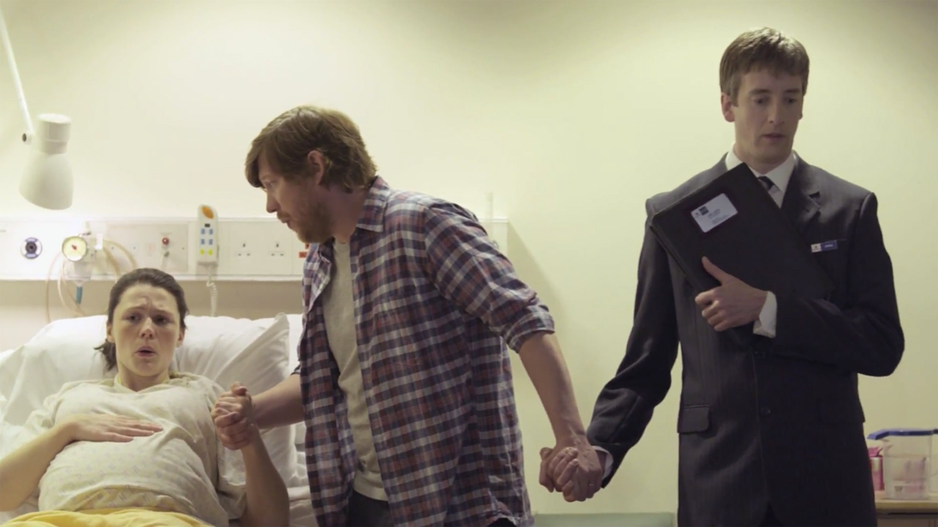
Suzuki Cars UK demonstrated quite how irresistible their cars really are
Challenge
Suzuki aimed to increase their share of the car market to 2% whilst driving footfall to dealerships and changing misperceptions amongst non-owners
Solution
The TV advert showcased the fun personality of the Suzuki Swift and that they are irresistible once driven, with the creative idea and line ‘Have To Have It’
They selected programmes that offered shared viewing and supported the campaign with sponsorship of movies on ITV to convey an ‘always on’ presence
Results
Sales increased by 23%
Market share grew by 0.16% to 1.22%
Internet traffic up by 50% year on year
Notes:
Challenge
Suzuki have been around for a long time but, as a brand, are more famous for their motorcycles than their cars.
But Suzuki Cars UK had strong ambitions to grow their brand and to increase their share of the car market to 2% by 2015. In order to do this, they needed people who had previously never considered a Suzuki to put one onto their purchasing shortlist, something very few new car buyers did.
Several factors made the task more challenging. Firstly the car market was in decline – 4.4% year on year. Secondly, Suzuki had not launched a new model – a traditional driver not just of sales but of consideration too – for three years. The final challenge was that Suzuki hadn’t been on TV since 2010 and their brand metrics were suffering in line with their sales.
During their absence on TV, Suzuki had relied on direct and dealer communications. They needed a big idea that not only got people to consider the brand as one of their Top 3 potential new cars, but also one that drove footfall in dealerships and positioned Suzuki as a brand with an emotional pull.
The insight for the campaign came from current owners. People who actually owned a Suzuki Swift thought they were great fun to drive. Contrastingly, non-owners felt the complete opposite. If they could counter this misperception from non-owners, they would start to build consideration of the Swift and of Suzuki.
The Solution
Swift owners’ passion for their car was again demonstrated through further research. 56% of people who test drive a Suzuki go on to buy one. This startling fact – that every other test driver ends up buying a Suzuki – led to their strategic idea “To drive a Suzuki is to want a Suzuki”.
This idea was what was needed to pique prospects’ interest enough to want to visit a dealership and test drive a Suzuki.
In the case of the Swift, fun was the motivating factor: something they would latch onto for the campaign. This emotional motivation for buying a Suzuki lent itself best to TV as the lead medium. TV could achieve many of the aims for the campaign.
Not only is TV the most emotionally stimulating medium, but it is also a key driver of awareness and has the power to change perceptions.
The strategic insight was expressed with the creative idea and line ‘Have To Have It’ and this core idea was used for the TV advert.
The television ad showed a man test-driving a Suzuki who then didn't want to give the car back. The sponsorship idents played out a number of scenes set in a dealership where customers, smitten with Suzukis, didn’t want to give them up. The style of the ads was fresh and exciting and most importantly it stood out from Suzuki’s competitors with a line that urged people to try a Suzuki out for themselves.
When planning the TV campaign, the aim was to select programmes that offered shared viewing moments, where the excitement and fun sensory receptors were at their highest levels. This led to high profile 60’’ ads in Euro 2012, building excitement and intrigue, followed by idents that ran as sponsorship of ITV movies.
The campaign kicked off with 60” spots in week one, 40” spots in week two and 30”s in weeks three and four. Over 400 ABC1 Adult TVRs were bought in high excitement programmes including Superstar, The Big Bang theory and Thelma’s Gypsy girls. The approach built around shared viewing enabled them to reach over 70% of their target audience.
The ad campaign was supported with sponsorship idents which helped to give the campaign longevity and convey an ‘always on’ presence for Suzuki. The sponsorship of over 250 movies on ITV1 reached 86% of 25-54 ABC1s.
The TV campaign was supported by press and online advertising.
Results
In 2012, Suzuki was the 2nd fastest growing car brand in the UK – sales increased by 23% versus a market average of 5%.
Suzuki’s market share increased by 0.16% from 1.06% to 1.22%
2012 saw around a 50% YOY improvement in traffic to the website the highest volume of unique visitors the site has ever seen.
Brand metrics improved too, paving the way for long term consideration:
Affinity towards Suzuki increased by 8%
Positive opinion of Suzuki improved by 6% year on year
Advocacy towards Suzuki increased by 7%
Crucially, there was a further increase in Top 3 consideration of Suzuki. This increased from 7% to 9% after only a month of the campaign airing. This equates to 22,000 more potential car buyers who are now considering Suzuki on their shortlist.
To read the full case study and access the creative visit: https://www.thinkbox.tv/Case-studies/Suzuki

