Slide 1


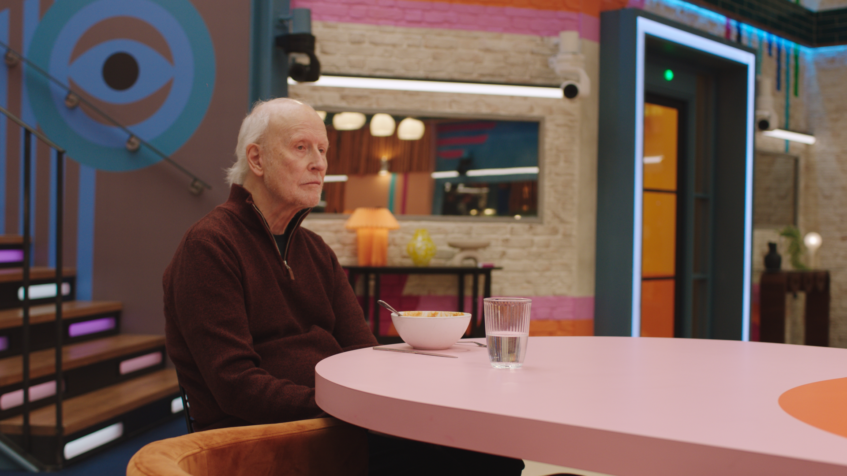
Age UK: The house is an isolating place when everyone has gone
The Challenge:
For millions of older people, the festive period can magnify feelings of loneliness and isolation, as routine services wind down, shops close, and images of families and friends coming together fill our screens. Age UK needed to show the scale of isolation among older people at Christmas.
The Solution:
Collectively Age UK, MG OMD and ITV produced 1 x 20” and 3 x 30” films that would place a single older person in the most iconic house on TV, The Big Brother House, and have viewers confront the loneliness affecting 1.6 million older people.
The Results:
The campaign reached 2.5 million in one evening, and became Age UK’s most viewed video on their TikTok channel. The campaign increased metrics throughout the funnel and importantly helped increase understanding of Age UK and the work they do.
Notes:
The Challenge
For the last 8 years, Age UK have run a brand campaign over the Christmas period to support their fundraising message and highlight the issue of loneliness at this poignant time. However, given the vast budgets of Christmas advertisers, the need for so many brands to now go beyond a standard approach to get noticed, and the demand on people’s attention, the challenge to be seen gets harder every year. Furthermore, not only did Age UK have the challenge of competing with the entire market to get their audience’s attention, but this year Age UK needed an idea with 70% less budget than the year before, reducing their SOV to 6% in the charity sector alone. If Age UK were going to cut-through this year, MG OMD had to come up with an idea that would drive disproportionate impact, fame and talkability.
The TV Solution
TV has by far been the biggest driver of success for Age UK at Christmas, partly because it could run alongside the fundraising campaign; but also because of the platform’s ability to drive talkability and fame. Age UK have witnessed firsthand the amazing power TV can have, with campaigns such as Old People’s Home for Four Year Olds At Christmas which drove an amazing amount of conversation. As a result, when it came to answering the brief in 2023, TV was the first channel MG OMD looked at due to the performance of past campaigns and the reach it had with the target audience.
The Plan
The idea was to produce four short films that showed a lonely older person in the empty expanse of the Big Brother house, bringing the uncomfortable reality to life that ‘The house is an isolating place when everyone has gone’. But with the series still live, the house full of housemates who couldn’t leave, and multiple cameras catching every movement, accessing the house, let alone depicting isolation, was going to be a challenge.
With seven days to go before the Big Brother final, MG OMD were naïve in thinking they could capture the content in the days after the housemates left. However, with five days to go, Banajay confirmed that the house would be disassembled within an hour of the final finishing. To get the content needed, the team had to shoot whilst the housemates were in the house, asleep and on a closed set, with only the actor on set. There was just 75 minutes to capture it all before the housemates woke up and the filming of the Big Brother final commenced.
In possibly the fastest advertising shoot ever, the team managed to capture multiple takes in multiple iconic locations around the house, with ITV Creative editing the content down into four 30 second silent spots. However, MG OMD and ITV didn’t stop there, they wanted to ensure the campaign films were not just contextually linked through the visuals, but through sound too. In the final days of editing, the team were not only able to secure Marcus Bentley, the voice of Big Brother (who gifted his recognisable voice to introduce the ads), but were also able to secure the iconic Paul Oakenfold theme tune. All these elements were critical to ensure that within the opening seconds of the campaign, the audience presumed it was another regular advertisement for Big Brother in the format they were so used to seeing.
On December 23rd, as most families were settling into the start of their Christmas festivities, the ads were placed in the biggest shared viewing family show of the weekend, The Voice, to juxtapose the togetherness of viewers at home with the silence of an older person, alone in an empty Big Brother House. Each ad was timestamped with the actual time it played out to echo the live aspect of Big Brother. Owned and earned social delivered additional reach and premium digital OOH from Ocean maintained the campaign across the remaining Christmas period.
Results
The spots shown in The Voice reached 2.5 million viewers. This reach was increased with supporting media, including out of home. Over half a million people shared the creative on social media, driving huge conversation and delivering Age UK’s most watched TikTok of all time.
Despite this being a brand campaign with no overt fundraising call to action, it led to a direct uplift in donations, with TV being the main driver of this increase.
There were significant uplifts in positivity toward Age UK as well as uplifts in willingness to donate in the next 6 months. And finally, the campaign also directly led to increases in conversations about loneliness in older people and understanding of the work that the charity does to combat the issue.

