Slide 1


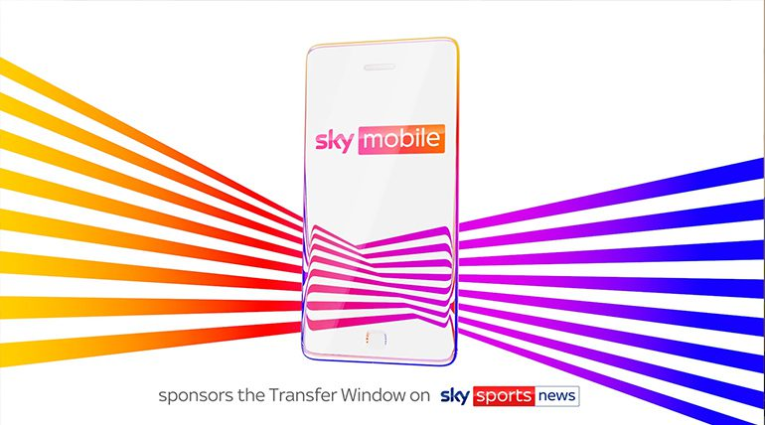
Sky Mobile partners with Transfer Deadline Day
Challenge
Sky Mobile needed to create standout in a highly competitive market and encourage people to switch from their current provider to Sky Mobile
Solution
They sponsored Sky Sports News’ Summer Transfer Window as part of a strategic partnership
This involved sponsoring a package of transfer programming, a contextual spot, a licensing deal, social media and PR
Results
Advocacy +48%, talkability +86%, Purchase Intent + 49% and Consideration +70%
Notes:
The Challenge
The lead-up to the highly anticipated iPhone 15 launch in September 2023 marked the busiest period of the year for mobile networks. As a relatively new player, Sky Mobile needed to cut through the noise in a market that is highly contested through contract pricing, network coverage and access to the latest handsets.
Developing a platform that created a point of difference for Sky Mobile vs. their competitive set, by promoting properties that are unique to the brand, would be key to driving strong front of mind awareness, increasing consideration, purchase intent and most importantly driving incremental sales.
The TV Solution
Sky Mobile had previously Sponsored This Morning (ITV), Sky Max and more recently, A League of Their Own, so they were well aware of the benefits a well-executed sponsorship delivers, particularly when it comes to increasing key consumer behaviour metrics. They also understood the value of sponsorship as a primer, making sales-focussed advertising work harder as a result, and so they looked for a potential sponsorship property in 2023.
The perfect vehicle was secured. Sky Mobile signed up to sponsor Sky Sports News' Summer Transfer Window - a strategic partnership that enabled the brand to align with unmissable content, promote “Watch” and build credibility for their “Switch” messaging.
To create a point of difference, the brand’s comms would focus on:
Promotion of “Watch”: The ability to stream Sky apps like Sky News, Sky Sports and Sky Go without using data allowance.
Encouraging prospects to “switch”: Surfacing unique Sky Mobile offers and promoting the “text-to-switch” mechanic that made it easier than ever for UK mobile customers to transfer to a new network.
The Plan
The sponsorship package consisted of:
All Sky Sports News transfer programming from June to September 2023 including:
Good Morning Transfers
Transfer Talk
The Transfer Show
The Transfer Centre
Sky Sports News 5 to 7 (this is where the biggest transfer stories would be covered)
Alongside this, Sky Mobile ran an in-programming graphic sponsorship of the Transfer Window Countdown Clock that ran throughout the Transfer Window.
They also negotiated a licensing deal which enabled them to create a bespoke Transfer Window spot using Sky Sports News branding that announced Sky Mobile’s bespoke Transfer Offer for new customers. This contextual spot was highly targeted to ensure it played out in content that would appeal to football fans in the build up to Transfer Deadline Day. This included spots in Sky Sports News, Gillette Soccer Saturday, Saturday Social and also key Premier League games such as Sheffield Utd v Man City and Newcastle v Liverpool. The TV ad also included a QR code that drove users to a landing page that promoted Sky Mobile’s ‘Transfer Offer’.
The partnership provided an excellent opportunity to get a high frequency of message across at a critical time. It also meant that Sky Mobile could ‘own’ the 2023 summer transfer window and that they would be part of the ‘switch’ conversation wherever and however the UK’s football fans got their transfer fix.
To support the TV activity, Sky Mobile ran activity online which included a 5 second sponsor pre-roll on all Transfer content on SkySports.com and the Sky Sports app as well as a contextual display ad around Transfer editorial. There was also a homepage takeover that ran on SkySports.com on Transfer Deadline Day with the special offer for new customers.
On social media, there was branded content featuring Dharmesh Sheth from Sky Sports News and other Sky Sports talent. This content was called ‘Switch List’ and covered the biggest transfer stories of the day.
For PR, they recruited Harry Redknapp who delivered a ‘Talk to ‘Arry’ stunt where he visited iconic locations in London to talk to the public, discussing the Transfer Deadline stories and promoting Sky Mobile’s ‘Transfer Offer’.
Results
In total, there were 187 sponsored shows on TV with 12,495 seconds of sponsor branding
Approx. 5m individuals were reached by the TV partnership
Sponsorship effectiveness research, conducted independently by Savanta, showed substantial increases in key consumer behaviour metrics across the board (comparing viewers vs. non-viewers):
Advocacy +48%
Talkability +86%
Purchase intent +49%
Consideration +70%

