Slide 1


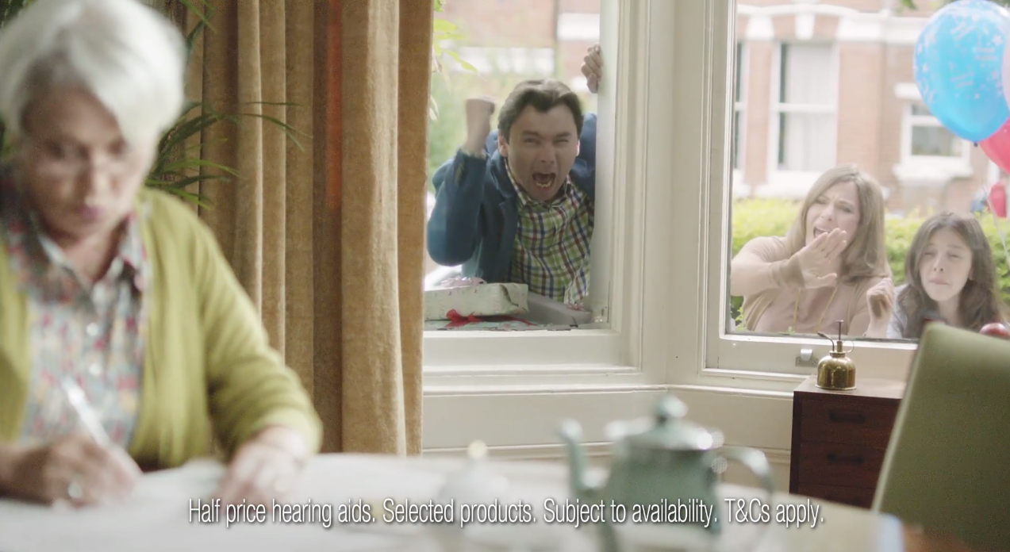
Boots Hearingcare uses TV to inject new life into the brand
Challenge
Boots Hearingcare needed to increase the number of hearing test appointments via both the website and the call centre
Solution
Creative agency Mother produced a spot that promoted the Hearingcare offering but was also aligned to Boots overall campaign
By using only daytime segments on ITV1 and Channel 4, they were able to drive cost efficiency
Results
Bookings over the phone increased by 85% for hearing care checks and 52% for a full hearing assessment
There was an increase of 315% in web traffic
Sales revenue for the month was up by almost 20% year on year
Notes:
Challenge
Denial, inactivity and fear of high expense rule in this market, and for Boots Hearingcare, the ongoing, tough business challenge is to break through this strong sense of disinterest and apathy. Boots Hearingcare understand the purchase cycle for hearing aids is lengthy, emotional and complicated, but the first step for consumers is a relatively simple one and that is to make an appointment to have a hearing test. The key communications objective for this campaign was to call consumers to action to make an appointment either online or through the customer call centre and book a free hearing test.
The longer-term business ambition for Boots Hearingcare services is to grow market share significantly within the next three years. The annual marketing objective at the outset of this activity was to grow the volume of hearing tests from 50k to 120k per annum and in order to achieve this, the role for communications was to increase awareness of Boots Hearingcare as a provider of all things related to hearing loss; the longer-term aim, to match the market share ambition, is to increase awareness by 40%. So the first TV campaign for Boots Hearingcare was going to have to produce a step change.
The Solution
It was clear TV would be the best solution for the Boots Hearingcare campaign as the analysis of the ‘suffering’ target audience, Adults aged 55+, clearly showed a strong affinity and love of television; around one third of them agree watching TV is a favourite pastime. Mother came up with a 10” spot which both served the Hearingcare brand in its own right, but at the same time, was also a part of the overall Boots offering. With the ‘Here Come The Girls’ advertising vehicle truly established, the creative approach was to dial up key elements from the overall campaign, notably the humour and the famous music, and develop a new, bespoke communications treatment for Boots Hearingcare.
The power of the Boots brand meant that Boots Hearingcare could be uniquely positioned as the perfect partner to guide people through the difficult process of helping people to re-gain their hearing. There are no marked seasonal peaks with Hearingcare, so taking full advantage of the timing flexibility the campaign ran in mid-August for three weeks. The activity of the spots took place across Monday to Wednesday as appointment bookings for Hearingcare show that the beginning of the week is busiest, mirroring the viewing habits of the target audience which also skewed towards the beginning of the week.
The primary target audience’s viewing habits revealed that both ITV1 and Channel 4 are strong media favourites; however, by using daytime segments only on these two channels, they were able to drive cost efficiency.
Results
On a pure web traffic basis, there was an increase of 315% across the month of August compared to August 2010.
There was a 35% average weekly increase in web visits in comparison to the pre-TV week for the campaign and a 127% increase for people booking appointments.
Bookings over the phone increased by 85% for hearing care checks and 52% for a full hearing assessment.
Sales revenue for the month of August was up by almost 20% YOY and performance figures (appointments and sales) for the following month also continued to be strong.
To read the full case study and access the creative visit: https://www.thinkbox.tv/Case-studies/Boots-Hearingcare

