Slide 1

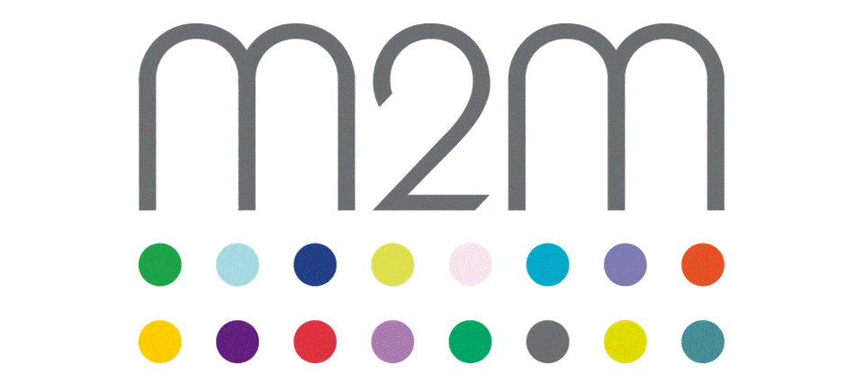

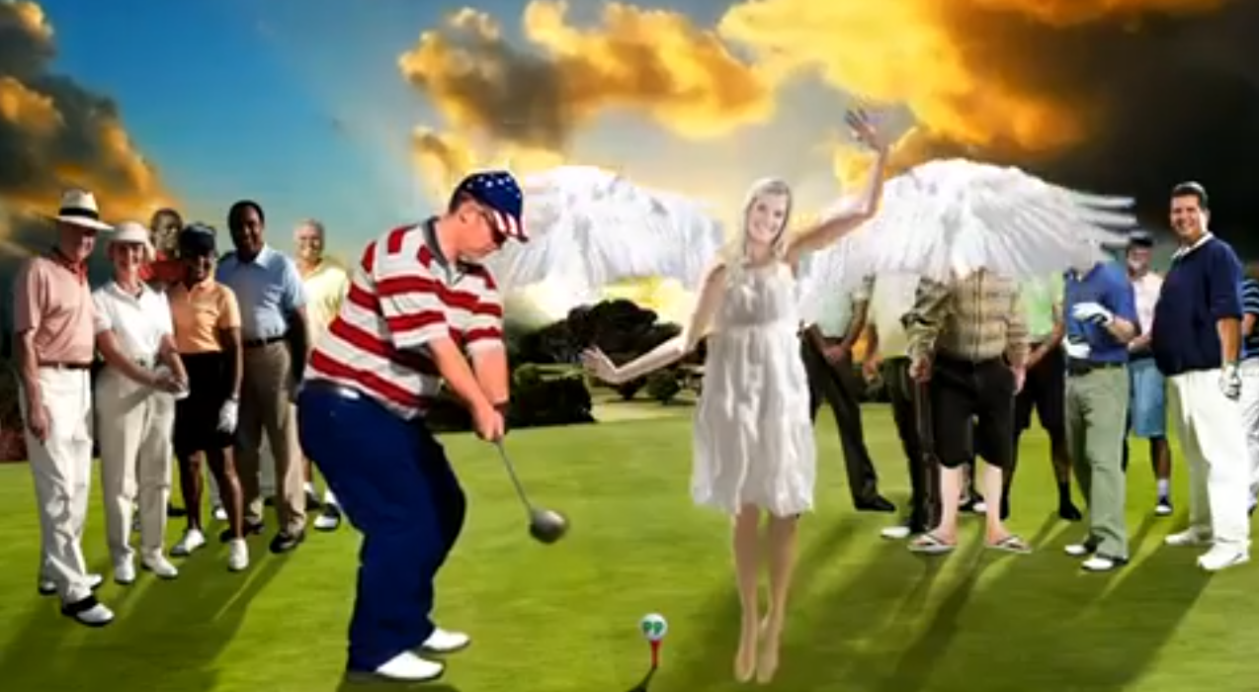
Paddy Power uses TV’s drive to live to help inspire Europe to Ryder Cup victory
Challenge
Paddy Power wanted to amplify awareness of their Ryder Cup ’Sky Tweet’ stunt to promote their brand attributes
Solution
They created special content to encourage viewers of Sky Sports coverage of the Ryder Cup to send their messages of good luck to Team Europe
The ‘Help A Yank To Shank’ tweets were relayed in real time and displayed high across the Chicago skyline
Results
Twitter delivered 18 million impressions (2.5 x the Twitter norm) over the weekend
Staggering 21% engagement rate
#GoEurope received 65.5k mentions with sport celebrities such as Gary Lineker and Austin Healy getting involved
Notes:
Challenge
Prior to the beginning of the 2012 Ryder Cup, American Captain Davis Love III stoked the flames for a fiery confrontation by encouraging U.S. fans to deliver the loudest frenzy ever seen at the tournament
With this firmly in mind Paddy Power, in conjunction with M2M and Crispin Porter + Bogusky, embarked on an audacious plan to redress the balance for Team Europe.
Paddy Power wanted to build on their already formidable reputation as a fun and mischievous brand by creating intrigue and a sense that something big was happening around the competition.
The main objective was to amplify awareness of the Paddy Power ’Sky Tweet’ Ryder Cup stunt whilst driving active social media participation, empowering viewers to get involved.
And in a way that was:
Socially enhancing vs. genuinely disruptive.
Reaching an active social media audience vs. traditional golf audience
The challenge was to create a real time campaign which would transport European fans’ support over to Chicago. The idea was to utilize a fleet of acrobatic planes to create the world’s highest and largest tweets printed in the Sky to show European support. Each letter would be bigger than the Shard and the sky tweets visible for 20 miles.
The Solution
The key to the success of the campaign was to ensure that there was sufficient activity on twitter using the Paddy Power promoted hashtag ‘#GoEurope’. TV was the clear choice as the main driver for the campaign for two crucial reasons. Firstly, they had to build awareness of the stunt amongst a core, highly targeted audience extremely quickly but in addition to that they understood TV’s dominance in its ability to act as a catalyst for online conversations – crucial in order to bring the stunt to life.
TV has become an integral part of the new digital social environment (50% of people using twitter do it while watching TV) and as such the plan was to harness TV’s unique ability to spark online conversations in real time. TV’s role was essentially to act as a real time audience feedback loop.
A special ‘help a yank to shank’ TV copy was created specifically and was shown exclusively in the second day’s live Ryder Cup coverage throughout the duration of the day’s play. The success of the TV campaign relied on secrecy and extremely short lead times (not to mention the weather forecast) and as such M2M worked closely with their partners at Crispin Porter + Bogusky and Sky Media to ensure they were able to place the adverts at exactly the right time for maximum impact.
Results
From an initial media results perspective, the promoted trend on Twitter delivered 18 million impressions (2.5 x the Twitter norm) over the Saturday and Sunday with a staggering 21% engagement rate. The promoted tweets on Twitter delivered 171k impressions and combined nearly 30k clicks (8.9%) and #GoEurope received 65.5k mentions, and indeed #GoEurope was adopted wholesale by fans as well as sports celebrities Gary Lineker and Austin Healy.
To read the full case study and access the creative visit: https://www.thinkbox.tv/Case-studies/Paddy-Power-Ryder-cup

