Slide 1
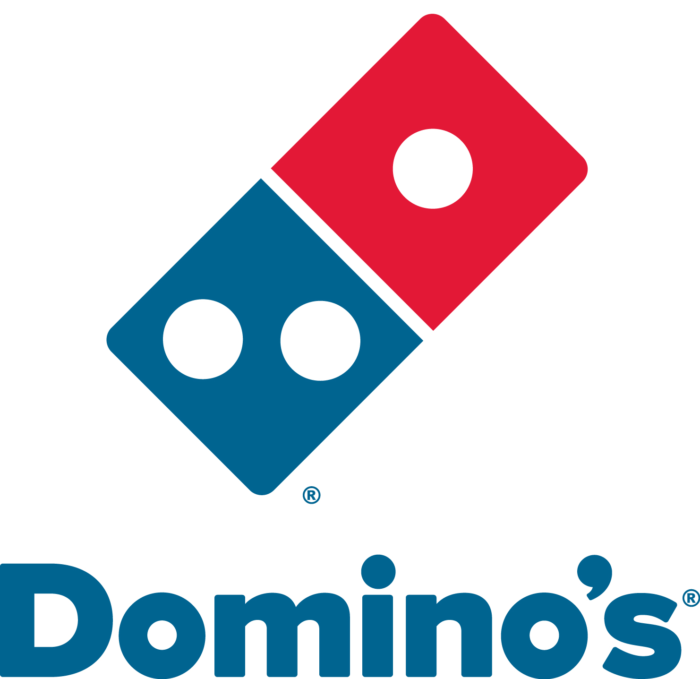
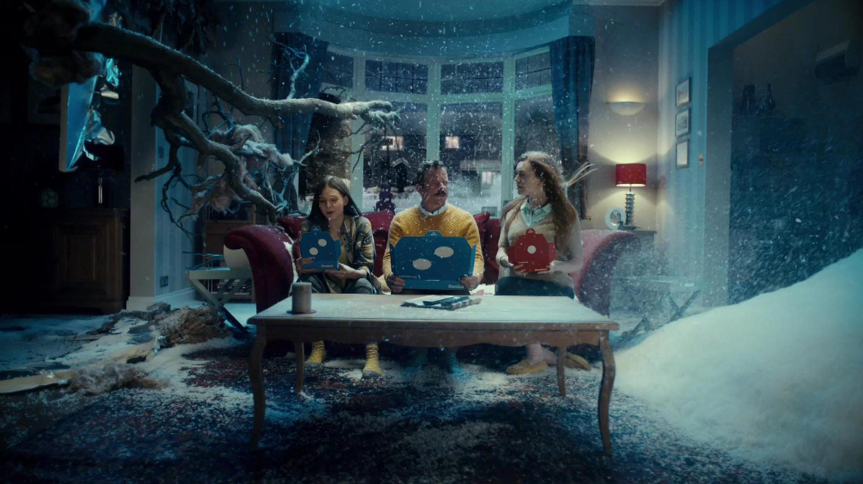
Domino’s – The Journey To Greatness
Challenge
As part of their 5 year plan, Domino’s had set themselves the objective of becoming the no.1 pizza company by expanding their audience and doubling their sales
Solution
Domino’s evolved their TV buying strategy, using sponsorships and partnerships in addition to spot advertising to focus on different mealtime moments, as well as creating a Channel 4 documentary
Results
Domino’s became the number one pizza brand by market share and preference
TV accounted for approx. half of all incremental revenue generated by marketing communications
Notes:
The Challenge
Domino’s had been a success story, showing steady growth since their arrival in the UK in 1985. In 2010, to build on this track record and encouraged by forecasts of further market growth, they worked out a 5 year plan. The key objectives of which were:
To be the no. 1 pizza company by 2015, which meant more than doubling 2010 sales
To deliver average weekly sales of £20,000+ per established store
Sustainable, profitable growth, with profits increasing in line with revenues
This was to be delivered by the same formula that was at the heart of the growth to date, namely six promotion-led communications per year, aligned to menu delivery cycles, featuring new deals or products.
The challenge facing Domino’s in 2011 was that growth was slowing and was being driven by higher prices rather than greater penetration or frequency of purchase. In a fast moving franchisee-led business there was pressure to accelerate growth, but this was made difficult by the increase in competitors - particularly new aggregator competitors such as Hungry House and Just Eat.
Working with their media agency, Arena Media, they conducted some extensive customer segmentation analysis. This identified ‘Family Feasters’ as a key growth opportunity beyond the existing heartland of 18-34 year old ‘Social Snackers’. In the ethnographic study, customers conveyed the feeling that having a Domino’s pizza made mealtime experiences great and so the brand idea ‘Greatness from Domino’s’ was born.
The Solution
TV had always made a significant contribution to Domino’s activity – from their iconic sponsorships of The Simpsons and Britain’s Got Talent to building fame for initiatives like Two-For-Tuesdays. So TV was always going to be the most significant communications channel going forward, but it needed to change in order to drive the next phase of growth.
The new campaigns focussed on how Domino’s combination of product, value and service could make occasions great, especially for families. The new ads promoted Domino’s pizza for meal occasions such as ‘The Midweek Rescue’, ‘Winter Survival’ and ‘Big Night In’.
They used sponsorships to get closer to mealtime moments. They became the official partner of the X-Factor Mobile App. This allowed them to serve games and redeemable pizza vouchers on Saturday evenings to families who were voting for their favourite act.
In addition, to get closer to mid-week mealtime throughout the year, they sponsored Hollyoaks on Channel 4. The timing of the show and the audience profile was perfect for Domino’s.
The Plan
The new strategy meant that their TV activity focussed more on midweek meal occasions and so the airtime was more balanced across the week. Also, as early peak was the key time for ordering a pizza, they significantly upweighted this daypart.
Arena Media used econometrics to guide the phasing of the TV, focussing more on autumn and winter and also upweighting key sales events like pay weeks and bank holidays. They also moved beyond conventional campaign cycles. For example, in 2016, they implemented a football ‘kick-off’ strand by buying spots in must-watch games just before kick-off which drove audiences to order Domino’s for delivery at half-time.
Alongside the Hollyoaks sponsorship which ran across the year, they produced special content for fans and offered money-can’t-buy experiences such as behind the scenes access and meet the cast. They created a special meal deal called the ‘Hollyoaks Hunger Buster’ that proved popular and generated £1.8m in sales. They also got cast members to tweet their support for the Teenage Cancer Trust – a charity that Domino’s supports.
Another initiative involved customers being allowed to personalise their own pizza and then add it to their menu. Entitled Pizza Legends, this idea meant a deeper engagement with customers. Over 200,000 personalised Legends were created during the TV campaign and an additional 210,000 were created afterwards. This drove repeat ordering, contributing to over 1.4m orders in total at 38% higher value than a typical order. They also used Sky AdSmart to test audience engagement with different pieces of copy to inform future planning.
Outside of paid media, Channel 4 created a documentary series called ‘A Slice of Life’, that went inside Domino’s stores to show the commitment and enthusiasm of their employees. Tracking research showed that this had had a positive impact with 66% saying it made them feel more favourable towards Domino’s (31% felt about the same).
Results
Since the introduction of their new approach, Domino’s has seen growth and profitability accelerate because of the shifts in customer behaviour and perception - an outcome driven by changes to the communications model of which TV was by far the largest ingredient.
By the end of 2016, ambitions had been either achieved or exceeded:
Domino’s became the number one pizza brand by market share and preference
Sales doubled and e-commerce sales quadrupled from 2010 to 2016
Average weekly sales for existing stores exceeded £20,000
Group profit and share price doubled in value vs 2010
The brand hit a new milestone in 2016 by achieving £1 billion sales
Domino’s grew an average of over 10% year on year from 2013 onwards – the only large fast food chain to do so
Customer profile shifted to include more families alongside the core younger audience
E-commerce was central to the growth and TV was the most effective driver of it
Domino’s became the most preferred pizza brand with a preference score 46% higher than their nearest competitor
TV accounted for approx. half of all incremental revenue generated by marketing communications
Like for like base sales increased by 23%
In three years, 6.6m users downloaded the X Factor app, which generated 94m user sessions and 800,000 visitors to the Domino’s in-app hub. 4.6m viewers interacted with the ad-sync games and experiences. The vouchers provided through the app provided 625,000 direct sales
Highly commended for Best Ongoing Use of TV in TV Planning Awards
To read the full case study and access the creative visit: https://www.thinkbox.tv/Case-studies/Dominos-The-Journey-to-Greatness

