Slide 1
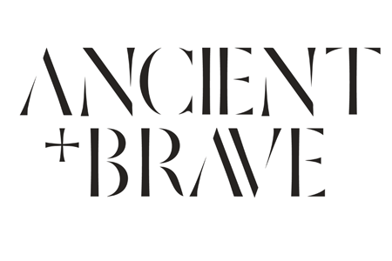

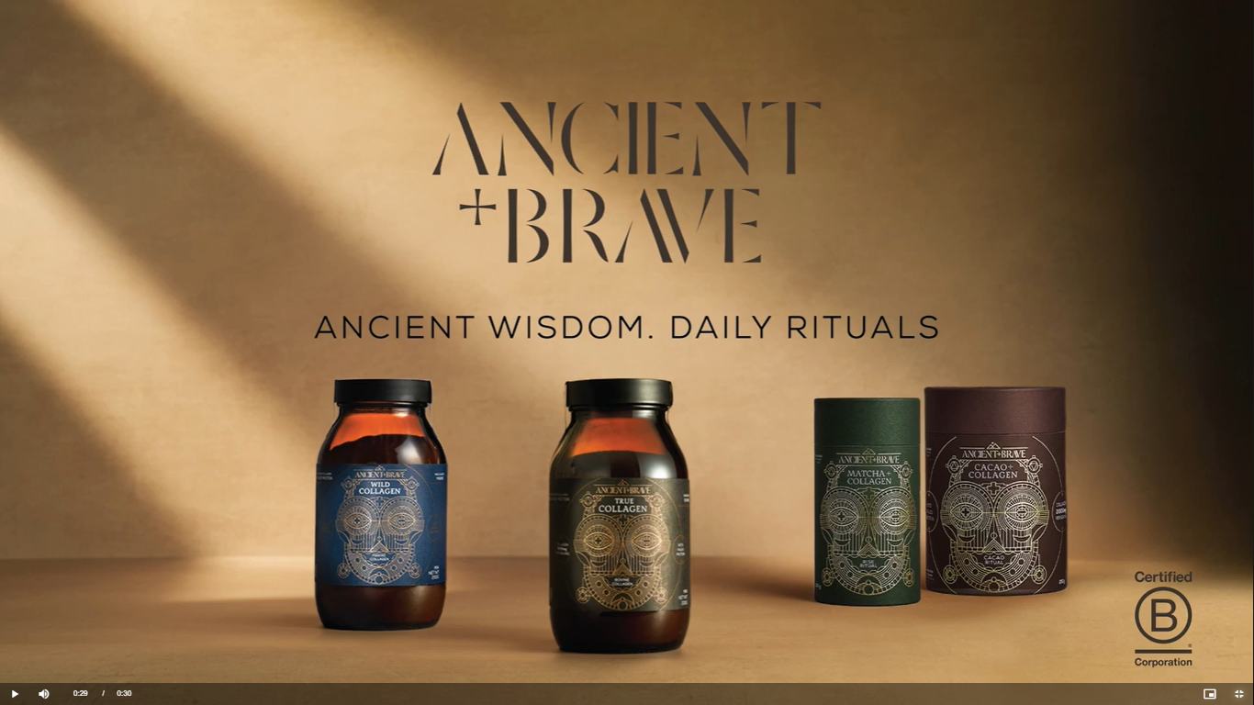
Ancient + Brave: supplementing growth with TV
The Challenge:
Ancient + Brave was looking to increase its awareness and consideration in a category dominated by larger brands.
The Solution:
They won a share of £600,000 of airtime as part of Channel 4 and B Labs UK’s advertising initiative which meant they were able to launch on TV for the first time.
The Results:
Brand tracking by Sonder showed an 80% increase in awareness and an 86% increase in consideration for the brand that placed them on par with their nearest competitors.
Notes:
The Challenge
Ancient + Brave is a British B Corp business that specialises in wellness and supplements. Founded in 2018, the brand is focused on providing consumers with natural supplements to support joint and skin health, gut function, cognitive focus and energy that fit with customers' daily wellness rituals. Since launching, the brand had been built successfully through social media and digital channels, but were looking to grow awareness and consideration and take the brand to the next level.
The TV Solution
As a B Corp business, Ancient + Brave spotted that B Labs, the business behind the B Corp certification, had partnered with Channel 4 to launch an advertising initiative designed to help purpose-led businesses grow. Along with 4 other B Corp businesses, Ancient + Brave won a share of £600,000 of airtime across Channel 4 channels and Channel 4 Streaming. This meant they were able to reach an engaged audience at scale, to drive awareness, consideration and long term brand growth.
The Plan
Armed with a TV ad produced by creative agency, ELVIS; Ancient + Brave made their debut on Channel 4 along with the other 4 B Corp brands in a bespoke premier break in the first episode of the new series of Channel 4 big hitter Taskmaster, on 25th September.
After successfully launching the campaign along with the other winners of the funding, Ancient + Brave took the campaign to Channel 4 Streaming, with targeting designed to reach a highly engaged, health-conscious audience at scale.
This ensured that the campaign showed up in some of Channel 4’s biggest shows across the period like Gogglebox, Educating Yorkshire and Married at First Sight UK. These, along with some high quality linear placements, ensured a spike in new customer acquisition for the supplement business.
Results
The campaign delivered back some strong results for Ancient + Brave. Independent brand tracking by Sonder benchmarked the brand against key competitors throughout the campaign. Brand awareness showed an 80% increase amongst Channel 4 viewers, which in turn led to an 86% increase in consideration for the brand. Sonder brand tracking also highlighted that Ancient + Brave had scaled the brand and had successfully matched their nearest competitor in terms of awareness and consideration as a result of the campaign.

