Slide 1
TV is the best profit generator
Vinted - Clothes

Slide 2
TV delivers the largest share of short-term media driven sales
Share of Short-term Media Driven Sales vs. Share of Media Spend
(Average of 52 optimised brands, across 2018 – mid 2021)
Smaller bubbles represent 2019 positions
Source: ‘Demand Generation’, Nov. 2019, MediaCom / Wavemaker / Gain Theory
Media Mix Navigator, Sep. 2022, EssenceMediacom / Wavemaker / Mindshare / Gain Theory
Notes:
Finding from the Media Mix Navigator (2022) has shown a slight difference in channel performance in comparison to the previous databank (Demand Generation, 2019)
This chart shows channel performance in 2019 vs. the current databank.The horizontal axis displays the share of media spend that a channel takes up - this is an average across the 52 brands in the databank and TV, for example, accounts for 48% of the average media mix.
The vertical axis displays the media driven incremental sales and shows the proportion that was driven by the different channels. The line across the chart is the equilibrium with the channels represented as different coloured dots - the larger dots represent the latest study, whilst the smaller dots are from 2019. Any dots that sit on the line of equilibrium indicate that that channel’s share of spend is equally matched by the share of the sales contribution and is therefore of average efficiency. If a channel is above the line, it means that that channel is ‘punching above its weight’ as it’s delivering above average share of sales given its share of spend, and vice versa.
Looking in more detail, most channels are relatively close to the line. This is likely to be because the brands in the databank are already conducting econometric modelling, and therefore constantly learning about which channels work best and adjusting their spends over time. The chart also shows that TV and Generic Search are actually the two biggest channels that are driving scale.

Slide 3
Both linear TV and BVOD deliver good ROI performance
Total (short and long-term) ROI Index Channel Hierarchy
Source: Media Mix Navigator, Sept. 2022, EssenceMediacom / Wavemaker / Mindshare / Gain Theory
Notes:
Both Linear TV and BVOD deliver good ROI performance, as shown by findings from ‘BVOD Almighty: Reach and Return’ commissioned by Thinkbox.
This chart demonstrates the total (short and long term) ROI performance by channel. It’s worth noting that the data is shown as indices (and not absolute ROI delivery). Thus, it means that linear TV is 41% better than the average of all channels.
The data is shown as indices because the dataset behind the analysis includes a range of product categories. The absolute £££ return you would normally expect from advertising, of course, varies by category. Thus using indices helps understand overall normative performance of each channel relative to everything else.
The channels are ranked by total performance. But in the bars you can see the differing delivery of return by short term (up to 3-months) and long-term (3-months up to three years).
You can see that linear TV has the highest proportion of longer term delivery.
For more information on this study please see:
https://www.thinkbox.tv/research/thinkbox-research/bvod-almighty-reach-and-return/

Slide 4
The predictability of payback varies greatly by channel
The Variability of Returns by Channel
(Data 2018 – Mid 2021)
Increasing risk / reward of achieving return
0% = Median ROI
Source: Media Mix Navigator, Sep. 2022, EssenceMediacom / Wavemaker / Mindshare / Gain Theory
Notes:
Findings from ‘BVOD Almighty: Reach and Return’, shows that the predictability of payback varies greatly by channel. Using the Media Mix Navigator, it’s based on data from Gain Theory, EssenceMediacom, Wavemaker, and Mindshare which covers 52 brands and £2.2 billion of media spend over 3 years.
The charts shows how the variability of returns differs significantly across different forms of advertising. This essentially indicates the risk of investing in different channels based on the predictability of their returns.
The median brand ROI in the databank for each channel is represented by the zero across the middle. To assess the predictability of each channel, the analysis looks at how spread out the different brand ROIs are for each channel in comparison to that middle brand. Basically, the bigger the bar, the bigger variance there is between the best performer and the worst performer – so the greater degree of risk. Outliers have been removed.
As you can see, BVOD is the most predictable (therefore least risky) channel, delivering 20% of variance compared with the median return. This was closely followed by linear TV with a variability of 24%.
It’s worth noting that high variability works both ways: although it involves greater risk, there is the possibility of achieving a much higher than average ROI (as well as a much lower one).

Slide 5
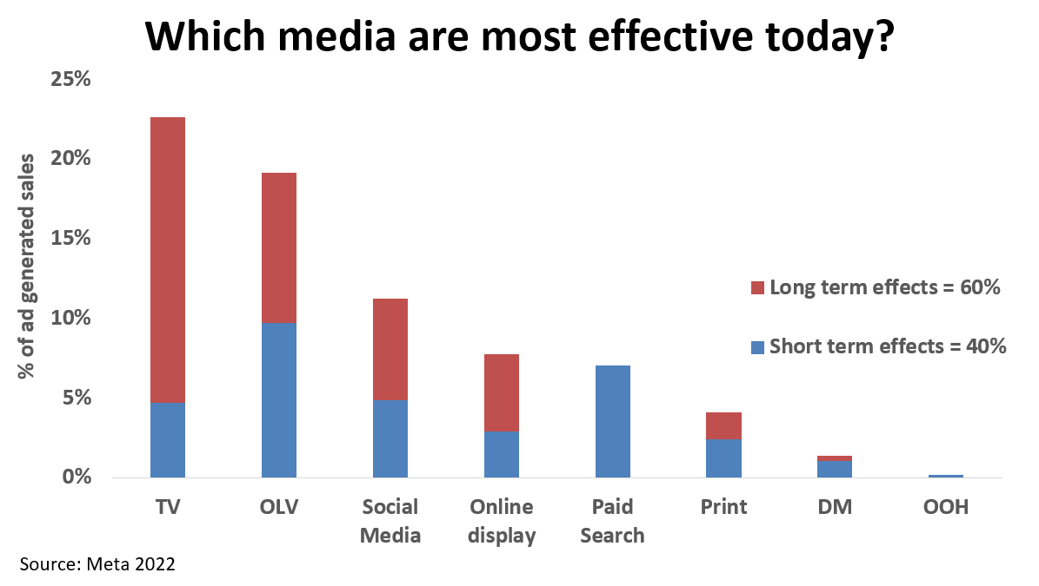
TV produces the largest share of ad generated sales
Source: Les Binet / Meta 2022, OLV = Online Video
Notes:
Research from Meta shows the effectiveness of different channels for 3,500 different advertising campaigns in different markets and different categories around the world.
The research measured both the short-term and long-term effects of advertising on sales, revenue and profit. When looking at short terms effects, the most effective media for short-term performance marketing tend to be in digital media, in particular, online video and paid search, as shows by the blue bars in this chart. The biggest short-term spikes come from these digital channels, but what Meta's research shows is that only about 40% of the payback from advertising comes back in the short term from those short-term direct effects.
The remaining 60% comes from the long-term effects, when accounted for, it shows that TV is the most effective medium closely followed by online video.

Slide 6
TV is vital for long-term profit
Source: ‘Advertising Effectiveness: the long and short of it’, 2013, IPA
Notes:
The IPA’s ‘Advertising effectiveness: the long and short of it’ was produced in association with Thinkbox and written by Les Binet and Peter Field. The study was an econometric analysis of the IPA Effectiveness Awards Databank, looking at the business effects of 1,000 advertising campaigns over a 30 year period.
In this study, the IPA found that TV pays back both over the short and long-term, but the long-term approach is where the real power lies and where the greatest profit is generated.
For more information on this study, see the full write up on the Thinkbox website:
https://www.thinkbox.tv/Research/Thinkbox-research/The-Long-and-Short-of-it

