Slide 1
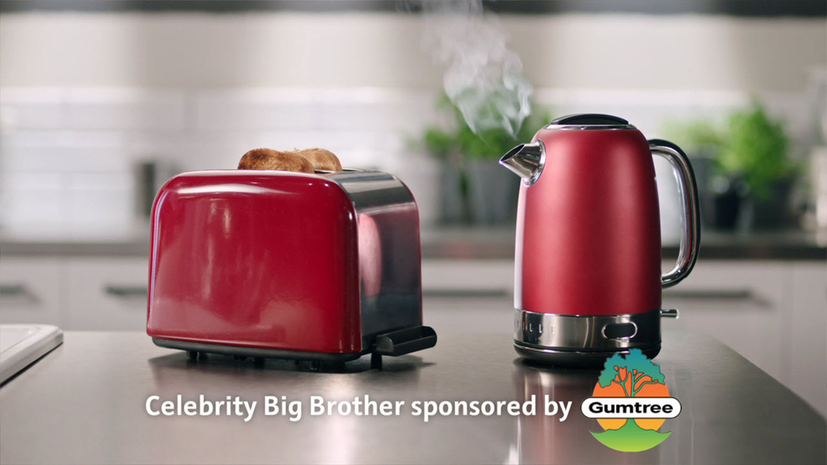
Gumtree stars in the Big Brother house
Challenge
Gumtree needed to change negative perceptions and drive site visits through targeting mums; the household decision makers.
Solution
They partnered with Celebrity Big Brother fully integrating the brand into Channel 5 as well as the TV programme.
Once the show had finished iconic items from the programme were then sold on Gumtree.
Results
Saw a 14% increase of new visitors to the site.
338,000 views and 20,000 replies for the items sold from the house.
Notes:
The Challenge
In 2015, the competitive landscape for Gumtree was becoming more fragmented and increasingly competitive. Facebook was developing its ‘Marketplace’ goods for sale offering and there were new entrants to the market including Wallapop and Shpock. In addition, they were up against a perception that classified selling was a bit old and cheap – people thought Gumtree wasn’t for them and was primarily for cash strapped students.
The challenge therefore was to make people reconsider the brand, particularly amongst mums as they are the principal decision makers in a household, that reinforce the understanding that the goods for sale on the site are pre-loved and good value. In addition, Gumtree wanted to drive incremental traffic to the site and increase penetration and listings.
The TV Solution
Gumtree’s media agency, the7stars, recommended a partnership with a suitable TV property. They found the perfect partner in Celebrity Big Brother on Channel 5. Not only would the programme offer scale and reach, but it was perfectly targeted and offered Gumtree a host of different opportunities to showcase the brand and how it worked. Also, by showing that Gumtree sold quality products that were good enough for image conscious celebrities, they could change the perception of the brand.
the7stars negotiated a fully integrated partnership with the channel, the programme and its producer Endemol that included:
Sponsorship credits around each episode
Extending the sponsorship online
Sponsorship of the mobile app
Competitions
Use of IP
Marketing on and off air
Bespoke spots across Channel 5 and 5*
Exclusive content for use on Gumtree assets
Social media
Research
The Plan
the7stars designed and brokered a three-pronged approach to the media plan.
Bespoke teaser ads in December that got viewers postings goods on Gumtree for Big Brother to bid on in order to furnish the house. The competition ran for a week – 3rd to 9th December 2014 – and had 42,000 entries.
Full ownership of the entire programme: inclusion on pre-launch marketing, sponsorship idents around every episode of the main show and also Celebrity Big Brother’s Bit on the Side, online takeovers, social media integration, exclusive competitions, co-branded content and use of CBB IP on Gumtree owned assets.
Once the series had finished, Gumtree customers had the chance to buy key iconic items from the house. There were 18,500 entries for this competition and a total of £11,000 was raised for homeless charity Crisis.
As extension to the above three phases, the campaign also included:
Exclusive content – Gumtree were granted behind the scenes access to the Big Brother house to interview two of the Art Directors. This content sat on Gumtree’s online blog and social media.
Use of IP – as the main programme partner, Gumtree were able to use imagery and logos across their website and social media content, which helped to cement the partnership with customers
Competitions - Gumtree offered customers the chance to win tickets to the Launch and Final nights of CBB
Results
14% increase in new visitors to the site
8% daily uplift on returning visits
388,000 views and almost 20,000 replies for the 41 items sold off the CBB set
The programme had over 21 million viewers and achieved its highest ever average audience – 3.6 million viewers and 16% share
The sponsorship ROI beat all other channels that have been used in the last 3 years (radio, outdoor, PPC and digital display)
People agreeing with the statement “The sponsorship made me want to check out what’s on Gumtree” almost doubled when comparing viewers to non-viewers of the programme – index 197
The sponsorship drove significant improvements in consideration and recommendation when comparing CBB viewers pre and post; consideration increased by 22 percentage points, recommendation increased by 27 percentage points, and positive word of mouth increased by 17 percentage points
Gumtree's sponsorship of CBB was ground-breaking, both in the level of integration between the Gumtree brand and the programme, and in the scale of ambition. We launched a huge activation programme engaging CBB fans with buying and selling on Gumtree and successfully reintroduced Gumtree to our core 'mums' target audience through a witty and modern sponsorship creative.
To read the full case study and access the creative visit: https://www.thinkbox.tv/Case-studies/Gumtree

