Slide 1


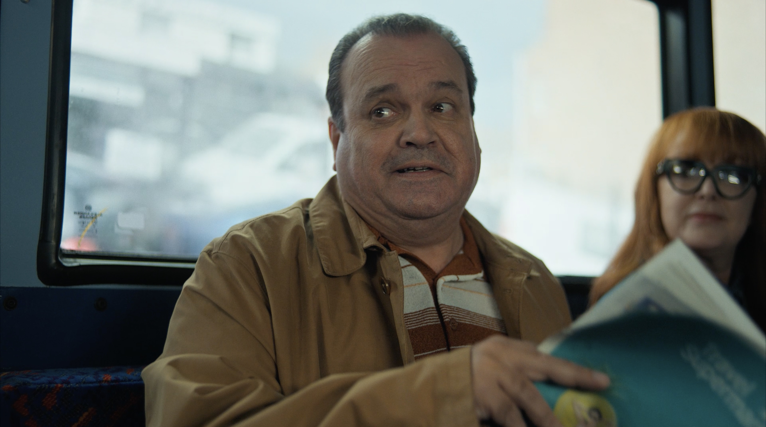
Travel Supermarket: Checking in for TV Air
The Challenge:
Travel Supermarket is a travel comparison site, paid per click by holiday companies. With the travel sector being highly competitive space on TV but Travel Supermarket was over reliant on below the line channels to drive results for the brand. But these channels were experiencing diminishing returns. They needed to drive web traffic and long-term brand awareness.
The Solution:
Emailing profiling had highlighted TV as the lead channel for consumption. It ticked all the boxes, TV would drive trust, emotion and send strong signals. By shrinking the playing field to just the North and Scotland, Brazil Street and Travel Supermarket could leverage economies of scale to drive results for the business.
The Results:
Campaign reached 49 million adults across linear and BVOD. Sky Web Attribution showed a 66% uplift in web traffic driven by TV. Channel 4 Playback study showed a nearly 50% uplift in consideration for Travel Supermarket.
Notes:
Key Points
Travel Supermarket is a travel comparison site, paid per click by holiday companies. With the travel sector being highly competitive space on TV but Travel Supermarket was over reliant on below the line channels to drive results for the brand. But these channels were experiencing diminishing returns. They needed to drive web traffic and long term brand awareness.
Emailing profiling had highlighted TV as the lead channel for consumption. It ticked all the boxes, TV would drive trust, emotion and send strong signals. By shrinking the playing field to just the North and Scotland, Brazil Street and Travel Supermarket could leverage economies of scale to drive results for the business.
Campaign reached 49 million adults across linear and BVOD. Sky Web Attribution showed a 66% uplift in web traffic driven by TV. Channel 4 Playback study showed a nearly 50% uplift in consideration for Travel Supermarket.
The Challenge
Travel Supermarket are a travel comparison site and paid per click out by holiday companies who pay them for site traffic. Therefore the ultimate focus of campaigns is always about driving site traffic, but the business was over reliant on Google which meant you are just one algorithm change away from seeing a nose dive in web traffic.
Travel is a highly competitive sector on TV with more new brands on TV than ever before, for example, in the first quarter of 2024, 103 separate travel brands were live on TV. As a result of this clutter, Travel Supermarket hadn’t spent on TV since 2016 and had become over reliant on below the line media to drive demand. This existing channel mix were experiencing diminishing returns and were no longer delivering new prospects. As a result, the brand tasked media agency, Brazil Street, with a clear set of objectives the campaign would need to drive web traffic, which in turn would lead to on site conversions while driving brand awareness to increase long term performance.
The TV Solution
Armed with clear objectives, Brazil Street started to craft a strategy that would deliver against the objectives. This work started by profiling over 200,000 customer emails. These emails were matched against Experian mosaics data to build a picture of the Travel Supermarket audience. This approach identified TV as the lead channel for their consumption. TV ticked all the boxes needed as it would drive trust, emotion and would send strong signals. Along with this, TV was a proven driver of long term ROI; an important factor for Travel Supermarket in establishing themselves as a trusted, impartial voice in the travel space.
With huge investments from competitors on TV, Brazil Street knew they wouldn’t have the budget to compete on a national scale, but by pooling the spend into as few media channels as possible, Travel Supermarket would be able to drive economies of scale. In order to make the budget stretch as far as possible, Travel Supermarket and Brazil Street shrunk the playing field and focused the spend to the North and Scotland across ITV1 and Channel 4. These regions were identified through the emailing profiling as over indexing for Travel Supermarket and coupled with a lower CPT than other regions of the country, it was a no brainer for the brand.
The Plan
With a strategy in place that would shrink the playing field, Brazil Street puts there plan into action. Armed with both 30”and 20” creatives, Starting with the 30”, Brazil Street were able to work out the optimal swap point to introduce the 20” cut down, which was mid-February, driving cost efficiency without limiting the impact on brand messaging. Along with this, Brazil Street were able to leverage a wealth of data to understand the optimal periods to capitalise on high travel demand. This allowed the brand to be on air for key periods ensuring impact on the business.
When it comes to spots, Brazil Street had a focus on hero spots in the launch phase of the campaign, selected to maximise reach. This led to a focus on live sport in the early stages of the campaign to deliver lighter linear viewers. As a result of this, Brazil Street were able to capitalise on the growing audience around the World Dart’s Championship Final between Luke Littler and Luke Humphries. This spot alone drive 1,530 people to the site within in 5 minutes. Along with this, Brazil Street gave careful consideration to peak programming that would maximise de-duplicated reach vs audiences reached so far with the campaign. Using Techedge, Brazil Street were able to build an audience of currently reach and then used this insight to select programming that would allow them to reach audience not yet exposed to the campaign. Attribution data from Adalyser informed the campaign strategy. This allowed Travel Supermarket to optimise the channels, dayparts and days of the week to delivered the most cost efficient cost per session. as a result of this, Monday was identified as a key day for upweight. And finally, Brazil Street accessed kids TV channels at a lower cost per thousand in order to reach second hand family audiences, driving lower cost per sessions.
Results
The campaign was a roaring success for Travel Supermarket. C-flight analysis showed that over 49 million adults had seen the campaign across both linear and BVOD. This was delivered at an effective frequency of 10. Costs per reach point was significantly lower than that of the competition and demonstrated that with more budget the campaign would have seen further headroom for growth before hitting diminishing returns.
Adalyser data showed immediate uplift in web traffic following spots. This was during the campaign to optimise but when paired with Sky Web Attribution between immediate and long term uplift, with TV showing a roughly 66% uplift all driven by the TV activity. Results from a Channel 4 Playback study highlighted that a massively nearly 50% uplift in consideration for Travel Supermarket. This was coupled with a YouGov Brand study which showed that the brand had delivered an effective uplift in brand awareness vs the competition that had significantly outspent Travel Supermarket.
Client quote
‘Given that Travel Supermarket hadn’t made significant investments into media for the past eight years, we understood the need for carefully crafted return. Brazil Street developed an audience-first strategy by leveraging insights into our customers’ media consumption habits. Additionally, they identified key moments throughout the year to increase our share of voice. Launching during a highly competitive ‘peaks’ period meant our media buys had to content with event larger budgets. After a strong initial launch, Brazil Street continued to optimise the campaigns, collaborating closely with sales houses to achieve our business objectives.’- Steve Seddon, CMO, Ice Travel Group

