Slide 1


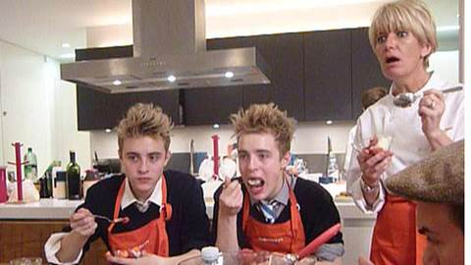
Sainsbury’s Try Team are a hit with The X Factor
Challenge
Sainsbury’s needed to maintain a high level of awareness during the festive period when their competitors were also frequently featuring on TV
Solution
Through a partnership with the biggest programme on TV, Sainsbury’s got closer to mainstream family life
“The X Factor Big Nights In With Sainsbury’s” was created – an online film series that involved cooking with the finalists at The X Factor house
45 films shot over a nine week campaign
Results
Sales for the 12 week period up to 29th December were up by 4.7%
Sainsbury’s achieved its best ever Christmas performance
Notes:
The Challenge
Sainsbury’s were competing with the other supermarkets to achieve stand-out in a congested TV environment. The lead-up to Christmas is a pivotal time for supermarkets. Sainsbury’s needed an idea that would encourage consumers to shop there over the festive period whilst not compromising on the quality of its food and drink.
It needed to do this by convincing families that it represented good value for the family shop, but also Sainsbury’s wanted to bring the brand closer to family life. Inspiring people to ‘try something new today’ is in the DNA of Sainsbury’s. Proof of this philosophy can be found in the Sainsbury’s Try Team – a team of women from across the UK who have been inspiring the nation to cook for over fifteen years.
The Solution
The TV solution involved the use of the Sainsbury’s Try Team and the partnership with the biggest show on TV – The X Factor. The Try Team were used to inspire a mainstream TV audience to share the food they love with the people they love, simply and cheaply.
With a budget of less than £250k, ‘The X Factor Big Nights In With Sainsbury’s’ was created - an online partnership with ITV.com, FremantleMedia and the decade’s biggest TV show. The Try Team visited The X Factor house once a week to cook with the finalists. This unprecedented access allowed them to shoot 45 films over a nine-week campaign.
For viewers it afforded a rare chance to see their favourite TV personalities be themselves off air, learning to cook and having fun whilst creating tasty dishes. For Sainsbury’s, it allowed full brand and product integration into a TV phenomenon. The videos were uploaded to a content rich Sainsbury’s food channel which was fully integrated into The X Factor’s website.
The Sainsbury’s campaign was the perfect example of how a TV property could be adapted and used across other media. 21 Try Team recipes were created for Sainsburys.co.uk, and these tips were seeded on YouTube and Facebook. In addition to this, Sainsbury’s was also the first grocer to use Sky’s green button service. The recipes were uploaded to the service as a series. Finally, pre-roll advertising was used across ITV.com for the duration of the series.
Results
• Over 38% more ad impressions were served than estimated by ITV.com.
• Over 3.5 million pre-roll video adverts were delivered on ITV.com.
• Sales for the 12 week period up to 29th December were up by 4.7% - Sainsbury’s achieved its best ever Christmas performance.
• Dwell time for the online content surpassed some of the biggest media sites (including BBC sites and Sky)

