Slide 1
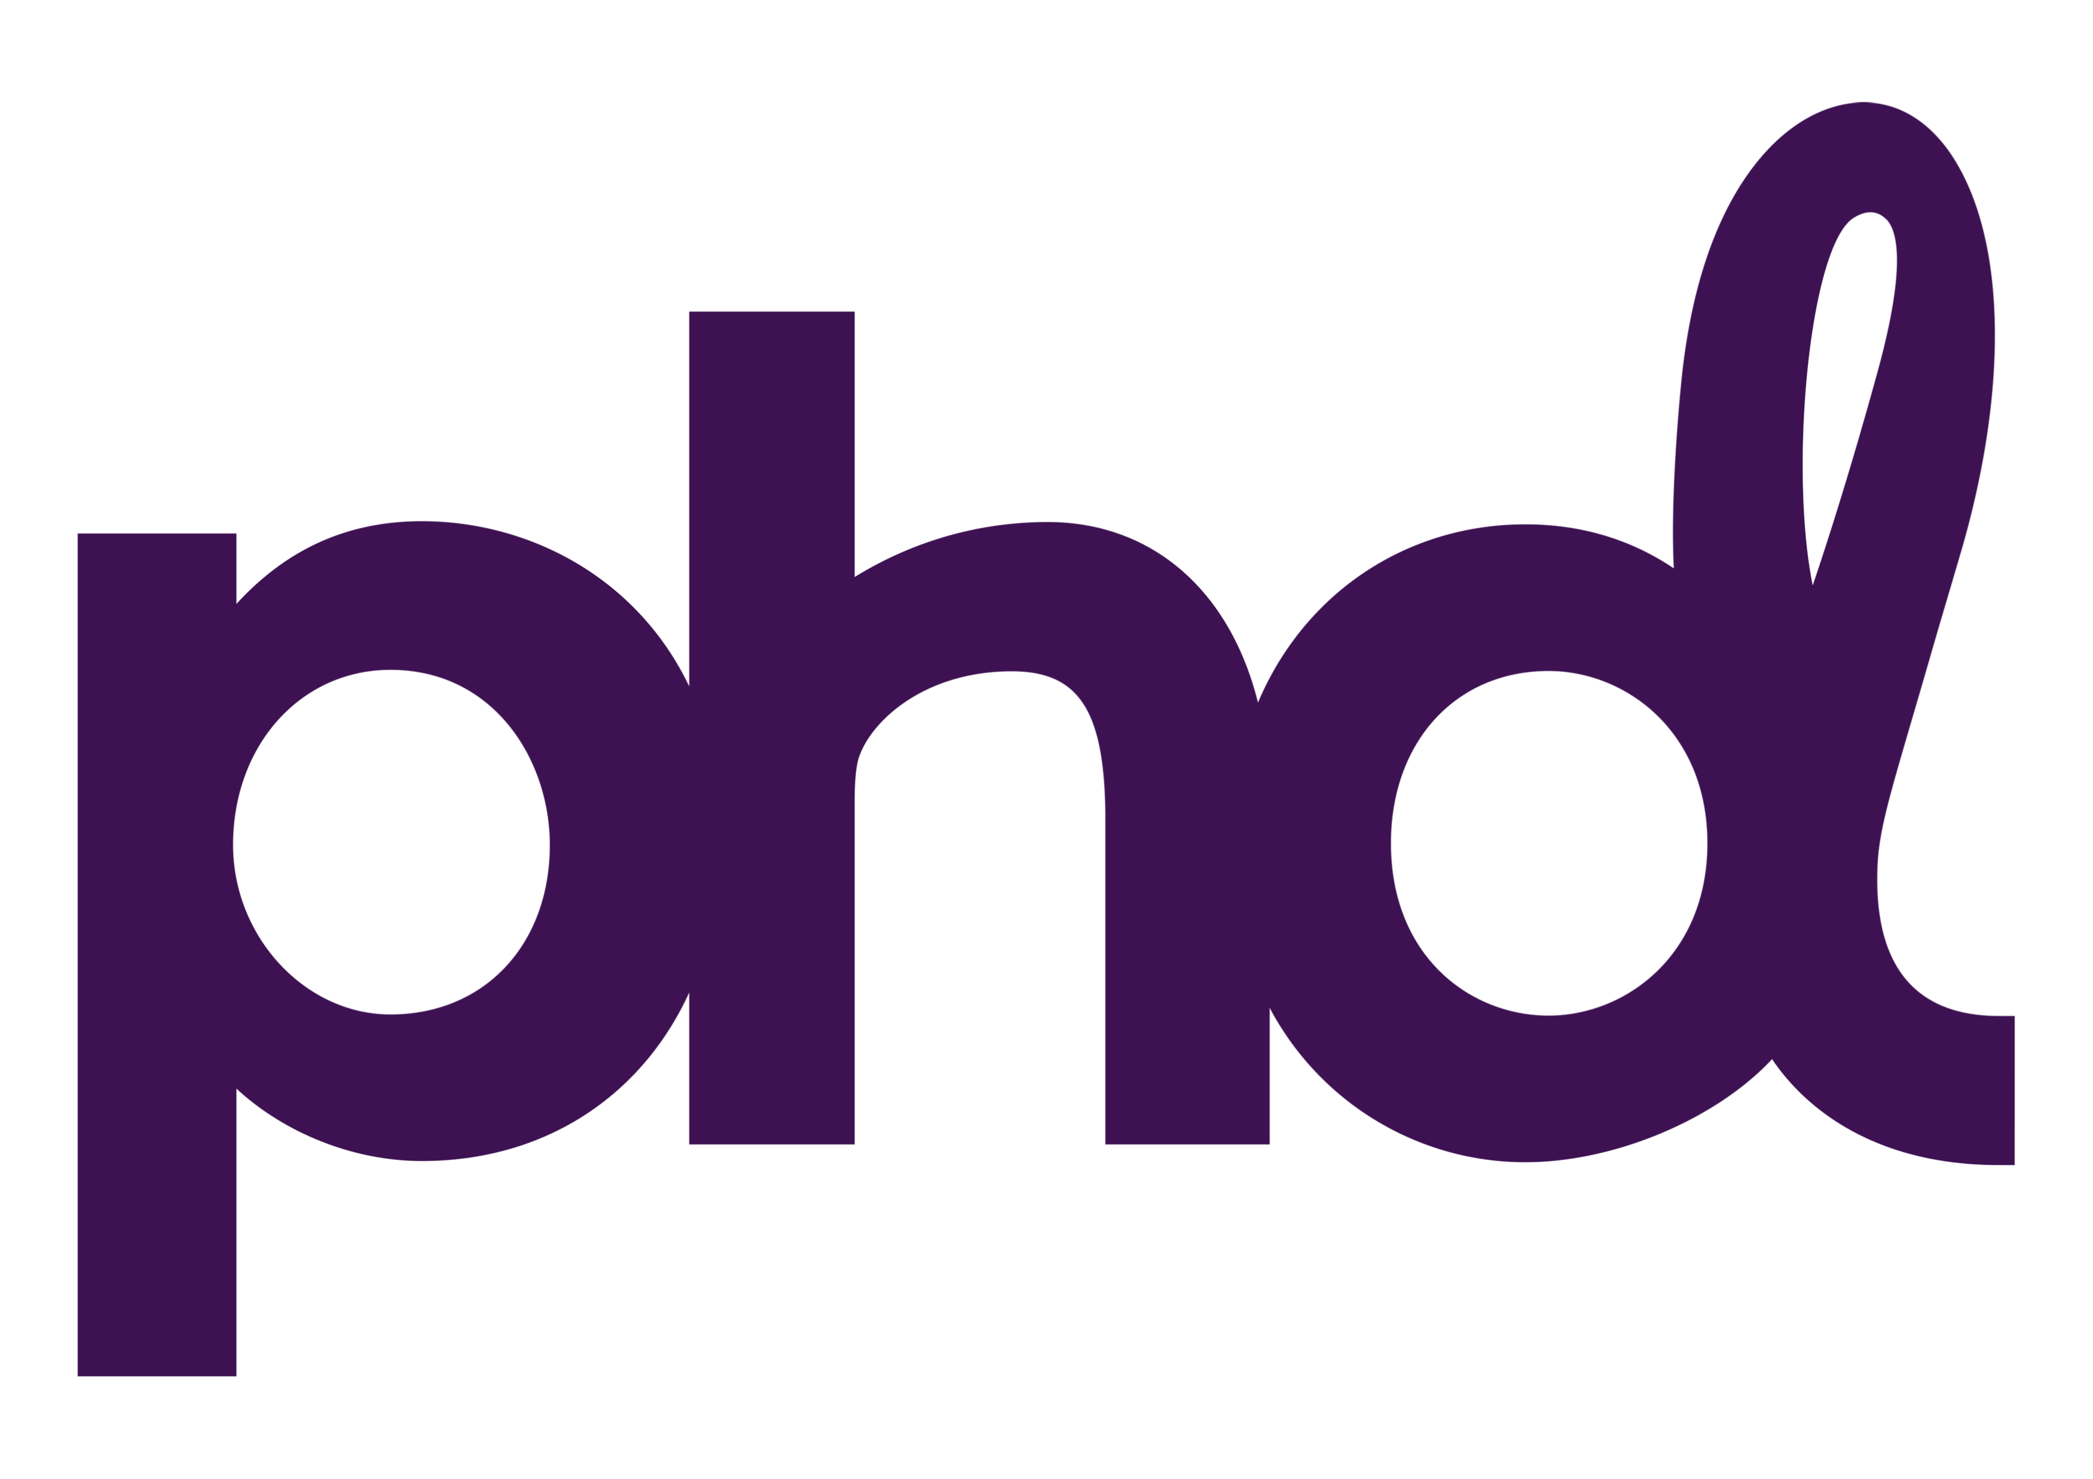
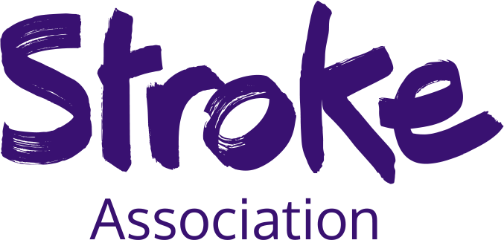
Stroke Association premieres on TV with Channel 4 to drive visibility
Challenge
Increase awareness of the Stroke Association and the number of people who know about it amongst those connected to stroke aged 35+
Solution
With Channel 4 as sole media partner, the charity leveraged TV’s unparalleled fame-driving and emotive power using 5” blipverts and a striking 60” ad, featuring six actual stroke survivors, in a Gogglebox ad-break premiere
Results
Awareness doubled and the number of 35-44’s who know about the association grew 12% YoY
Significant conversation and social engagement generated
Notes:
The Challenge
Stroke is the UK’s fourth biggest killer, affecting one person every five minutes, however the condition doesn’t rank among the top 10 health concerns.
Often, it’s difficult for people to picture what a stroke survivor looks like or to understand what kinds of challenges they may face afterwards. This lack of visibility created a problem for the Stroke Association, making it difficult to cut through and call attention to stroke as a serious health issue, and to promote the organisation’s role in supporting survivors and their families.
With less than 1% SOV, the charity’s prompted awareness was also in long term decline, falling from 49% in Nov. 2009 to 41% in June 2018, and only 9% of people in the UK could name a charity working in the area of stroke.
Consumer insight showed that the organisation had to communicate stroke’s brutal reality while challenging the fatalism around stroke – offering hope for recovery, highlighting the need for support and the role of the Stroke Association.
The campaign objectives were to:
Increase awareness of the Stroke Association amongst those connected to stroke aged 35+
Increase the number of people who know about the Stroke Association amongst those connected to stroke aged 35+
The TV Solution
Life after stroke isn’t always visible and it’s not easy to tell what a stroke survivor looks like, so working with their media agency, PHD, the Stroke Association’s overarching strategy was to make the cause visible.
They needed a high impact, emotive channel to be able to drive fame and tell the story from the point of view of real stroke survivors. As they also needed to speak with those connected to stroke, who are impossible to target precisely, a broadcast channel which spoke to the masses was a must.
Despite the Stroke Association having never used TV before, they knew it would be the essential channel for achieving the level of cut through and emotional resonance needed to elevate stroke from a condition to a cause, pushing it into the national conversation, and reframing how people viewed the condition.
By casting six actual stroke survivors, and hiring a director who had had a stroke, AMV BBDO brought the campaign to life in a strikingly emotive execution that told the story of what it’s like to experience a stroke from survivors’ points of view.
The Plan
Based on not only its heritage of successfully championing good causes, but also its wide range of channels and viewing audiences, the Stroke Association selected Channel 4 as their sole media owner partner.
To drive fame, the striking 60” ad launched in a special Channel 4 ad-break premiere during the final break of Gogglebox. To create tension and intrigue, and to mimic the confusion and disorientation often experienced by stroke victims, this was preceded by a series of 5-second ‘blipverts’ during ad breaks prior to the reveal.
The campaign ran for 10 weeks from April using a shorter 30” execution, with spots optimised around contextually relevant programming moments to extend reach and around major sporting events to drive fame.
To support the TV activity and to further drive conversation, particular around Stroke Awareness Month during May, video content also ran across YouTube and social media.
Results
Campaign awareness doubled amongst those connected to stroke
The number of 35-44 year olds who know about the Stroke Association increased by 12% YOY. Among this age group, ‘very likely to support’ rose 55%, and had doubled by September 2019.
Significant conversation was generated about both the topic of stroke and the association, with over 80% driven by the broad 35+ target
In May 2019, social engagements hit 1m for the first time ever, against a monthly average of 50k-100k
Despite not including a fundraising call to action, a financial impact was also felt - fundraising mailings to warm audiences have consistently generated income 15-40% above target, and a donation test on wave two had a 7:1 ROI.
The campaign was a finalist in the Best TV Newcomer category at the TV Planning Awards 2020. It also won ‘Best Use of Insight’ and the ‘Judges’ Choice’ categories at The Marketing Society Brave Awards 2020, as well as the Charity Times ‘Campaign of the Year’.

