Slide 1

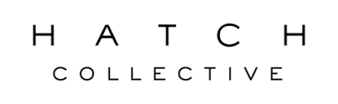
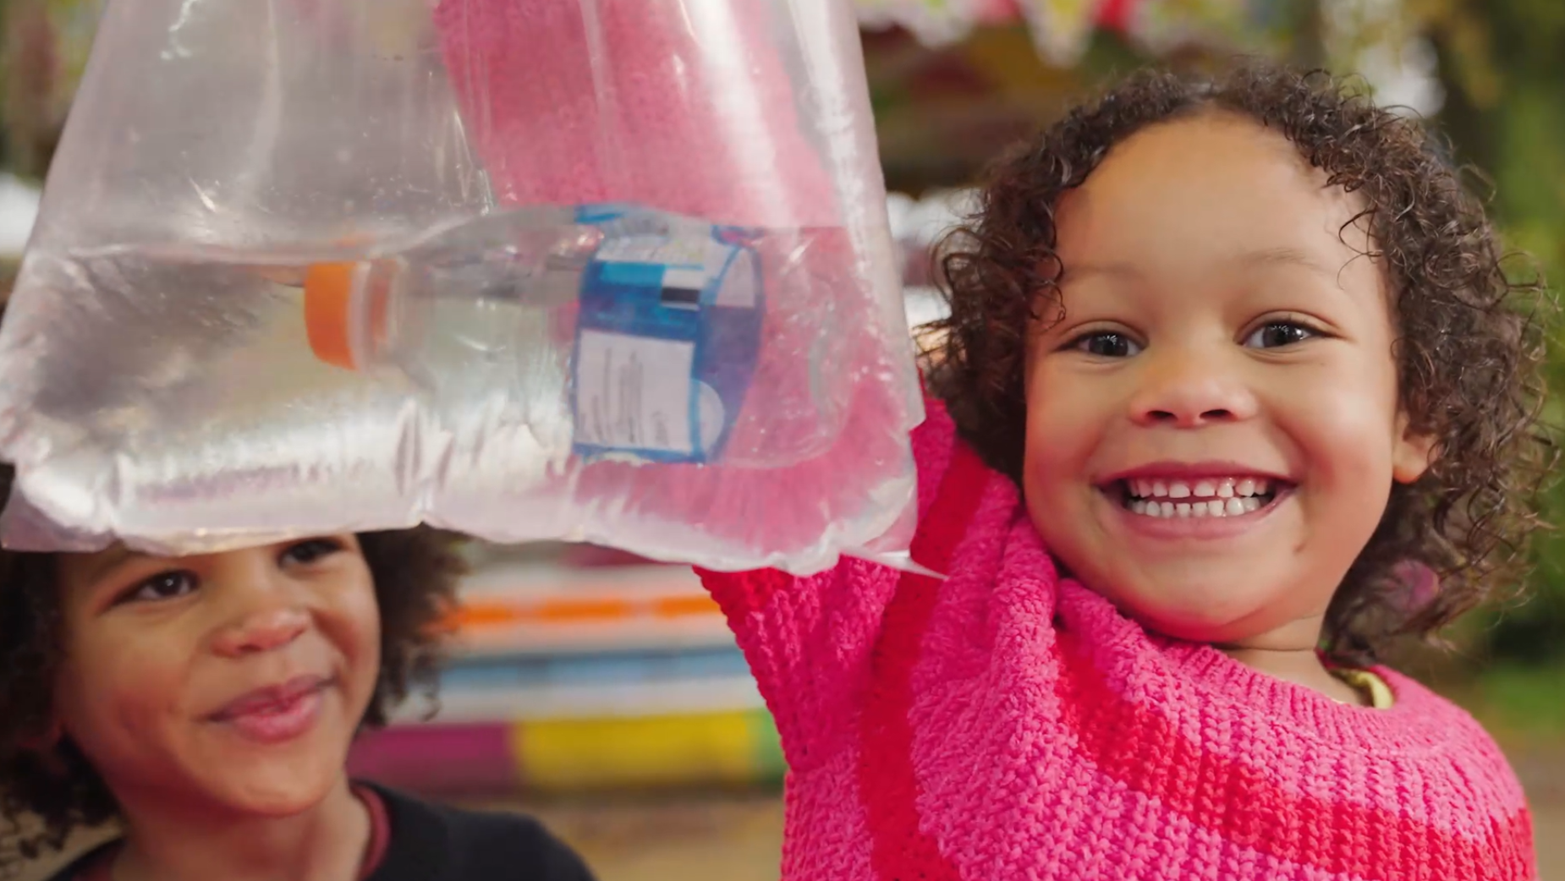
Ocean Bottle uses TV to save our seas
The Challenge:
Ocean Bottle needed to raise awareness in their bid to rescue plastic bottles from our oceans
The challenge was to encourage people to act, making a meaningful impact and driving real change
The Solution:
They won Sky’s Footprint Fund prize of £250k in airtime
Hatch Collective created a humourous ad, depicting a dystopian world where plastic bottles had replaced fish
This showcased the severity of the situation and encouraged viewers to take action
The Results:
Ocean Bottle had their most successful campaign ever
The campaign helped remove over 4.56m kilograms of ocean-bound plastic from reaching our oceans
Notes:
The Challenge
By 2050, there will be more plastic by weight in the sea than fish and so the stakes have never been higher to save the planet.
Founded in 2018, Ocean Bottle is a social impact brand first, reusable bottle brand second and on a mission to stop 7 billion plastic bottles in weight from entering the ocean by 2025.
With the sea making up 70% of the surface area of the planet, responsible for every other breath we take, it is the world’s largest carbon sink supporting 78% of all animal biomass.
However, with 20% of us admitting to buying plastic bottled water every day and each person in the UK buying over 150 plastic water bottles every year on average, we all need collectively and fundamentally to change our behaviour from using plastic bottles.
Each re-useable bottle of Ocean Bottle sold directly contributes to 1,000 plastic bottles in weight prevented from entering the sea.
The more people are aware of this, the more Ocean Bottles are sold, meaning that more plastic can be collected before it reaches the sea, thus ultimately removing a projected 7 billion bottles - the equivalent to the same size as the great pacific garbage patch.
The challenge was to increase their awareness significantly and encourage more people to act, making a meaningful impact and driving real change.
The TV Solution
Communicating environmental messages can often feel somewhat ‘preachy’ which can lead to consumers feeling lectured to and therefore alienated. Also, what often happens is that the public want to take action, but the challenge can feel so overwhelming that it is incredibly difficult to feel that you alone can make a difference.
Ocean Bottle and Hatch Collective wanted to encourage a complete behavioural change in how plastic is viewed and how we use and consume it without thinking.
To bring this message to life, Hatch Collective created an ad which depicted a strange yet dystopian world where fish is replaced by plastic. Scenes showed a girl winning a plastic bottle in a bag of water at the funfair, a woman picking which plastic bottle she would like at the fish counter in a supermarket, and a man serving a battered plastic bottle at the fish and chip shop.
Whilst the situations edged on the side of ridiculous, they provided a stark reminder of the severity of the plastic-pollution crisis and what could become a reality if we don’t act now. Putting these alternative outcomes in front of the audience allowed them to connect with viewers in a meaningful way, engaging with them on the importance of the issue and encouraging them to be part of the solution.
Being a sustainable brand, it was imperative that these credentials were reflected in the production. Hatch Collective therefore ensured that the ad was produced with their lowest ever carbon footprint for any location production.
The Plan
Hatch Collective’s thought-provoking and humourous “Hydrate and Help the Ocean” TV ad connected viewers to the plastic-pollution crises, resulting in Ocean Bottle winning the Sky Zero Footprint Fund and receiving £250k in media value to help raise awareness and encourage people to contribute to protect the health of our ocean.
The campaign aired across a mix of Sky channels with a ‘Must See VOD’ package that featured a wide range of Sky’s premium content to drive brand awareness. The campaign also used optimisation to maximise response.
Following the launch, Ocean Bottle aired the ad again in November 2024 across Sky channels.
Results
Winning the Sky Footprint Fund and investing in a sustainably produced TVC accelerated Ocean Bottle’s initiative to remove 1 billion bottles from the ocean by the end of 2023.
Clear evidence of the Ocean Bottle TV campaign cut through with significant, above average uplifts seen for prompted ad recall measures and overtaking several key competitors for prompted advertising recall
The Ocean Bottle ad creative scored significantly above norms for both attention and relevance with positive increases seen for most perceptions especially for Ocean Bottle funds the collection of ocean-bound plastic bottles
The TV campaign resulted in Ocean Bottle’s most successful Blue Friday campaign ever (encouraging sustainable shopping v consumption around Black Friday and doubling their impact) with a significant increase in both traffic and conversion rate
The campaign helped Ocean bottle to remove over 4.56m kilograms of ocean-bound plastic from reaching our ocean in 2023 and a staggering 20.9m kilograms to date.

