Slide 1

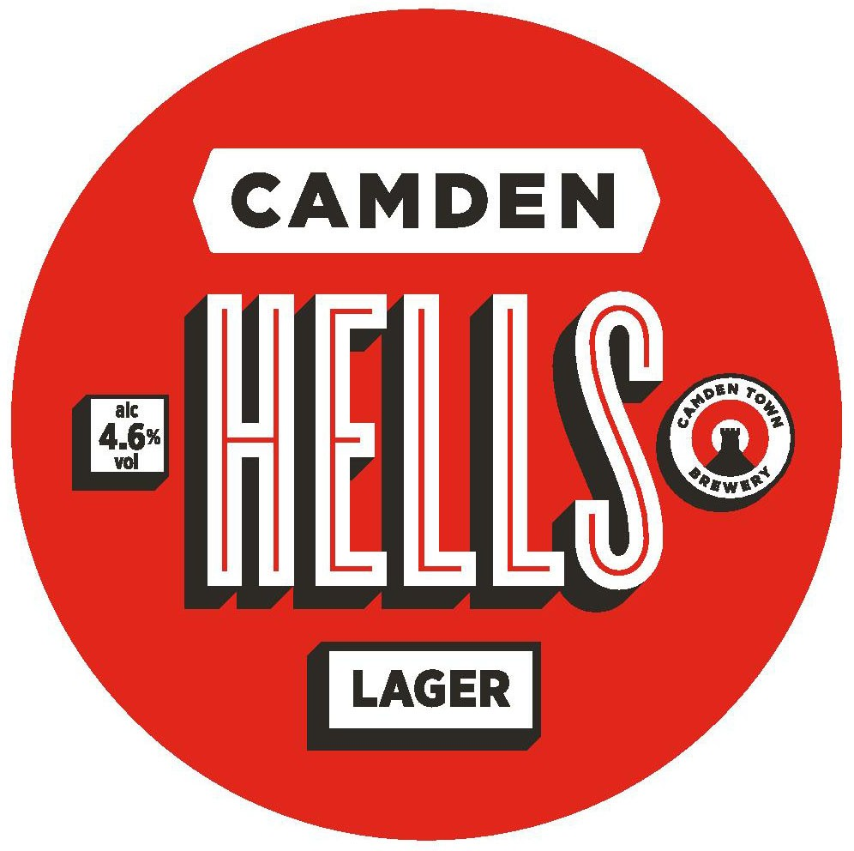
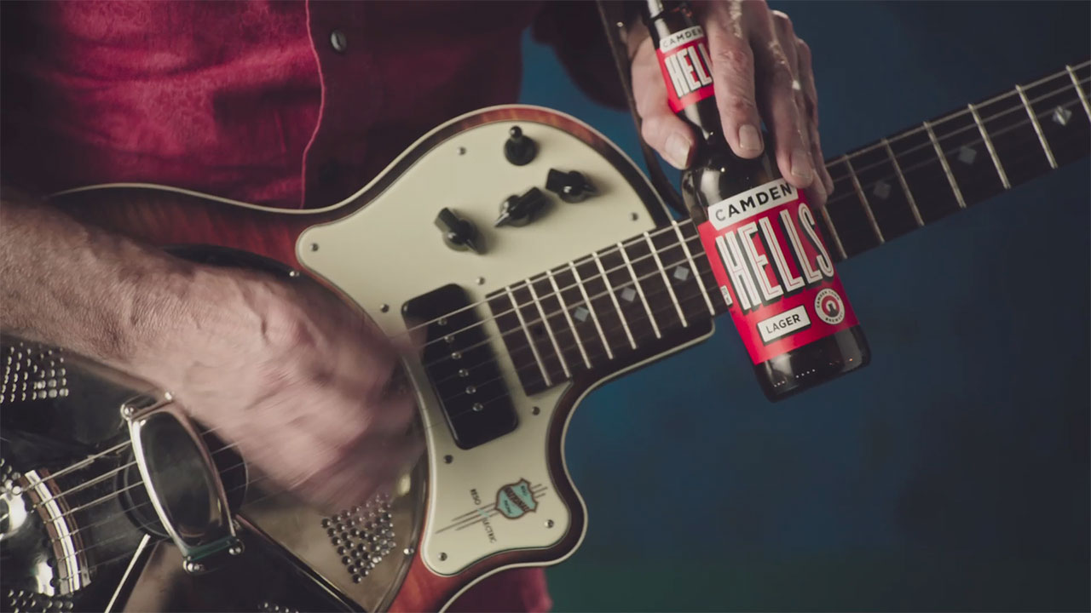
Camden Hells: The power of media to scale
Challenge
To become ‘the UK’s favourite lager’
Solution
A partnership with the ITV Growth Fund that would allow them to advertise in London on a budget they could afford
Alongside the TV campaign, there was activity on social media, posters, press, cinema and VoD
Results
Camden Town Brewery had to limit supplies as demand was so high
Significant increases in brand metrics - 90% of people said Camden Hells was a brand they would recommend after seeing the TV ad
Notes:
Challenge:
Camden Town Brewery (CTB) was founded in 2010 by Jasper Cuppaidge, with the vision of making ‘great beer available to all’. Due to the growth in the craft beer market, CTB was acquired in 2015 by ABInBev with ambitions to scale up the business. As Sir John Hegarty (one of the original investors in the brewery) said:
“At some point every brand that wishes to lead has to be willing to broadcast its fame and reputation.”
CTB started working with their agencies Electric Glue and The Garage Soho in order to accelerate the next stage of the journey. In 2017, their aim was to become ‘the UK’s favourite lager’ which meant just not getting bigger but retaining brand love. Their objectives were to grow awareness by 50% whilst retaining brand love at a high 80%.
The challenge for CTB was how to achieve that tricky balance of acting small but being big.
Solution:
With this ‘call to scale’ in mind, Electric Glue created a first ever partnership with the ITV Growth Fund, which allowed them a presence in London with budgets they could afford. They knew that by advertising on TV for the first time, they could significantly raise awareness of the brand and encourage people to try it.
However, with the principle of ‘acting small’ in mind, the TV schedule focussed on ‘craft’ programming in which to showcase the creative.
Results:
The campaign was so successful that CTB could not keep up with the demand and had to limit supplies.
In addition, there were significant increases in brand metrics when comparing people who had seen the campaign to those who hadn’t for example:
A brand for me – from 22% to 55%
A brand I like – from 30% to 57%
A brand I respect – from 34% to 61%
A brand I would recommend – from 82% to 90%
For the full case study and to view the ad campaigns visit: https://www.thinkbox.tv/Case-studies/Camden-Hells

