Slide 1


TV drives trust
Hilton - Don't Take Me Home

Slide 2
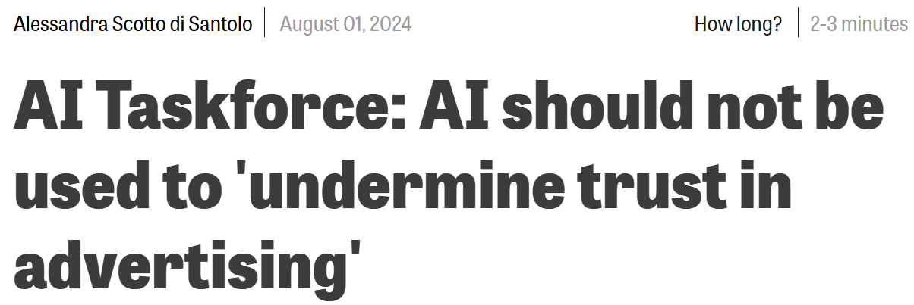
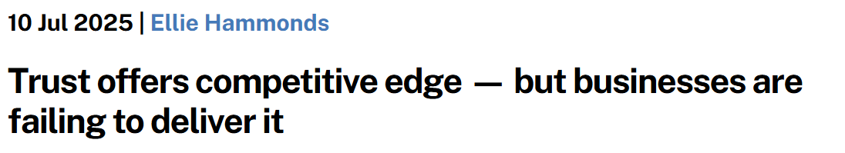
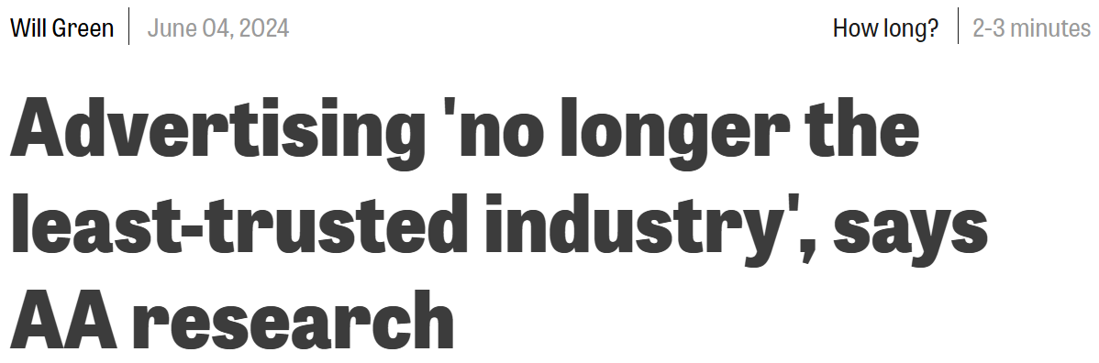
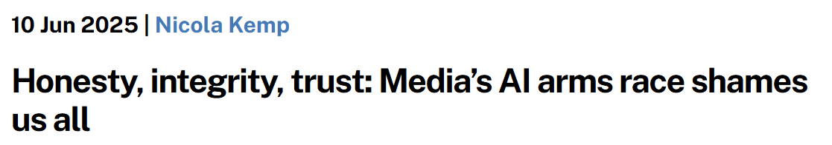
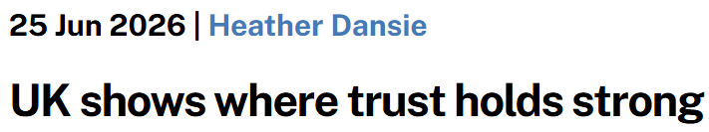
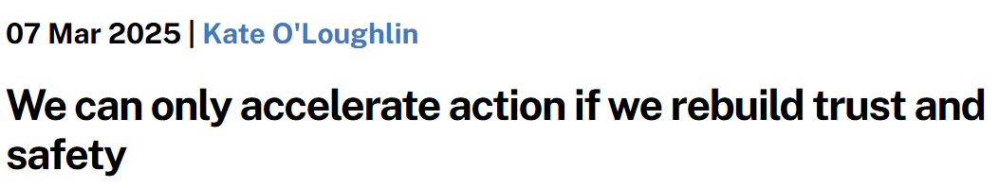
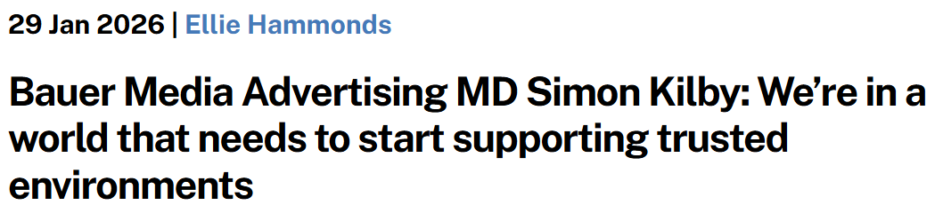
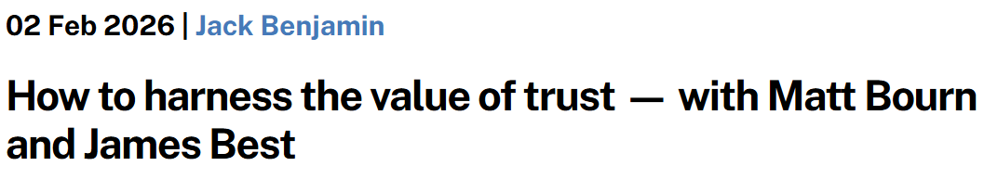
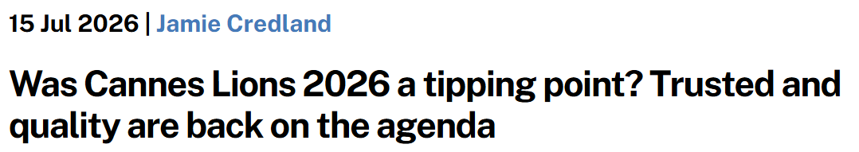
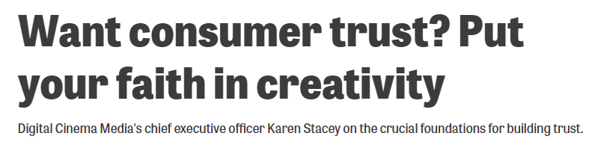
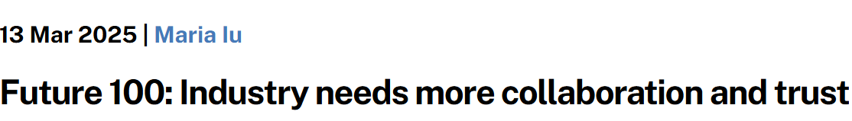
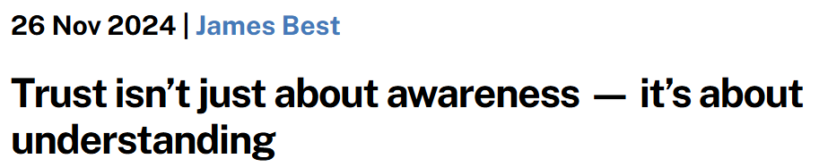
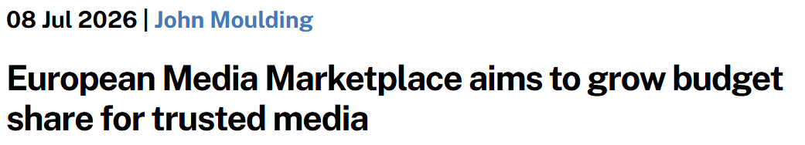
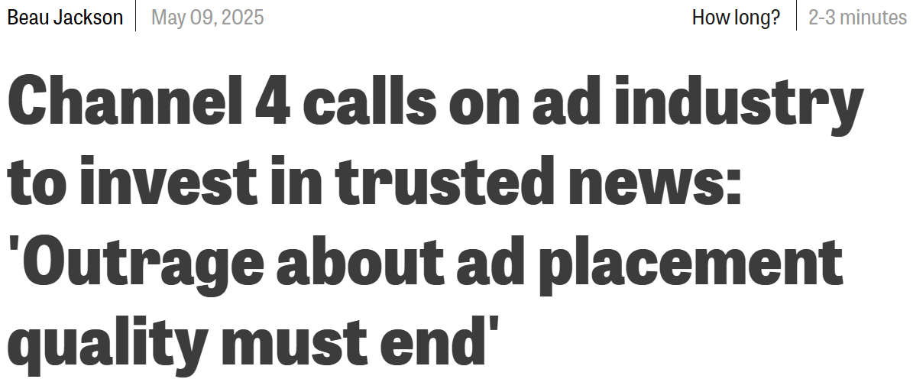
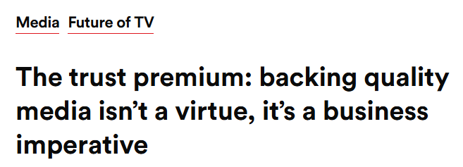
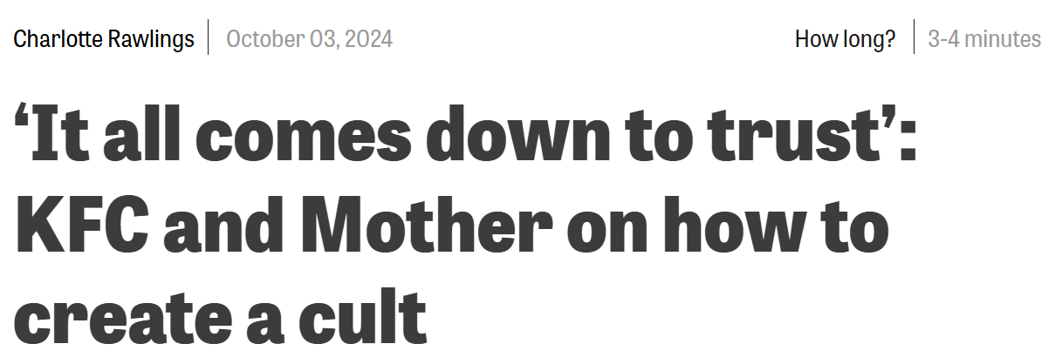
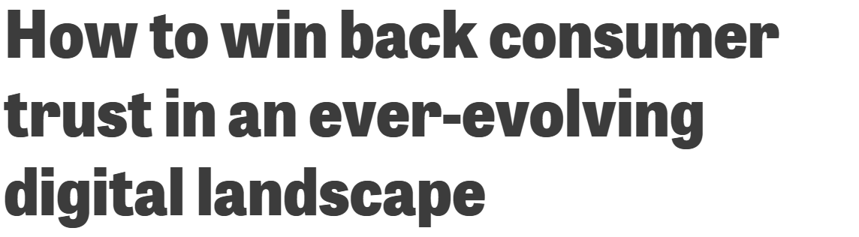
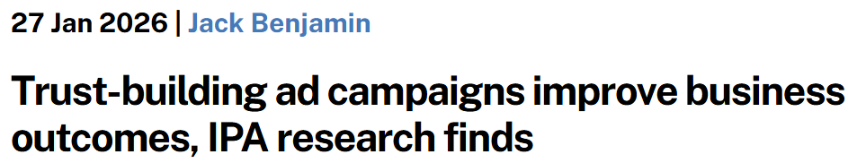
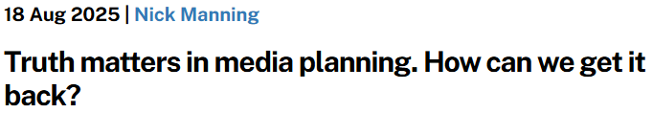

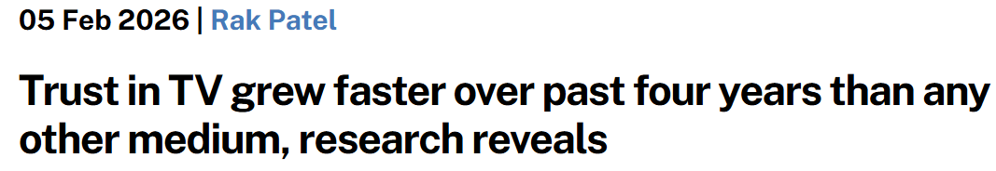
Everyone seems to want to talk about trust
Source: The Media Leader, Campaign, Videoweek, The Drum
Notes:
Trust has become one of advertising’s most written-about ideas. The trade press is full of it – articles, reports and opinions pieces exploring it’s role in building brands and shaping behaviour.

Slide 3


At a macro level, trust is linked to profit
Source: IPA Databank 2004-2022 for profit cases reporting very large trust improvements. NB: insufficient data prior to 2008.
Notes:
Analysis from the IPA shows that over the last 20 years the relationship between building trust in a brand and achieving greater profit has strengthened considerably. Twenty years ago, trust was the least important of the seven brand mental availability metrics that the IPA monitors, today it is the second most important, bested only by the perceived quality of the brand.
Read more here: https://www.thinkbox.tv/research/reports/tv-is-at-the-heart-of-effectiveness-whitepaper-by-peter-field

Slide 4

Trust now ranks as the No. 2 metric linked to driving business effects
Source: IPA Effectiveness Databank 2016 - 2024
Top – What You Got
Notes:
Analysis from the IPA shows that over the last 20 years the relationship between building trust in a brand and achieving greater profit has strengthened considerably. Twenty years ago, trust was the least important of the seven brand mental availability metrics that the IPA monitors, today it is the second most important, bested only by the perceived quality of the brand.
Read more here: https://www.thinkbox.tv/research/reports/tv-is-at-the-heart-of-effectiveness-whitepaper-by-peter-field

Slide 5

“Ad effectiveness and purchase intent were significantly higher when the ad was displayed on a platform that the audience trusted”
Source: Kristin Stewart (California State University/San Marcos) & Isabella Cunningham
(University of Texas/Austin), Journal of Advertising Research, 2017
Very – The Arrival
Notes:
The Journal of Advertising Research also states that ‘ad effectiveness and purchase intent were significantly higher when the ad was displayed on a platform that the audience trusted.’

Slide 6
At a headline level, people trust brands on TV more than anything else
% of people that trust brands that advertise on…
Source: Tapestry Research, 2025, ADS1a. Thinking about different places in which you see advertising, please tell us how you feel [TRUSTED] about brands that advertise [INSERT TYPE OF AD]. Social media e.g. Facebook, Instagram and TikTok.
Notes:
Trust in advertising is more important than ever. Amid growing uncertainty and declining consumer confidence, trust has become a key driver of business outcomes like brand preference and profitability.
Analysis from Tapestry Research highlights where consumers place their trust when it comes to advertising platforms. We asked people about the different places they see advertising and how they felt about brands that advertised on those channels.
Analysis reveals that people are most likely to describe brands advertising on TV as trusted (24%), with newspapers and magazines coming in second at 20%. People are least likely to describe brands advertising on YouTube (12%) and social media (9%) as trusted.
To dive deeper into why trust matters and why TV continues to lead, read more here: https://www.thinkbox.tv/why-tv/unrivalled-trust

Slide 7
Across all channels, brand trust falls as age increases
Source: Tapestry Research, 2025, ADS1a. Thinking about different places in which you see advertising, please tell us how you feel about brands that advertise [INSERT TYPE OF AD]. Social media e.g. Facebook, Instagram, TikTok.
Notes:
When Tapestry Research analysed the percentage of people who trust brands that advertise across different media channels, segmented by age group, the results showed that brand trust generally increases as age decreases. Younger audiences consistently reported higher levels of trust in brands across all media channels than older age cohorts.

Slide 8
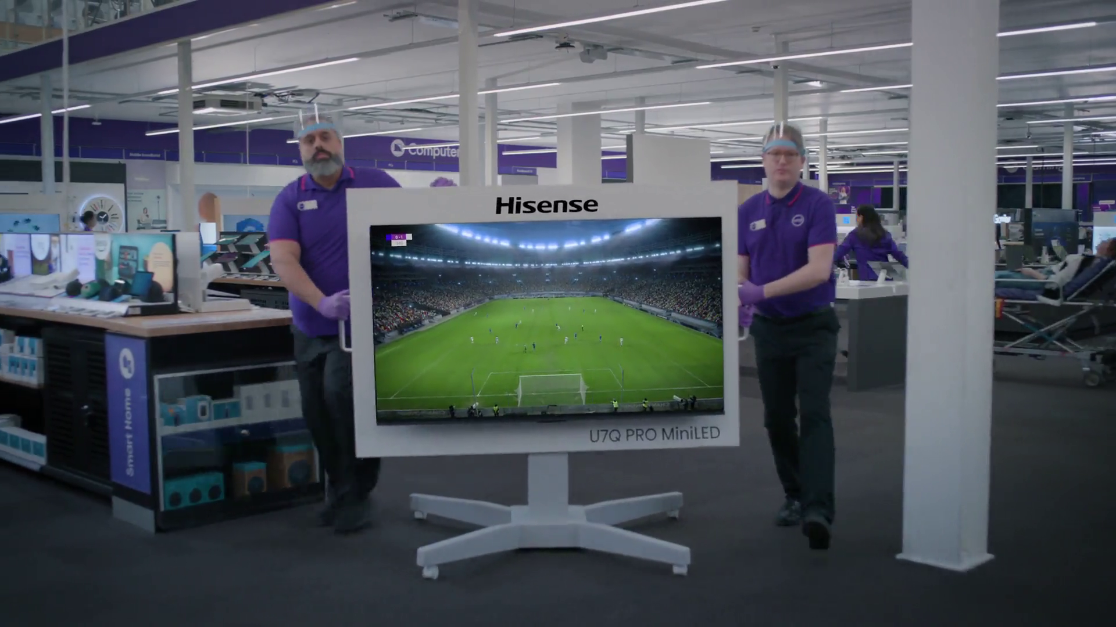
+44%
More likely to trust advertising seen within professional content
+15%
Currys - Analysis Paralysis
Higher brand trust when watched with others
Source: Context Effects, Map The Territory & Tapestry Research, 2024. Staying Power, Tapestry Research, 2025.
Notes:
Context Effects (Thinkbox, 2024) used ethnography and SEM to analyse in-home video viewing. It found that ads shown within professionally produced content were seen as 44% more trustworthy than those in user-generated or unregulated environments.
TV’s in-home, shared, high-attention setting creates the ideal conditions for trust to flourish.
Similarly, in Staying Power (Thinkbox, 2025), analysis shows that TV’s strength is amplified in shared viewing contexts, when people watch TV with others, brand trust grows 15%.
Read more about Context Effects here: https://www.thinkbox.tv/research/thinkbox-research/context-effects
Read more about Staying Power here: https://www.thinkbox.tv/research/thinkbox-research/staying-power-the-longevity-of-advertising

Slide 9

“Public promises carry more weight: hence why the words ‘as seen on TV’ are more convincing than ‘as seen on Facebook’”
Rory Sutherland
Notes:
TV also carries a sense of public accountability. As Rory Sutherland points out, public promises carry more weight. TV, being visible to millions, signals confidence. And that perceived investment works in a brand’s favour.

Slide 10
Where your brand advertises shapes how it's trusted
Trust translates
Trust transfers
Trust transforms
The link between trust and profit has strengthened significantly, making trust the second most important driver of commercial success today
The advertising environment matters, people trust brands on TV more than any other channel
Analysis shows a clear generational trend: brand trust is highest among younger audiences across all channels

