Slide 1
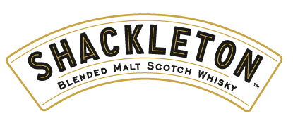
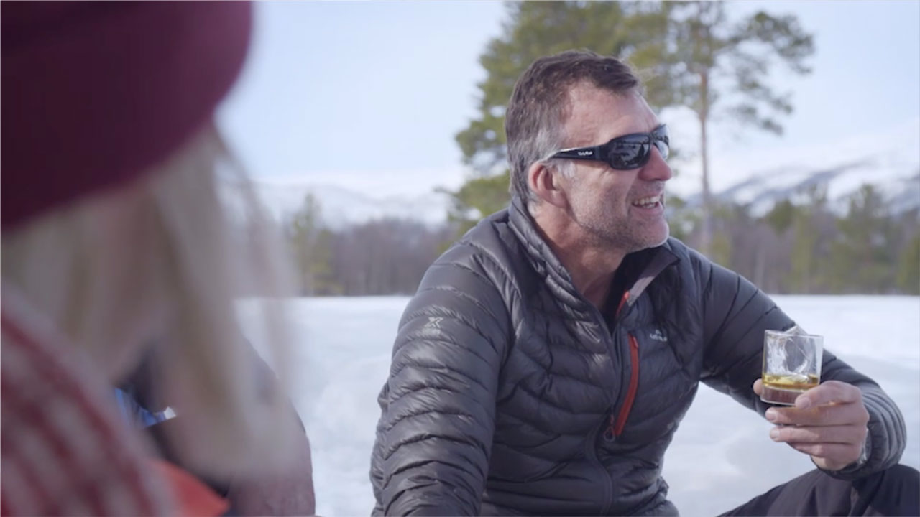
Shackleton Whisky – chasing the big adventure
Challenge
Whyte and Mackay set ambitious targets for their brand Shackleton Whisky – to grow value sales by 25% and volume sales by 33%. This was made harder by a limited budget and higher spending competitors.
The additional objective was to position the brand as adventurous to showcase the brand personality
Solution
Three month partnership with Nat Geo and Nat Geo Wild with a creative strategy of “Born Adventurous”
Results
Volume sales up 47%
Prompted awareness increased by 41%
Notes:
The Challenge
Launched in 2017, Shackleton Whisky is a blended highland malt inspired by one of the world's greatest explorers, Sir Ernest Shackleton and is based on the recreation of the whisky found beneath the ice 100 years after he took it on an Antarctic expedition.
Since launch, growth has been steady but Whyte and Mackay, the brand owners, felt that this product which tasted great and had excellent distribution should be growing faster than it was.
They tasked their media agency, Republic of Media, to illustrate the adventurous spirit of the whisky and make Shackleton the fastest growing blended malt in the UK.
There were ambitious targets:
Increase value sales by 25% YoY
Increase volume sales by 33% YoY
The challenge was made harder by the fact that the marketing budget was tight and they were being outspent by their competitors.
The TV Solution
Research conducted by Republic of Media led them to the conclusion that the target audience are more interested in the image of the brand rather than the merits of the liquid and that there was a gap in the market to position Shackleton as the whisky of choice for the adventurous.
They developed a strategy that was about chasing the big adventure. They wanted to drive awareness within the core target audience and build a campaign around the emotive theme of adventure – a space that no other brand was competing in.
A creative idea was developed with the strapline “Born Adventurous”, as adventure was rooted in the heritage of Shackleton. They decided that a TV partnership was the best route. It meant that they could tell the Shackleton story with TV’s storytelling prowess and position Shackleton as adventurous with the emotive power of AV. In addition, the campaign would feel big to those who saw it as, even with a small budget, they could reach a large number of the right people if they chose the best vehicle.
The Plan
They selected a partnership with National Geographic, which ran from September to November 2019. It involved a three-month linear sponsorship on Nat Geo, 200 hours of linear sponsorship on Nat Geo Wild and the creation of a hub where viewers could find out more about the story of Shackleton.
Aligning with a respected and credible brand such as Nat Geo gave Shackleton a voice to tell their story and they benefitted from the brand rub of Nat Geo’s trusted credentials. The frequency of message amongst the core target audience provided the perception of a large-scale TV campaign.
To launch the campaign, there was a social post from Nat Geo, but the main support media were print and OOH. The Guardian provided the opportunity to tell the Shackleton story in long form and 16 panels at Waterloo Station surrounded commuters with the adventurous spirit of Shackleton, encouraging consumers to breakout of commuting life and have their own adventure.
Results
Volume sales were up by 47%
Prompted awareness amongst all adults increased by 41%
Prompted awareness of Shackleton amongst modern spirit drinkers increased by 28%
National Geographic’s tracking showed that the campaign pushed the brand towards being viewed as more unique, adventurous and authentic among those exposed to the campaign
The campaign positioned Shackleton Whisky as a brand apart from other blended malts in the market and was seen as adventurous and truly different from the other brands surveyed
The campaign was a finalist in Best Use of Sponsorship at the TV Planning Awards 2020

