Slide 1
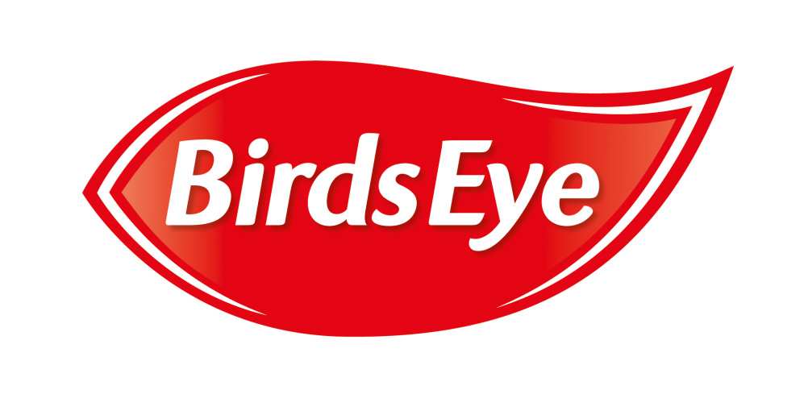
Birds Eye – from stormy seas to plain sailing
Challenge
Revenue decline, aggressive competition and negative consumer perceptions of frozen food was placing its core business at risk
The challenge was to stem sales decline, drive a turnaround to growth and reclaim position as category leader
Solution
Three pillar strategy – focus on the most profitable products, have fewer but bigger and better campaigns and be distinctive to reinforce memory structures already associated with Birds Eye
Results
17% uplift in awareness
Sales moved from 6% decline to 4% growth
Notes:
The Challenge
Birds Eye was once an iconic and well-loved brand, but three consecutive years of revenue decline had turned it into a dusty ‘almost’ heritage brand. Aggressive competition from private label brands, coupled with negative consumer perceptions of frozen food, placed its core business at risk as it haemorrhaged sales with seemingly no solution in sight.
Bird Eye’s communication plan wasn’t working. Their Master Brand strategy, whilst an efficient way to communicate multiple products, was weak in terms of impact and communications effectiveness. There was also too much focus and investment behind new product development, to the detriment of the core products which had made the brand famous.
Something had to change to stop Birds Eye sinking without a trace. The task was clear, if daunting: stem sales decline, drive a turnaround to growth and reclaim Birds Eye’s position as category leader in frozen foods. To achieve this, they needed to reawaken UK consumers latent affection for Birds Eye - and what better channel to lead the charge than TV? TV was where the brand was first built, with its TV adverts stretching as far back as the 1950s.
The TV Solution
Birds Eye worked with their agencies Grey and Zenith to develop a simple strategy, with three clear pillars, to steady the ship and re-launch the brand in 2016:
Focus on the core – support the most profitable products: Fish Fingers, Coated Fish, Peas, and Chicken
Fewer, Bigger, Better – support fewer campaigns and make them count, ensuring sufficient weights only on channels that yield the highest ROI
Be distinctive – whenever possible, build and reinforce existing memory structures that are already associated with Birds Eye
Birds Eye’s single-minded growth strategy meant media investment should only focus on the most profitable products. The key role for media was to drive penetration and rebuild brand equity to show consumers that Birds Eye was worth paying (a little) more for.
Three key insights formed Zenith’s media approach. Nielsen data showed that light buyers represented 87% of the category and accounted for 50% of volume, that overall reach (rather than frequency) delivers the greatest profit, and that every week is a penetration opportunity. This made a clear task for media: drive penetration by maximising weekly net reach across all channels and maximise weeks on air. This meant a single-minded AV approach for each of the most profitable products.
TV, VOD and Paid Social Video were the core channels identified by Zenith’s modelling as delivering the best ROI and brand outcomes. IPSOS learnings also showed that to establish a TVC effectively a minimum of 700 TVRs were required for launch, along with a minimum threshold of 1400 TVRs over 12 months. They also needed to maximise weeks on air as a priority metric, which meant a maximum of 6 weeks off air between bursts in the year.
When it came to the creative, Birds Eye already had one particularly memorable icon in its armoury – Captain Birds Eye. However, despite maintaining significant latent awareness, he had not been on screens for over a decade. His return was reinvented for a modern generation and saw a contemporary looking Captain step onto the deck, revealing a genuine, authentic side of his character. The advert marked a major change in direction, reinforcing Birds Eye as a trusted, credible brand that provides quality food, while still paying homage to its adventurous spirit.
The Plan
The challenge now was to make the new Captain as famous and distinctive as the old one. TV was, naturally, the hero lead channel which could make this happen.
A different approach was needed from Birds Eye’s usual media strategy to transform the communication to consumers. Through sacrificing some expensive peak airtime in return for a lower cost daypart strategy and using predominately 20” copy, Zenith adopted a ‘recency’ approach to their TV investment. Limiting weekly weights to 80-100 TVRs meant they were able to optimise the communication to 30% +1 cover every week, as well as limiting excess frequency build. In return, this released enough budget for each of the identified core products to have a more consistent weekly presence. Zenith also upweighted the daytime daypart to increase the presence and salience around mealtimes.
The revised TV buying strategy, streamlining of media channel selection and small increase in overall media investment combined to increase Birds Eye’s presence on TV from 26 weeks across the year to 50 weeks on air. To maximise volume sales, Zenith ensured the TV plan closely aligned to key in-store promotional activities.
With the goal to maximise weekly +1 reach, VOD was essential to enable Birds Eye to reach light TV viewers and deliver incremental reach to TV. VOD investment was increased (from c.12% of total AV budget at the beginning up to 20% today) and was spread across a mix of broadcaster VOD, YouTube and short-form video. 15% of Birds Eye’s overall budget was put into paid social video to help capture the shifting media habits of their audience.
Results
The turnaround strategy for Birds Eye, with TV at its heart, quickly strengthened brand equity and base sales.
Top of mind awareness increased from 29% to 34% year-on-year – a 17% uplift
Improved scores were seen on all brand tracking statements, helping to drive brand image through heritage, taste and trust.
YouGov Brand Index awarded Birds Eye the most improved ‘Brand Buzz’ in the frozen/chilled category
Sales were turned from declining 5% each year to being +1% in 2017 vs the previous year, less than 18 months into the new communication model. Importantly, this growth was coming from the core products they had chosen to support in media, moving from a 6% year-on-year sales decline to 4% growth.
The success continued into 2018 where Birds Eye closed out the year with a strong performance, with retail sales value up +3.4% (over £17m) while the category struggled to grow (-0.2%).
Nielson Econometric modelling isolated media – particularly TV’s – contribution to Birds Eye’s successful turnaround. Even with a 42% increase in TV investment budget, TV ROI improved by 24%. Short-term communication (Media) contributed 2.1% (up from 1.4% in 2016), and finally, aligning media with promotional activity drove 1.9% incremental volume sales.

