Slide 1
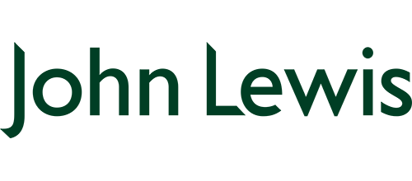
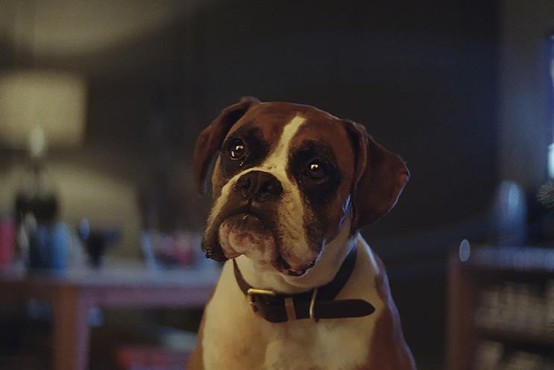
John Lewis innovates with on demand advertising
Challenge
John Lewis wanted to create the most innovative and impactful launch of their Christmas ad
Solution
A media first, making the ad exclusively available to download via Sky’s EPG
Created a raft of additional content for deeper engagement and implemented several innovations to encourage repeat on demand viewing
Launch involved full take over and roadblock on linear, VoD and Sky Go
Results
John Lewis achieved a 4.9% increase in sales, totalling £998m – their biggest Christmas ever
It was the biggest single day download ever with nearly 900,000 downloads
Notes:
The Challenge
John Lewis advertising is recognised as signalling the start of Christmas and each year is hotly anticipated. This cultural moment creates a unique environment, blurring the lines between advertising and entertainment with people actively seeking out advertising, commenting and sharing it.
In the past 12 months, retailers have increased their media spending at Christmas by 20% to over £185m. John Lewis’s share of voice is only 4% so they are operating in a highly competitive market. They tasked their media agency Manning Gottlieb OMD to bring freshness to the John Lewis Christmas campaign for 2016.
The Solution
MGOMD knew that the storytelling style of the Christmases ad would fit well on TV. In addition, they knew that the TV screen is the best for driving an emotional connection with the brand and also that viewers were watching more content on demand these days. So, working with Sky, they created the first ever ‘on-demand’ launch where viewers could watch the new ad whenever and wherever they wanted, as many times as they liked across any device.
Alongside the ad, additional content was also available in the form of a behind the scenes ‘making of’ the ad and a mini programme hosted by Sky talent Patrick Aryee looking at the urban living patterns of the animals featured in the ad.
Phase 1: The Binge View
On 10th November at 8am, the campaign launched on Sky’s 12 million set top boxes. For four days, viewers accessing the homepage of the EPG were met with an image of the John Lewis Christmas ad in a prominent position. They could then download the ad whenever they wished to see it
Phase 2: Catch up
The content remained available to search and view within the Sky system until 26th December.
Also:
A special 10 second ‘outro’ bumper to encourage viewers to visit the EPG
On launch day, there was a full takeover and roadblock at 8pm. This involved the full length 120” ad plus a bespoke 10” outro and link to the EPG
In the second phase, there was a cut down version of the ad, but viewers could press the red button to view the longer ad if they wished
Results
John Lewis achieved a 4.9% increase in sales, totalling £998m – their biggest Christmas ever
It was the biggest single day download ever with nearly 900,000 downloads
John Lewis content was over ten times bigger than the next biggest programme on launch day
Over 22,000 Buster the Boxer soft toys sold in the first two hours
Winner of ‘Best Use of TV Innovation’ in TV Planning Awards
To read the full case study and watch the ad visit: https://www.thinkbox.tv/Case-studies/John-Lewis-innovate-with-on-demand-advertising

