Slide 1
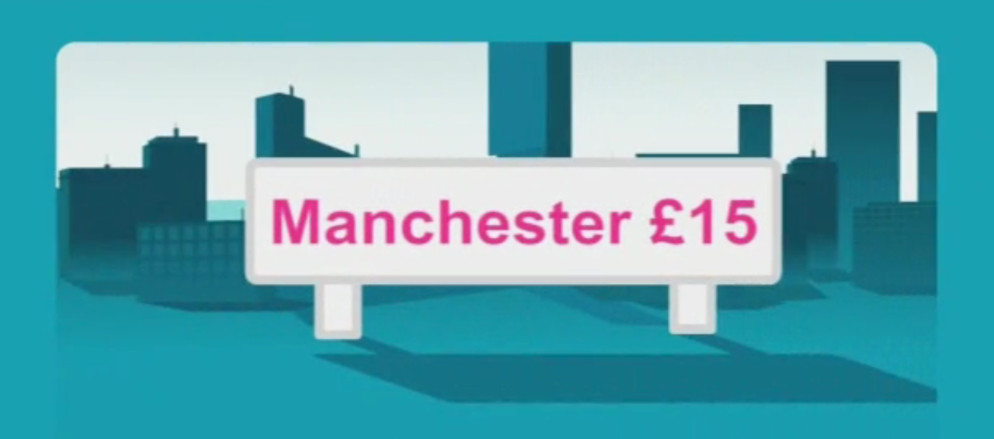
Arriva Trains use TV as a platform for success
Challenge
Arriva wanted to promote their reduced ticket prices for the 55+ market
Needed a TV solution that would demonstrate that Arriva Trains offers great value for money and is a convenient transport solution
Solution
A 56 spot campaign was bought across ITV1 Wales in afternoon programming across a period of 29 days
Results
Over 580,000 adults saw the commercial at least once, and over 200,000 saw the commercial at least four times
Sales target of 14,000 ticket sales was smashed by over 140% with over 34,000 tickets sold
A second campaign was then booked as a result of the success of the first
Notes:
Challenge:
Arriva Trains had previously used local radio to promote its Club55 ticket offers. They had wanted to use TV but were concerned about potential return on investment.
Arriva wanted to target the 55+ market and also to raise the profile and identity of the brand. They needed a TV solution that would demonstrate to the public that Arriva Trains offers great value for money and is a convenient transport solution.
Their specific objective was to achieve 14,000 ticket sales during the campaign.
Solution:
ITV1 seemed like the ideal solution as it provided a regional option and also offered appropriate programming for the target audience on weekday afternoons.
The campaign consisted of 56 spots bought across ITV1 Wales in afternoon programming from Monday to Friday across a period of 29 days. The spots appeared in programmes such as Loose Women, 60 Minute Makeover, The Alan Titchmarsh Show and Midsomer Murders.
Creatively they needed an ad that would appeal directly to their target audience. They wanted a simple no frills commercial informing people of their great deals, showcasing the cheap prices and the different destinations as well as featuring the URL and a contact number to drive people online to buy the tickets or to find out more information.
The TV campaign was supported by radio advertising.
Results:
Over 580,000 adults saw the commercial at least once, and over 200,000 saw the commercial at least four times.
Arriva Trains was hoping for approximately 14,000 ticket sales as a result of the advertising – in fact this sales target was smashed by over 140% as over 34,000 tickets were sold.
Arriva Trains went on to book a second campaign in 2010 as a result of the success of the first.
For the full case study and to view the ad campaigns visit: https://www.thinkbox.tv/Case-studies/Arriva-Trains

