Slide 1
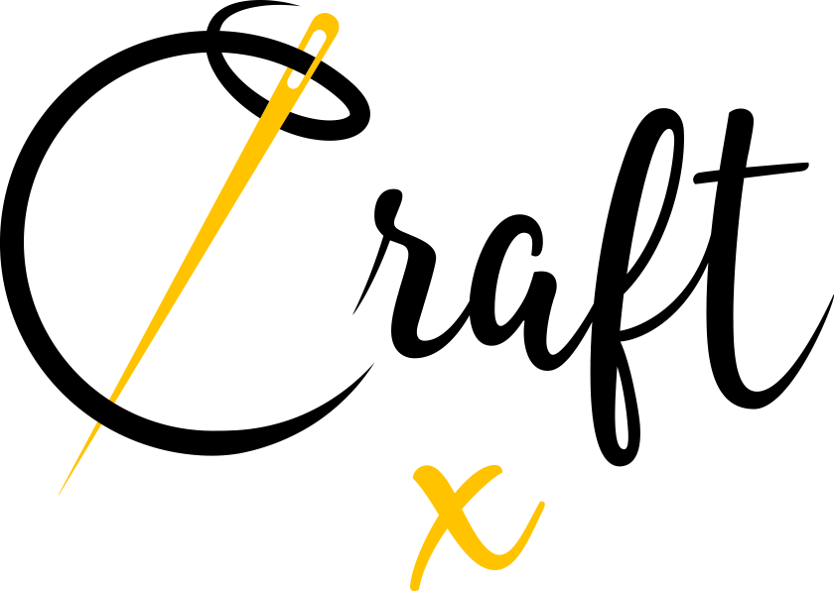
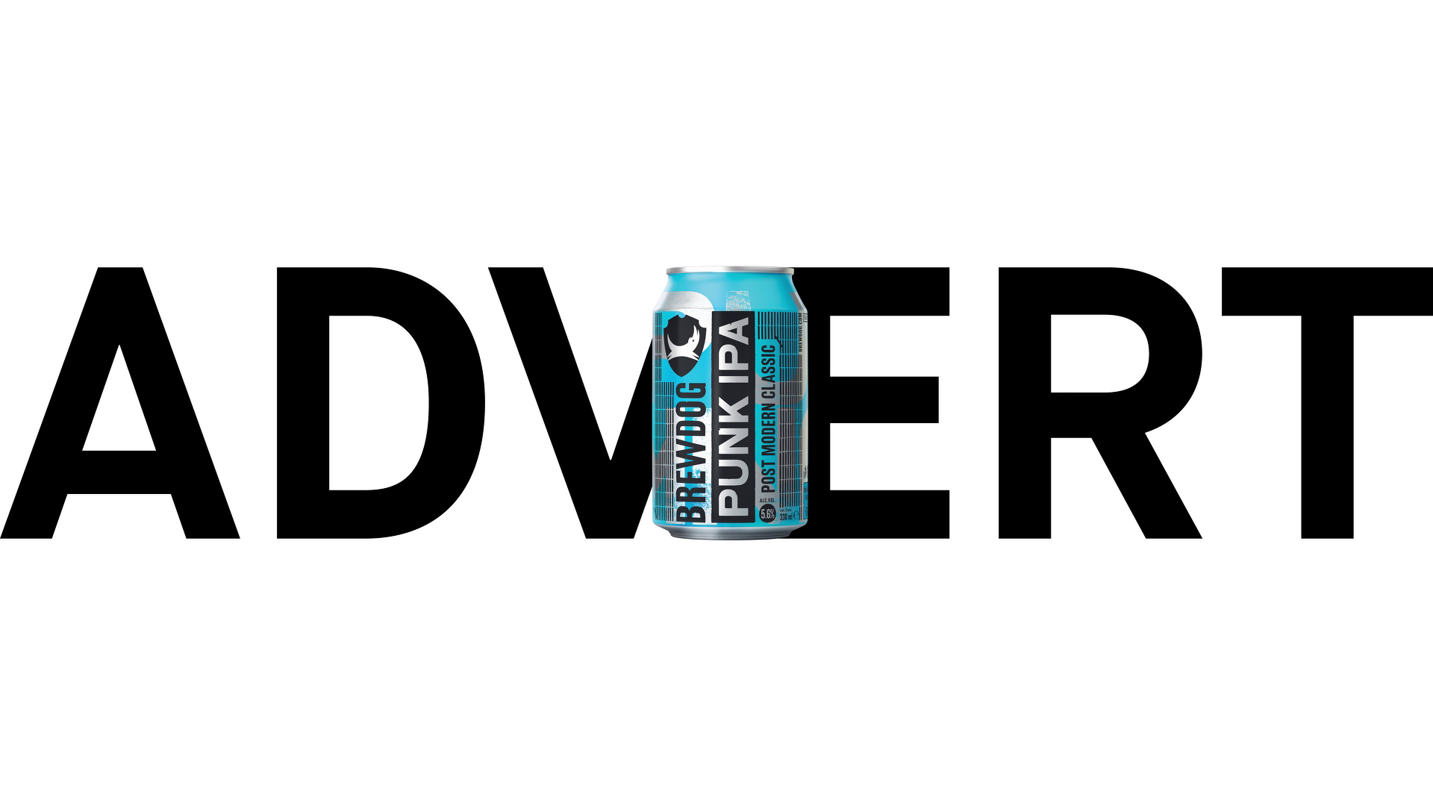
BrewDog: using TV to claim an unfair share of attention
Challenge
With brand growth slowing, BrewDog needed to encourage product trial from new customers.
Solution
Using selected TV spots for the first time provided the perfect opportunity to get noticed and drive online conversation.
With a loud creative, a bold approach was taken to stand out and keep the spirit of ‘punk’ alive. This included a selection of ‘anti-context’ spots.
Results
Awareness quadrupled for key target groups.
Ad awareness overtook two category leaders.
The campaign won Best Newcomer at the TV Planning Awards 2020.
Notes:
The Challenge
In 2019, BrewDog was reaching a natural ceiling, a point where growth from the existing buyers of the brand was levelling off. Category data showed that while 54% of beer drinkers knew BrewDog, only 18% had ever tried the brand. However, research showed that three quarters of beer drinkers were keen on trying new brands.
With a punchy off-trade sales target and comms budget well below the category average, Craft Media, Uncommon and Goodstuff, knew a brave approach was needed.
The TV Solution
Craft Media’s comms strategy was simple: get noticed, really noticed.
They worked to understand the shape and programming of the TV market to create a media plan which matched the creative ambition. This ensured they would be able to execute a small TV budget to maximum effect.
To achieve this, they decided to act in contrast to how most beer/lager brands behave, but in line with how consumers watch TV and talk about their favourite content.
If they couldn’t compete with competitors when it came to pure TVRs, what they could do was maximise effect by picking shows which generated the greatest level of Twitter conversation.
The Plan
Despite being an expensive month to advertise on TV, May is also a key month for beer and lager brands to drive trial and summer sales, so Craft Media and Goodstuff knew TV activity during this period was necessary.
A bold approach was needed to get BrewDog noticed during a competitive time of year. This involved buying only peak airtime and first in break spots as often as possible.
Just 11 spots were hand-picked with three criteria in mind.
1. Twitter conversation
Love Island, Game of Thrones, 8 Out of 10 Cats and The Last Leg were selected on the basis that they generated high levels of chatter around the content. This gave BrewDog the best chance of provoking a reaction from a highly engaged audience.
2. Context spots
With an attention-grabbing heavy metal track in the creative, Craft Media and Goodstuff were keen to select spots around content where the brand would fit in and there was a good target audience match. Alongside Game of Thrones – which met this criterion – The FA Cup final on BT Sport was also chosen for its presence in pubs and living rooms at half-time.
3. Anti-context spots
The creative was loud and blunt, so the agencies saw an opportunity to keep the spirit of ‘punk’ alive in the TV plan and make the most of BrewDog’s distinctive brand assets. They chose a selection of ‘anti-context spots’ which had an audience match, but the creative would contrast with the programme content. In addition to Love Island, spots in First Dates and Celebrity Juice were chosen to achieve this.
To support the TV activity, the media plan also included advertising in cinemas, out of home and on Instagram.
Results
Awareness and consideration quadrupled amongst women and beer and lager drinkers/buyers.
Ad awareness overtook two category leaders, both of whom had multimillion-pound campaigns running Awareneat the same time.
The campaign won Best Newcomer at the TV Planning Awards 2020.

