Slide 1
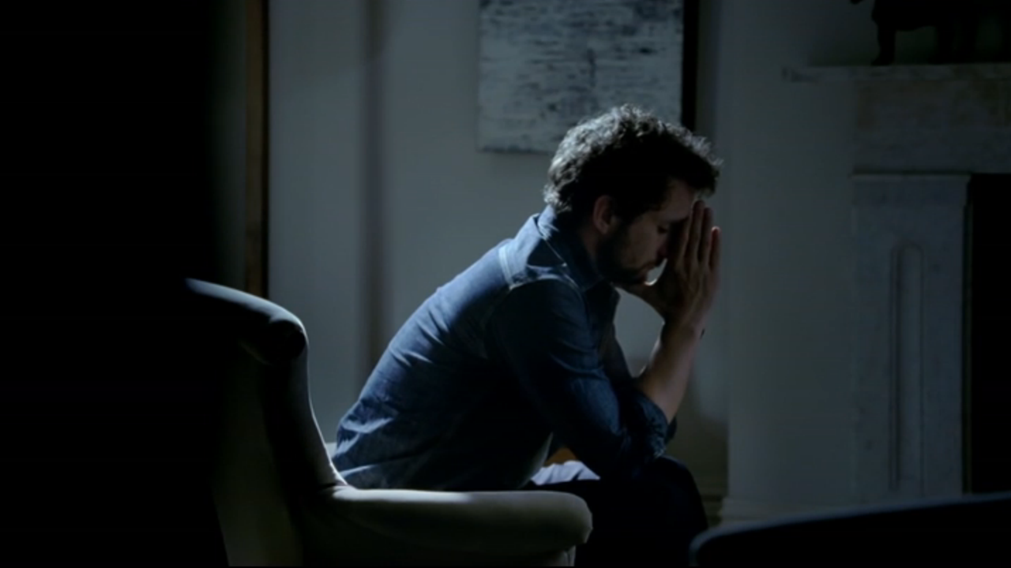
ADT used TV to reposition brand
Challenge
ADT wanted to reposition the brand whilst simultaneously driving enquiries
The challenge was to grow the home security market by creating a perception of home security as a utility that no home could be without
Solution
TV allowed ADT to convey the emotional trauma of being burgled and to portray ADT as the preventer of this genuine, emotional turmoil
Campaign used a combination of brand and DRTV with relevant, targeted programmes
Results
9% increase in overall sales
26% increase in appointments
Notes:
The Challenge
ADT is the only truly national residential and commercial security provider in the UK that offers professionally installed monitored alarm systems. They account for around 90% of all monitored sales within the UK residential market but, although they are the market leader, they have not yet become a household name, as they have in the US.
The challenge was to grow this home security market by creating a perception of home security as a ‘utility’ that no home could be without. By taking the lead in this market development, ADT hoped to establish themselves as the leader in the field, synonymous with home security.
They needed to increase the number of appointments booked as well as the amount of units sold and to do it all with the same budget level as the previous year. This meant creating brand preference and also communicating the benefits of ADT in a compelling way that would shake the audience from their inertia.
The Red Brick Road were appointed in June 2012 to develop a position that could revolutionise the way consumers thought about residential home security and ultimately inspire action.
The Solution:
Through primary and secondary consumer research, a powerful human truth was uncovered: the emotional effects of being burgled far outweighed the loss of any material possessions.
Therefore the creative work did not focus on the loss of material possessions, but instead emphasised that the true cost of burglary is the emotional impact it has. It was felt that few people who hadn’t been burgled before would have ever thought about this truth and that it would evoke a far more powerful response. This was dramatized in the line: ”It’s not just what they take, it’s what they leave behind.”
Most alarm systems are bought by people who have experienced the traumatic after-effects of burglary either first or second hand. By portraying these feelings in the right way, a powerful piece of advertising could be created. The key was to be hard-hitting without scaremongering and the line between the two is very fine, but it was important to move from a more traditional, rational narrative, towards an emotive one.
The best place to reach this audience was in their homes, the very places that needed the protection that ADT offered. TV was the obvious choice, not only because it is mainly consumed within the home, but also because of TV’s ability to connect with an audience emotionally. TV allowed ADT to convey powerfully the emotional trauma of being burgled and to place ADT as the preventer of this genuine, emotional turmoil. The TV campaign was launched in early September 2012 with a 30” brand TV ad and a 40” DRTV edit.
These beautifully and sensitively shot ads show contemplative and anxious looking individuals – victims of burglary – lost in a moment or over-reacting to an everyday sound. The voiceover explains, ‘at ADT we understand the real cost of burglary is not just what they take, it’s what they leave behind…’. Tension is built with quick edits and a soundtrack of real-life sounds captured during the shoot. The result is discomforting, until the calming resolve at the end that heroes ADT, accompanied by the voiceover, ‘…that’s why our monitored alarms offer round the clock security for round the clock peace of mind. ADT. Always there.’
In terms of media buying, a dual DRTV and Brand Television strategy was implemented. The Direct Response activity focused on providing consumers with the necessary information to take action and consisted of running 40” spots during weekday daytime on the most efficient television stations based upon historic response data. The brand ads consisted of running 30” spots in peak clock hours across:-
A mixture of cost-efficient multichannel stations that profile well against the ADT customer profile.
Higher profile ITV1 and CH4 bought nationally but up-weighted around ADT regions of sales strength.
Highly relevant and targeted programmes around home and crime content were also bought where available.
The TV campaign was supported by radio, PR and online.
Results
26% increase in appointments versus the last TV ad, with the same spend, run on the same dates
9% increase in overall sales
ADT broke the 800/week appointment barrier for only the third time in its history during October and November, the previous two occasions being in January which has always been the prime sales month
The ad so successfully drove leads that the campaign had to be taken off air while ADT revised lead handling operations to cope with volume
Shortlisted in the Thinkbox TV Planning awards in the category “Best Use of TV in an Integrated campaign”
To read the full case study and access the creative visit: https://www.thinkbox.tv/Case-studies/ADT

