Slide 1


Young people & TV
Deliveroo – Unexpected Guests

Slide 2
For 16-34s, total viewing is consistent across the year
16-34 – All devices
Source: Barb, 2025. 16-34. Online Multiple Screens Network
Notes:
This chart looks at Barb’s audience reporting capabilities. The focal meter data provides further insight into SVOD and video-sharing platforms to provide a view on ‘total identified viewing’ which includes:
Total broadcaster viewing – represents the time spent watching linear broadcast channels and broadcaster-owned VOD services (BVOD). This includes live viewing, as well as pre- and post broadcast viewing, and viewing to archive box-sets on a BVOD service. We capture and report this viewing across four screens — TV sets, tablets, PCs and smartphones. For tagged services, this includes any streaming regardless of whether it was through the home WiFi network.
Total SVOD/AVOD viewing - includes 19 VOD services — notably Amazon Prime Video, Disney+ and Netflix. Viewing is reported on all four screens, although this only includes viewing through a home’s WiFi network.
Total video-sharing– includes viewing — again on all four screens — to platforms such as TikTok, Twitch and YouTube. Our audience reporting for video-sharing platforms only includes viewing through a home WiFi network.

Slide 3
More seasonality seen in TV viewing, video-sharing flatter
16-34 – All devices
Source: Barb, 2025, Online Multiple Screens Network, 16-34, All devices
Notes:
Viewing to broadcaster content and SVOD platforms follow a seasonal trend for younger audiences, whilst viewing to video sharing services was broadly consistent.

Slide 4
Across the majority of the day, TV viewing is at a much higher level than video-sharing consumption
16-34s – All devices
Source: Barb, 16-34, Online Multiple Screens Network, All devices, daypart by hour, 2025. Total TV = Broadcaster TV, SVODs & AVODs
Notes:
For younger audiences, video-sharing platforms peaks later than other platforms.

Slide 5
Broadcasters deliver the largest scale for 16-34s compared to other commercial platforms on the TV set
16-34 – Commercial TV Set
Bubble area represents total volume of daily viewing
AVERAGE DAILY REACH (000s)
Other AVOD
TikTok
Twitch
AVE TIME VIEWED PER VIEWER PER DAY
Source: Barb, 16-34, TV Sets, 2025, Netflix, Prime & Disney+ Ad Tiers.
*Disney+ data available from 17th March 2025
Notes:
This chart breaks down viewing to the various platforms in terms of the average number of adults watching per day (for at least 3 minutes) on a TV set compared with the average time spent watching per viewer (i.e. only counting those who watched on that day).
Analysis across 2025 shows that the commercial broadcasters (linear and on demand) collectively reach 3.4 million adult viewers every day, with each of those viewers watching for an average of 2hrs, 10 mins a day. YouTube has a daily reach of 2.4 million adults and a view time of 2hrs 15 mins.
The ad-tier side of SVOD services such as Netflix has a daily reach of 0.8 million people and a view time of 2hr 1 min.

Slide 6




For 16-34s, TV sets account for 62% of total video viewing
 | Total TV | YouTube | TikTok | All other online video | % of all video time
 | 87.7% | 40.4% | 0.6% | 6.3% | 62.2%
 | 4.9% | 21.1% | 1.3% | 63.3% | 9.9%
 | 3.1% | 5.7% | 2.7% | 2.0% | 3.8%
 | 4.3% | 32.8% | 95.4% | 28.4% | 24.1%
Source: Barb 2025, Total TV = Broadcaster TV, Total SVOD/AVOD

Slide 7
For 16-34s, TV sets have the largest share of total viewing
Smartphones
Tablets
PCs
TV Sets
Source: Barb, 2025. 16-34s. Online Multiple Screens Network
Notes:
Analysis from Barb shows that the majority of total identified was spent watching broadcaster channels and VOD services.
In terms of devices, the TV set is the most popular screen for broadcaster viewing and SVOD/AVOD viewing. For video-sharing services like YouTube, TV set viewing accounts for a smaller proportion.
* Total identified viewing includes:
Total broadcaster viewing – this represents the time spent watching linear broadcast TV channels and broadcaster-owned VOD services (BVOD). This includes live viewing, as well as pre- and post-broadcast viewing, and viewing to archive box-sets on a BVOD service. This is reported across four screens — TV sets, tablets, PCs, and smartphones — by gathering information about what is streamed through the home Wi-Fi network. For tagged services that share their own census level data with Barb, this includes any streaming regardless of whether it was through the home Wi-Fi network or not.
Total SVOD/AVOD viewing – this covers 19 VOD services, notably Amazon Prime Video, Disney+, and Netflix. Viewing is reported on all four screens, although this only includes viewing through a home’s Wi-Fi network as these services are not tagged.
Total video-sharing – this covers the use of platforms such as TikTok, Twitch, and YouTube. As with SVOD/AVOD viewing, reporting for video-sharing platforms only includes viewing through a home Wi-Fi network on all four screens.

Slide 8
For 16-34s, Total TV accounted for 82% of TV set viewing
1 hrs 55 mins
Source: 2025, Barb / IPA TouchPoints 2025
Total TV = Broadcaster TV, SVODs & AVODs. TV set only.
Notes:
Methodology
The quantitative analysis of total video consumption in the UK was undertaken by Thinkbox. It combined 2025 data from Barb and the IPA’s TouchPoints.
Barb data shows how much time is spent viewing broadcaster content, live or time-shifted (including BVOD) on all devices as well as Blu-Ray/DVD viewing. This chart also utilises Barb’s expanding audience reporting capabilities to provide a view of time spent viewing content on YouTube, TikTok, other video sharing services (such as Twitch) as well as SVOD/AVOD platforms. Whilst Barb reports on in-home consumption, a combination of Ipsos Iris and IPA TouchPoints data was used to determine the remaining out-of-home consumption.
The combination of these sources creates a solid estimate as it utilises the robustness of Barb data (11,500 panel members, representative of the UK TV population, metered actual consumption data, analysis across a whole year) alongside Ipsos Iris and IPA TouchPoints data to capture any out-of-home consumption.

Slide 9
Three ways to watch Total TV
Adults
16-34
3 hrs 26 mins
1 hr 47 mins
Source: 2025, Barb, Thinkbox estimates VOD includes Broadcaster VOD, SVOD and AVOD
Notes:
Breaking down Total TV into the different ways reveals the increasingly important role of Live and VOD viewing.
This data uses both Barb data and includes an estimate of any unknown viewing that is thought to fall into Playback and Live viewing.

Slide 10
16-34s spend more time with TV advertising than YouTube and TikTok combined
14%
48%
16-34s
Ad time per day: 8:58
33%
Source: 2025, Barb / Broadcaster stream data / UK Cinema Association / Ipsos Iris
**YouTube ad time modelled at 3.33% of content time (Enders Analysis, 23rd October 2024) and excludes those estimated to be on the YouTube Premium tier. *TikTok ad time modelled at 3.4% of content time using agency and broadcaster estimates. **Other online modelled at 3.33% of content time.
Notes:
Without a single source data provider on time-spent watching AV advertising, this analysis takes a jigsaw approach, using a variety of data sources to build the most accurate picture of AV viewing time possible.
The data approach used to build the estimate for each platform:
Total TV: Barb data for Total TV (broadcaster and SVOD/AVOD services) and the broadcasters’ own census data for BVOD advertising viewing time.
Cinema: The UK Cinema Association provides total box office seats sold. We’ve estimated 15 minutes of advertising per seat.
YouTube: Ad time modelled at 3.33% of content time (Enders Analysis, 23rd October 2024) and excludes those estimated to be on the YouTube Premium tier.
TikTok: Ad time modelled at 3.4% of content time using agency and broadcaster estimates.
Other online video: ad time modelled at 3.33% of content time.

Slide 11
Now even easier to reach 16-34s with TV advertising
All Adults
16-34 Adults
Source: Barb 2025 – TV set viewing, proportion of total viewer minutes that are ad supported
Notes:
Even though the world is fragmenting, it’s actually easier to reach audiences.

Slide 12
VOD viewing is more prominent among younger audiences
Source: Barb, 2022-2025, Online multiple screens, All devices, Commercial broadcaster VOD and SVOD’s.
Notes:
VOD viewing is more prominent among younger audiences.

Slide 13
Addressable drives incremental cover for 16-34s
Audience: 16-34
Source: Barb BVOD Planner (2025, 6 weeks 9-14) / natural delivery / station average prices. Addressable includes BVOD & SVOD Ad Tiers (Netflix, Disney+, and Prime Video).

Slide 14
VOD enabling 16-34s to watch more entertainment, drama & films
16-34 – TV set
MINUTES PER PERSON PER DAY
Source: Barb - TV set only, 16-34s, 2025
Notes:
This data highlights how both the content 16-34s watch and the way they watch it are changing.
Last year, 16-34s spent more time watching Entertainment, Drama, and Film, and video on demand was a key driver. VOD offers the choice and control that viewers seek for this type of content.
However, Sport, News, Hobbies, and Current Affairs are still predominantly consumed through linear TV.

Slide 15







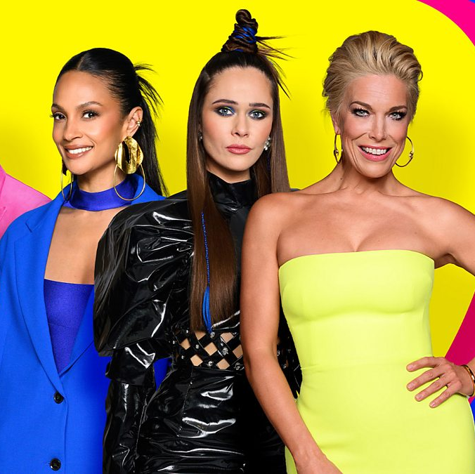


16-34 Top TV programmes 2025 (All devices)
The Celebrity Traitors
BBC 1, 6 Nov
3,106,686
I'm a Celebrity... Get Me Out of Here!
ITV1, 16 Nov
2,596,235
The Traitors
BBC 1, 17 Jan
2,262,985
New Year's Eve Fireworks
BBC 1, 31 Dec
1,823,870
The Apprentice
BBC 1, 6 Mar
1,416,929
The Great British Bake Off
Channel 4, 2 Sep
1,364,135
Love Island
ITV2, 11 Jul
1,359,259
Eurovision Song Contest
BBC 1, 17 May
1,225,224
Amandaland
BBC 1, 25 Dec
1,168,353
Love Island All Stars
ITV2, 4 Feb
1,157,498
Source: Barb, 2025, 16-34. Average audience figures. TV and / or Online Network. TV and Online Pre-Broadcast 1-28 days. Top performing episode only.
Notes:
Top TV programme 2025 for 16-34’s (All devices).
In 2025, The Celebrity Traitors emerged as the top TV programme of the year, pulling an average audience of 3.1 million viewers.

