Slide 1
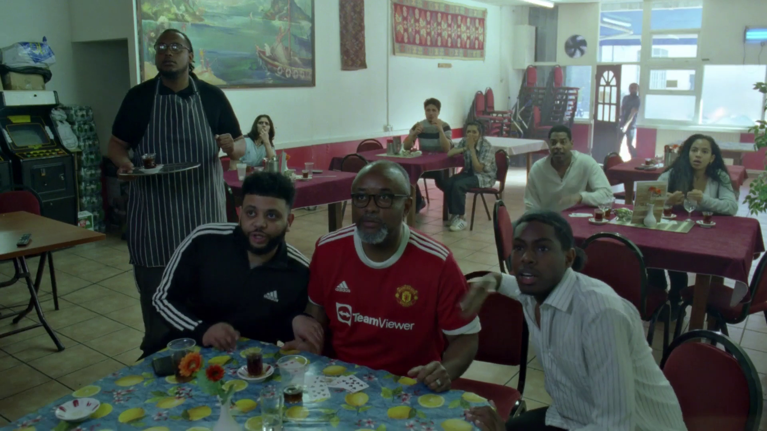

Young people & TV
Adidas – Hey Jude

Slide 2
Broadcaster TV accounts for 22% of 16-34s’ video day
ALL INDIVIDUALS
Average video time per day
All Individuals: 4 hrs, 47 mins
16-34
16-34s: 4 hrs, 32 mins
Source: 2024, Barb / IPA TouchPoints / Pornhub / UK Cinema Association / Ipsos Iris
Notes:
Broadcaster TV accounts for 54.3% of video viewing for all individuals and 21.7% for 16-34s.
Methodology
The quantitative analysis of total video consumption in the UK was undertaken by Thinkbox. It combined 2024 data from Barb, the IPA’s TouchPoints, Pornhub, UK Cinema Association, and Ipsos Iris.
Barb data shows how much time is spent viewing broadcaster content, live or time-shifted (including BVOD) on all devices as well as Blu-Ray/DVD viewing. This chart also utilises Barb’s expanding audience reporting capabilities to provide a view of time spent viewing content on YouTube, TikTok, other video sharing services (such as Twitch) as well as SVOD/AVOD platforms. Whilst Barb reports on in-home consumption, a combination of Ipsos Iris and IPA TouchPoints data was used to determine the remaining out-of-home consumption.
The combination of these sources creates a solid estimate as it utilises the robustness of Barb data (11,500 panel members, representative of the UK TV population, metered actual consumption data, analysis across a whole year) alongside Ipsos Iris and IPA TouchPoints data to capture any out-of-home consumption.
Time spent viewing video at cinemas was based on total admissions data from the UK Cinema Association profiled for each audience using data from DCM.
Source: Ipsos iris Online Audience Measurement Service, 12-month average Jan – Dec 2024. Internet users aged 15+, using PC/laptop, smartphone or tablet device.
Technical note: [Broadcaster] data for YouTube includes content owner data for the BBC, Channel 4, CNBC, ITV, NBC and Sky. [Commercial broadcaster] data for YouTube includes content owner data for Channel 4, CNBC, ITV, NBC and Sky. TikTok data is both website and app.
Ipsos iris is the UKOM endorsed service for the measurement of audiences of online content. We passively track the online behaviour of a single-source panel of over 10,000 UK adults, who install software across their devices (a combination of smartphones, tablets, PCs and laptops). The panel is recruited to be representative of the internet population demographically, geographically and by device type. This passive data is fused with anonymous, device-level data derived from site-centric tags on hundreds of the biggest sites and apps to create a synthetic panel of around 1 million synthetic panellists. More detail on the methodology can be found here.

Slide 3
All Individuals
Average video advertising time per day
All Individuals: 18:05
16-34s: 9:49
Broadcasters account for over 53% of all video advertising for 16-34s
16-34s
Source: 2024, Barb / Broadcaster stream data / UK Cinema Association / Ipsos Iris
**YouTube ad time modelled at 3.33% of content time (Enders Analysis, 23rd October 2024) and excludes those estimated to be on the YouTube Premium tier. *TikTok ad time modelled at 3.4% of content time using agency and broadcaster estimates. **Other online modelled at 3.33% of content time.
Notes:
Broadcaster TV & SVOD accounts for 85.0% of all AV advertising time

Slide 4
Total TV weekly reach (linear TV + BVOD)
Weekly Reach % | 2020 | 2021 | 2022 | 2023* | 2024
Adults | 91 | 91 | 91 | 89 | 90
ABC1 adults | 91 | 91 | 91 | 90 | 91
15-34 | 81 | 81 | 80 | 76 | 81
Men | 90 | 90 | 90 | 89 | 90
Women | 92 | 91 | 93 | 89 | 91
HP+CH | 90 | 90 | 91 | 89 | 90
Source: IPA TouchPoints, 2020 (average of both waves), 2021 (average of both waves), 2022 (average of both waves), 2023 (W1 2023 - Fieldwork Dates: 17th January – 26th March 2023) , 2024 SuperHub (W2 2023 + W1 2024 - Fieldwork Dates: 20th Sep 2023 – 3rd Dec 2023, 16th Jan 2024 – 12th Apr 2024).
Notes:
Linear TV and broadcaster combined reaches 90.3% of the adult population each week.
*Note the fluctuations in weekly reach year-on-year could also be impacted by the dates of the fieldworks/time of year in 2023.

Slide 5
BVOD drives 13% incremental weekly TV reach for 15-34s
Source: Total TV. Adults 15-34, IPA TouchPoints, 2020 (average of both waves), 2021 (average of both waves), 2022 (average of both waves), 2023, 2024 SuperHub (W2 2023 + W1 2024), Fieldwork Dates: 20th Sep 2023 – 3rd Dec 2023, 16th Jan 2024 – 12th Apr 2024.
Notes:
Linear TV and broadcaster combined reaches 81% of 15-34s each week.

Slide 6




Viewing to TV content is predominantly done on the larger screen for 16-34s
 | Live TV | Playback / BVOD | SVOD / Other AVOD | YouTube | TikTok | All other online video | % of all video time
% of all video time* | 12.1% | 9.7% | 20.7% | 35.1% | 12.3% | 6.0% | % of all video time*
 | 97.7% | 89.3% | 83.1% | 35.5% | 1.1% | 1.7% | 61.0%
 | 1.0% | 2.5% | 7.5% | 20.4% | 2.1% | 54.8% | 10.1%
 | 0.5% | 2.8% | 3.9% | 7.8% | 2.2% | 1.0% | 4.0%
 | 0.8% | 5.4% | 5.5% | 36.3% | 94.6% | 42.5% | 24.9%
Source: Barb 2024, live +3 mins, *taken from Thinkbox’s 2024 video viewing day. 16-34.

Slide 7
Competition is more even amongst younger audiences
16-34s – All devices
Bubble area represents total volume of daily viewing
AVERAGE DAILY REACH (000s)
Other
SVOD
Twitch
Other AVOD
AVE TIME VIEWED PER VIEWER PER DAY
Source: Barb / 16-34s, all devices – 2024
Notes:
This chart breaks down viewing to the various platforms in terms of the average number of 16-34s watching per day (for at least 3 minutes) compared with the average time spent watching per viewer (i.e. only counting those who watched on that day).
Analysis across 2024 shows that the commercial broadcasters (linear and on demand) collectively reach 4.0 million viewers every day, with each of those viewers watching for an average of 2hrs, 15 mins a day. The combined portfolio of BBC channels (linear and on demand) has a daily reach of 2.7 million and an average view time of 1hr 38 mins. YouTube has a daily reach of 6.2 million people and a view time of 2 hours 11 mins (Barb only measure in-home viewing, we estimate that YouTube would be larger in viewing time if out of home viewing was included).
SVOD services such as Netflix has a daily reach of 3.9 million 16-34s and a view time of 1hr 57 mins.

Slide 8
Commercial broadcasters deliver the most scale for 16-34s on the TV set
16-34s – TV Set
Bubble area represents total volume of daily viewing
AVERAGE DAILY REACH (000s)
Other SVOD
TikTok
Other AVOD
Twitch
AVE TIME VIEWED PER VIEWER PER DAY
Source: Barb / 16-34s, TV sets – 2024
Notes:
This chart breaks down viewing to the various platforms in terms of the average number of 16-34s watching per day (for at least 3 minutes) on a TV set compared with the average time spent watching per viewer (i.e. only counting those who watched on that day).
Analysis across 2024 shows that the commercial broadcasters (linear and on demand) collectively reach 3.8 million viewers every day, with each of those viewers watching for an average of 2hrs, 16 mins a day. The combined portfolio of BBC channels (linear and on demand) has a daily reach of 2.4 million and an average view time of 1hr 39 mins. YouTube has a daily reach of 2.2 million people and a view time of 2hr 11 mins.
SVOD services such as Netflix has a daily reach of 3.2 million people and a view time of 1hr 58 mins.

Slide 9
Broadcasters deliver the largest scale for 16-34s compared to other commercial platforms on the TV set
16-34 – Commercial TV Set
Bubble area represents total volume of daily viewing
AVERAGE DAILY REACH (000s)
TikTok
Other AVOD
Twitch
AVE TIME VIEWED PER VIEWER PER DAY
Source: Barb, 16-34, TV sets – Q4 2024, Netflix & Amazon Ad Tiers.
Notes:
This chart breaks down viewing to the various commercial platforms in terms of the average number of 16-34s watching per day (for at least 3 minutes) on a TV set compared with the average time spent watching per viewer (i.e. only counting those who watched on that day). This analysis covers Q4 2024 to utilise Barbs ad tier data for Netflix & Amazon Prime.
Analysis of Q4 2024 shows that SVOD services like Netflix have a much smaller commercial daily reach of 0.6 million (ad tier) compared to their total TV set reach of 3.2 million (all tiers). Amazon Prime has a commercial reach of 0.9 million, compared to a total TV set reach of 1.2 million.
The commercial broadcasters (linear and on demand) collectively reach 3.9 million 16-34s every day, with each of those viewers watching for an average of 2hrs, 20 mins a day. YouTube follows, with a daily reach of 2.3 million people and a view time of 2hrs 15 mins.

Slide 10
The TV set remains the home for viewing to high-quality content
TV set viewing time by platform
2024, 16-34
1hr 53 mins
PER DAY
Source: Barb
Notes:
Looking at the breakdown of TV set viewing, to provide a bit more granularity, professionally produced content takes up the vast majority of time.
43% is Broadcaster TV, 40% is SVOD and 16% is YouTube. The emerging AVOD players, Pluto TV, Samsung TV, Rakutun TV, Tubi who are big in the states are yet to make a meaningful impact in the UK – they account for less than 0.3% of total TV viewing time.

Slide 11
VOD enabling 16-34s to watch more entertainment, drama & films
MINUTES PER PERSON PER DAY
Source: Barb, 2024, TV set only, 16-34
Notes:
This data highlights how both the content 16-34s watch and the way they watch it are changing.
Last year, 16-34s spent more time watching Entertainment, Drama, and Film, and video on demand was a key driver. VOD offers the choice and control that viewers seek for this type of content.
However, Sport, News, Hobbies, and Current Affairs are still predominantly consumed through linear TV.

Slide 12
16-34s have an affinity for entertainment, sport, and films
% of all viewing
Genre | Individuals | 16-34s | Index
Entertainment | 25% | 33% | 134
Drama | 22% | 17% | 76
Sport | 10% | 16% | 155
Films | 11% | 11% | 107
Documentaries | 12% | 9% | 75
Children | 2% | 4% | 191
Hobbies/Leisure | 6% | 3% | 53
News/Weather | 6% | 3% | 51
Source: Barb 2024, % of all commercial broadcaster viewing, 16-34s index vs individuals.

Slide 13
16-34’s: SVOD’s strong; UK original content dominates
Rank | Channel Group | Programme Title | Series | Average Audience (m) | Origin
1 | Netflix | Baby Reindeer | 1 | 3.2 | UK
2 | Amazon | Clarkson's Farm | 3 | 3.0 | UK
3 | Netflix | Fool Me Once | 1 | 2.8 | UK
4 | Netflix | Bridgerton | 3 | 2.3 | UK / USA
5 | Netflix | The Gentlemen | 1 | 2.2 | UK
6 | ITV | I'm a Celebrity... Get Me Out of Here! | 24 | 1.9 | UK
7 | BBC | The Traitors | 2 | 1.8 | UK
8 | Netflix | Friday Night Dinner | 2 | 1.8 | UK
9 | Amazon | Fallout | 1 | 1.8 | USA
10 | Netflix | Friday Night Dinner | 1 | 1.8 | UK
Rank | Channel Group | Programme Title | Series | Average Audience (m) | Origin
11 | Netflix | American Nightmare | 1 | 1.4 | USA
12 | BBC | The Apprentice | 18 | 1.4 | UK
13 | ITV | Mr Bates vs The Post Office | 1 | 1.3 | UK
14 | Netflix | One Day | 1 | 1.3 | UK
15 | Netflix | Monsters: The Lyle and Erik Menendez Story | 1 | 1.2 | USA
16 | CH4 | The Great British Bake Off | 15 | 1.2 | UK
17 | Netflix | Friday Night Dinner | 5 | 1.2 | UK
18 | Netflix | Rick and Morty | 7 | 1.1 | USA
19 | Netflix | Supacell | 1 | 1.1 | UK
20 | Amazon | The Boys | 4 | 1.1 | USA
Source: Barb, 2024, 16-34. TV set viewing, Average audience per episode (excludes one-offs, kids, films and sports)
Notes:
UK original content dominates the top series for 16-34s in 2024. Baby Reindeer on Netflix was the most-watched series of the year for this age group, averaging 3.2 million viewers per episode.

Slide 14
16-34’s: Sport & Entertainment live; Films for on-demand
Top 10 Programmes Viewed Live
Rank | Channel Group | Genre | Programme Title | Audience (m)
1 | BBC / ITV | Sport | Euro 2024: Spain v England | 2.48
2 | BBC | Entertainment | New Year's Eve Fireworks | 2.17
3 | ITV | Sport | Euro 2024: Netherlands v England | 2.10
4 | ITV | Sport | Euro 2024: England v Slovakia | 1.71
5 | BBC | Entertainment | Gavin & Stacey | 1.62
6 | BBC | Sport | Euro 2024: Serbia v England | 1.50
7 | BBC | Sport | Euro 2024: England v Switzerland | 1.42
8 | ITV | Sport | Euro 2024: England v Slovenia | 1.40
9 | BBC | Sport | Euro 2024: Spain v France | 1.19
10 | BBC | Entertainment | Eurovision Song Contest | 1.10
Top 10 Programmes Viewed On Demand
Rank | Channel Group | Genre | Programme Title | Audience (m)
1 | Disney+ | Children | Bluey | 4.72
2 | Disney+ | Films | Moana Sing Along | 4.49
3 | Netflix | Drama | Baby Reindeer | 3.71
4 | Amazon | Hobbies & Leisure | Clarkson's Farm | 3.14
5 | Netflix | Films | Minions The Rise of Gru | 3.12
6 | Disney+ | Films | Frozen Sing Along | 3.03
7 | Netflix | Drama | Fool Me Once | 2.95
8 | Disney+ | Films | Encanto | 2.93
9 | Disney+ | Films | Elemental | 2.86
10 | Netflix | Films | Dr. Seuss' The Grinch | 2.80
Source: Barb, 2024, 16-34, Live +3 mins, TV set viewing, Top performing episode.
Notes:
For 16-34s, sport and entertainment are primarily watched live, while films are regularly consumed on-demand.

Slide 15





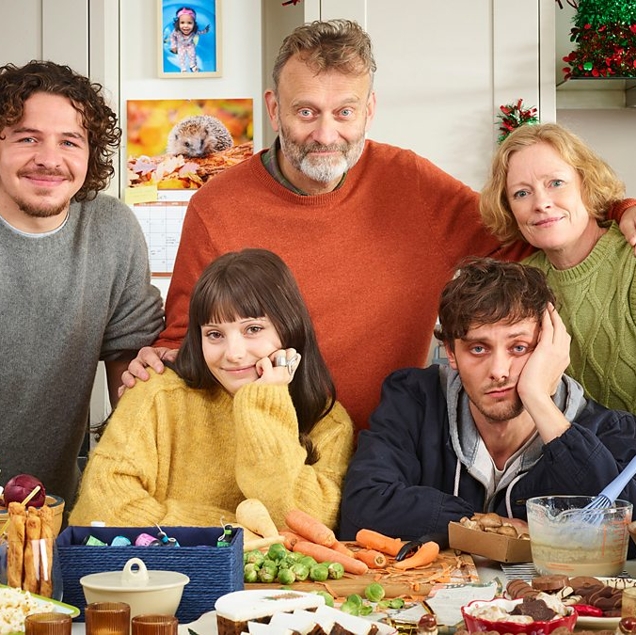


16-34 Top TV programmes 2024 (TV set and device)
Gavin & Stacey
BBC1, 25 Dec
4,546,248
Wallace & Gromit: Vengeance Most Fowl BBC1, 25 Dec
3,467,955
Euro 2024: ESP v ENG
BBC1 & ITV1, 14 Jul
2,621,294
I'm a Celebrity... Get Me Out of Here!
ITV1, 17 Nov
2,423,819
Euro 2024: NED v ENG
ITV1, 10 Jul
2,337,766
New Year’s Eve Fireworks
BBC1, 31 Dec
2,016,019
Euro 2024: ENG v SVK
ITV1, 30 Jun
1,756,151
Outnumbered
BBC1, 26 Dec
1,745,824
The Traitors
BBC1, 26 Jan
1,694,364
The Apprentice
BBC1, 1 Feb
1,640,844
Source: Barb, 2024, 16-34. Average audience figures. TV and / or Online Network. TV and Online Pre-Broadcast 1-28 days. Top performing episode only.
Notes:
Top TV programme 2024 for 16-34’s (TV set & device).
In 2024, Gavin & Stacey emerged as the top TV programme of the year, pulling an average audience of 4.5 million viewers.

