Slide 1
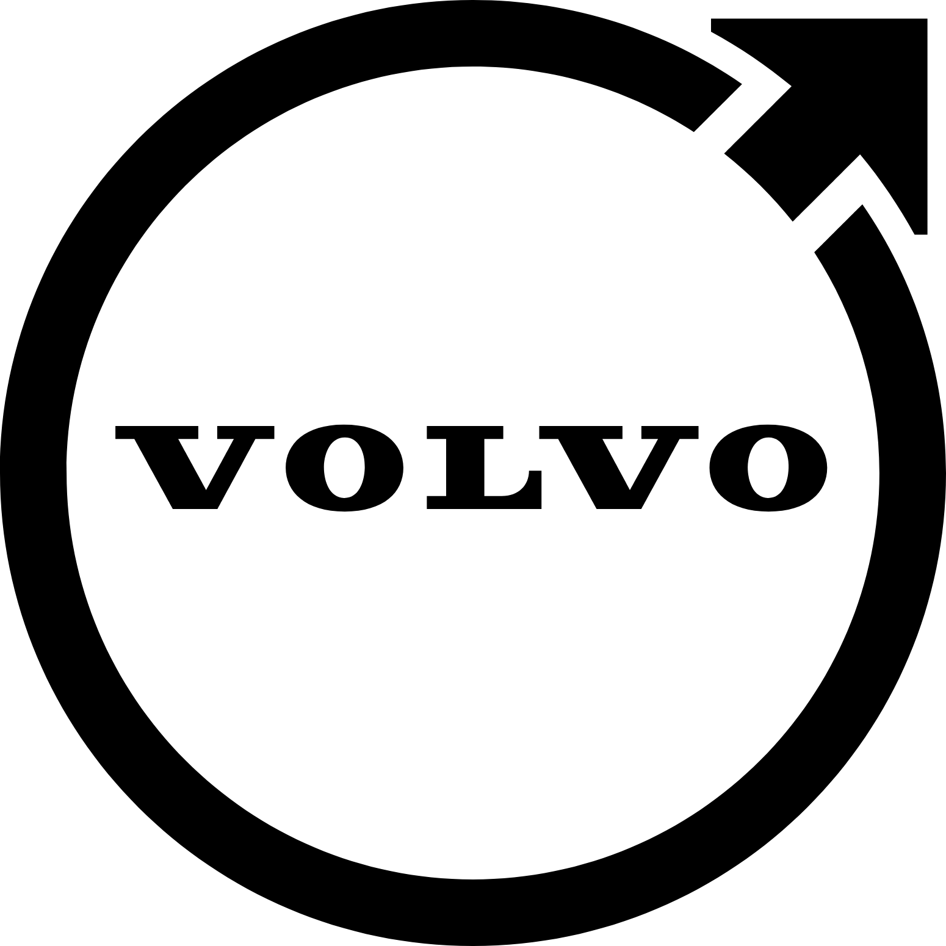
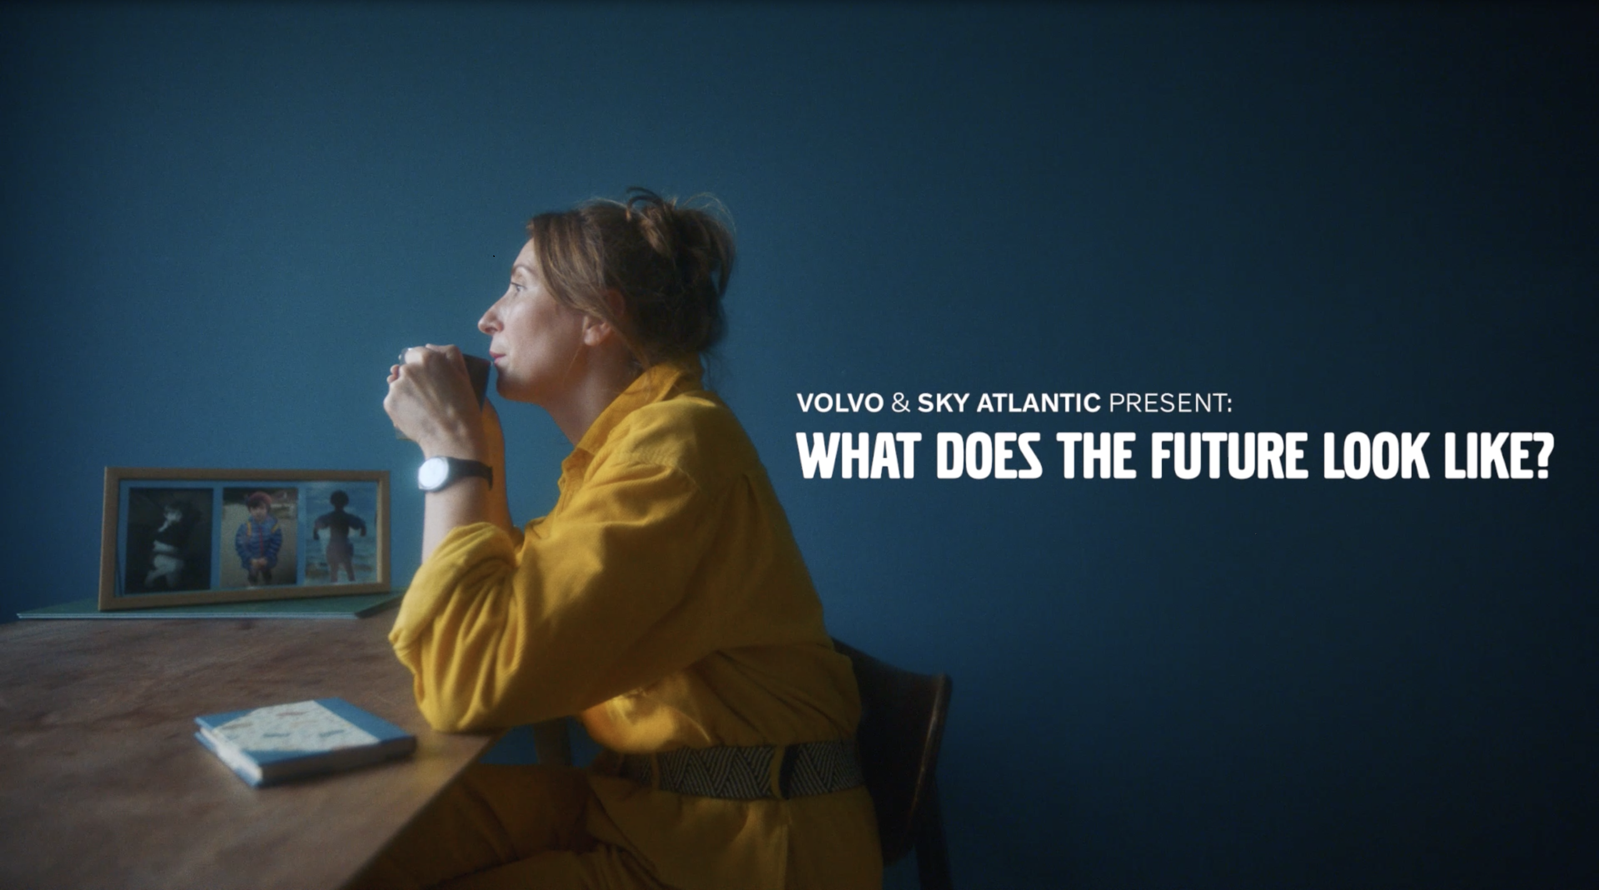
Volvo: using premium TV content to build a premium brand
The Challenge:
Wanting to enter the High-end automotive sector, Volvo needed to change perceptions on the brand beyond being the safest around, while also increasing purchase intent.
The Solution:
Sponsoring Sky Atlantic, Volvo used high-end programming to create the association of the brand with the high end, while also telling human stories about how the brand can help the world around them.
The Results:
Sponsoring Sky Atlantic, Volvo used high-end programming to create the association of the brand with the high end, while also telling human stories about how the brand can help the world around them.
Notes:
The Challenge
In 2013, Volvo aspired to moving into the premium space while still providing and unrelenting focus on safety. They had worked hard to produce stunning new designs; but hadn’t started to build the premium association with the brand. Volvo turned to agency Mindshare with a brief containing clear objectives; change consumer perceptions to be more than safety, increase consideration and further consumer engagement with new and existing customers.
With challenge ahead of them with clear objectives to hit, Volvo needed to build a strategy that would allow them to build a new association and memory for the brand, that would see them habitually reach premium consumers in the most premium environment.
The TV Solution
With the clear objective of reaching a more premium upmarket audience with the highest frequency possible to make the association as habitual as possible. Mindshare set out to find the right property that would deliver this frequency. Having a clear objective of creating premium associations as regularly as possible, it was clear that sponsorship would be the only route to hit the objectives.
The Plan
Having found that sponsorship was the correct route, Mindshare needed to find the right sponsorship avenue for Volvo. Enter Sky Atlantic. The Sky channel was 5 years old at the time and has a history of being the highest end, high gloss media entity on the market; were looking for a new sponsor. Volvo jumped at this chance and launched with glossy idents asking the viewers ‘What makes a quality production?’ which linked together the high-end production of Volvo cars with the high-end productions sitting on Sky Atlantic. Not being able to directly sponsor HBO programming on the channel, Mindshare and Volvo brought the sponsorship into the real world by placing cars at premiers of each of the new HBO shows like Penny Dreadful and Game of Thrones. This provided the perfect backdrop to engage Volvo consumers with integrated solutions including tickets and branded cars.
After seeing success with the partnership in the first few years, Volvo, were now starting to gain a foothold in the premium automotive sector but needed to do more to stand out from the crowd. As a brand, Volvo has always prided itself on putting people’s wellbeing first. Originally this meant making cars safter than any other. With safety now ubiquitous in the sector, it was now right at the bottom of the consideration pile with ‘proud to own’ now the most important factor for those in market. Understanding a small but growing consumer base was key to this approach. This audience wanted to purchase things that would inspire them to make a positive impact on the world. This led to Volvo creating a new brand position as a ‘Defiant Pioneer brand for Defiant Pioneers’. Flipping the traditional narrative of Cars people are driving to stories about people driving the cars. Volvo’s new platform of ‘Human Stories’ was born. These ‘Human Stories’ were 4–7-minute docudramas produced with Sky, Grey and Mindshare- told the story of people trying to make the world a better place. The series launched with 30” ad-like trailers on Sky Atlantic and 15 and 5 second idents to drive the coverage and frequency. Launching in 2016, the campaign evolved the partnership into something more comprehensive with multiple touchpoints across Sky. This partnership continues to evolve with product -led idents, laying audience targeting to enable engagement, retargeting between branded and product content. They also became the first partner to be included in Sky’s EPG takeover.
Having seen huge success with the partnership in the last few years, the Automotive industry was entering a pivotal period with the EV market now being a huge section of new cars sold each year. With a growing consideration with high end players in the market starting to erode Volvo position, they needed to change their approach. Having seen that the automotive sector was starting to forget about women, Volvo saw the opportunity to signal they weren’t just part of the electric revolution but were in fact the leaders. Leveraging insights that the Sky Atlantic was the perfect platform to reach their new ‘purposefully progressive’ audience; down to the fact that viewers of the channel over indexed for alternative fuel autos, they were also more like to consider purchasing in the next 12 months. Both Sky and Volvo were at the forefront of sustainability and seen as leaders in their efforts for their sectors. New idents that placed the new Hybrid and full electric range were created along with a new version of ‘Human Stories’ under the banner of ‘What does the future Look like?’ all featuring women working in production from costume design to makeup. These stories highlighted the sustainable elements of production on Sky Atlantic productions while mirroring the efforts that Volvo were undertaking. The shorts were launched across Linear, VOD and Sky social channels and included integration with Sky’s EPG guide via voice search on sky remotes. Mindshare and Volvo were able to take the learnings from this activity in 2022 and aim to take the partnership to new heights in 2023.
Results
After the first year of sponsoring Sky Atlantic, Volvo saw spontaneous awareness more than double, while promoted awareness almost trebled. The partnership was having an outstanding impact on all brand health metrics; by November 2016, Sky Atlantic viewers were twice as likely to consider Volvo and purchase intent had grown by almost 4 times the rate of non-viewers.
Having seen success with the channel partnership and off-screen integration, in 2016 with the launch of ‘Human Made Stories’, Volvo continued to see outstanding results. The films themselves were viewed a whooping, 32 million times with 97% of viewers watching them to completion. The films continued to showcase increases in spontaneous awareness and promoted recognition. They also started to separate Volvo out from its competitors, All key metrics showed upticks in performance with key metric of ‘Proud to Own’ and ‘Understands People Like Me’ were showing steady growth over the 3 year period the ‘Human Made Stories’ campaign ran for. The campaign also coincided with a 28% increase in sales. Although it can’t be directly linked back to the campaign; the association with Sky Atlantic clearly showed links with purchase intent to be purely coincidence.
With the backdrop of the pandemic and Brexit pinching the supply chain, Volvo still delivered results and the partnership continued to perform. Spontaneous and promoted awareness both saw increases over the period the ‘What Will the Future Look Like?’ films ran of 21% and 13% respectively. And bucking a category trend in 2022, purchase intent also grew. The metrics around sustainability also saw increases across the campaign period with all metrics showing improvements post campaign. Finally, as the campaign was aiming to engage females in a meaningful way, all the metrics tracked showed increases with female viewers with purchase intent jumping to 52%, 22% higher than the category norm.

