Slide 1


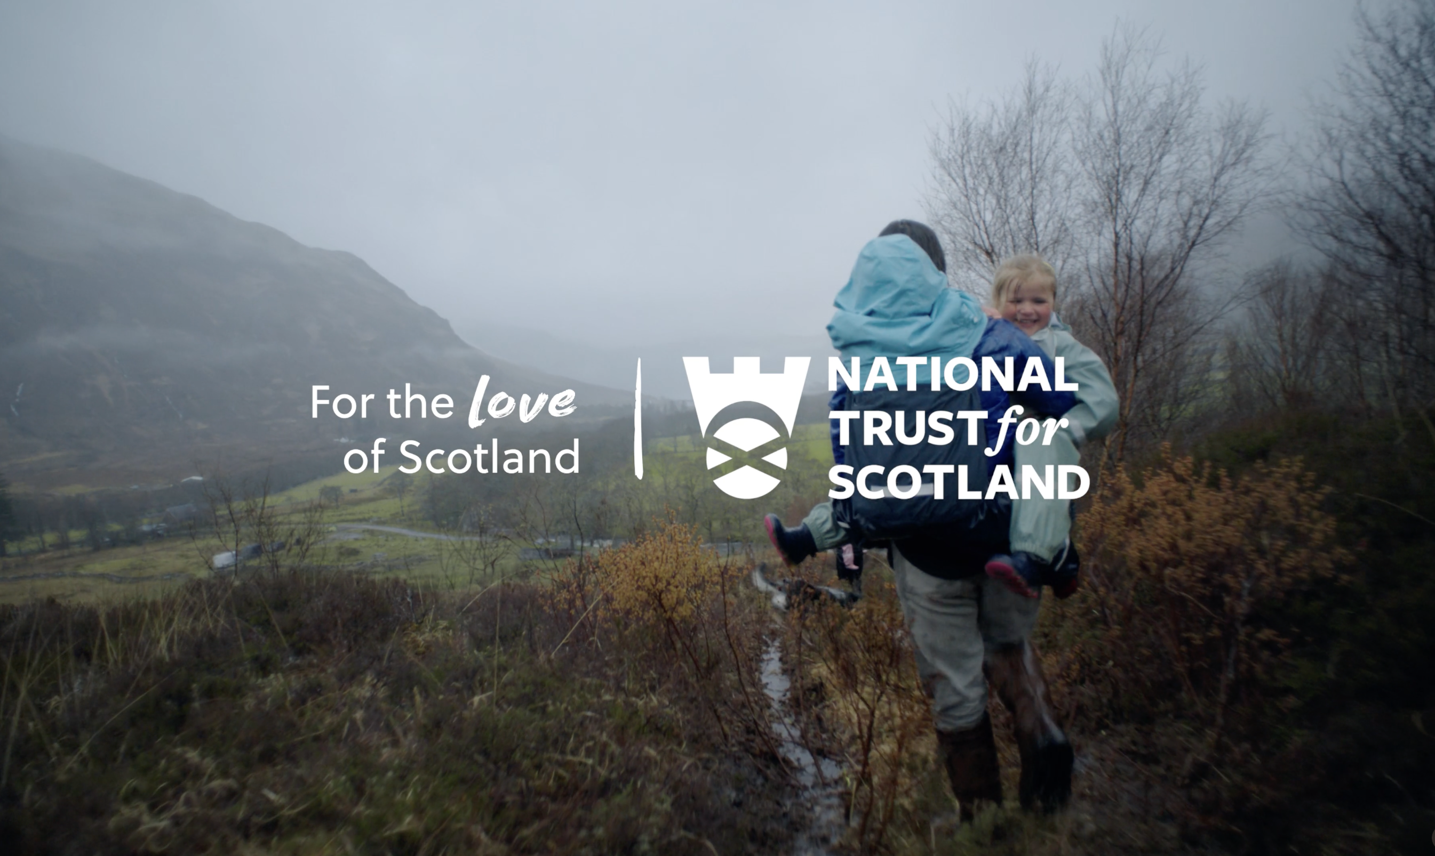
The National Trust for Scotland: Using TV to ask for help
The Challenge:
With 2022 bringing the Cost-of-Living Crisis with it, the National Trust for Scotland needed to reposition itself as a charity and ask for help rather than relying on just memberships to continue protecting Scotland’s heritage.
The Solution:
With the insight that 85% of donations come off the back of solicitation, the National Trust for Scotland would use TV to directly ask for help from viewers during tough economic times.
The Results:
Reached 88% of Scotland’s population with activity. Resulted in 25,669 new membership sign-ups. Increases above targets for all brand metrics tracked, and a massive 66% said they would take action off the back of seeing the campaign.
Notes:
The Challenge
The National Trust for Scotland has been protecting, preserving, and enjoying Scotland’s heritage since 1931. As a charity, it relies largely on memberships and donations to maintain its role as protector of Scottish heritage. At the start of 2022, things were looking a little tough for the National Trust for Scotland. The onset of the cost-of-living crisis meant many consumers were now watching their spending. Cutting back on memberships and other non-essential spending.
A study into National Trust for Scotland membership highlighted that the main reason for most to become a member was to make use of the savings that come with days out rather than a belief in the cause. With charitable donations often sustained during tough economic times, the National Trust for Scotland needed to shift perceptions of the trust. They needed the membership to mean more than just cheaper access to days out, but also they play an integral role in protecting the places they love visiting. The National Trust for Scotland had a clear set of objectives around increasing prompted brand awareness and total ad awareness, increasing brand positivity and finally increasing the claimed action as a result of seeing the ad.
The TV Solution
Armed with clear objectives, Carat got to work on understanding the best way to hit the ambitious goals. Using research from the Charities Aid Foundation, Carat highlighted that charitable donations are highly personal and inherently linked to a person’s individual belief system. This research guided Carat into working out the key target audiences for the activity; this audience segmentation fed back into the personal beliefs of those who already donated. Turning their attention to academic work next, Carat were able to highlight the specific mechanisms that trigger a donation. With 85% of donations coming off the back of solicitation, the National Trust for Scotland would go into the market to ask their target audience for help directly.
While the research steered the thinking, the media choice would need to focus on a channel that would actively demonstrate the ‘need’ for the Trust’s work and care while still maintaining reach throughout each step of the campaign. It was clear to Carat that the best way to achieve this would be with TV across Linear, BVOD and sponsorship environments thanks to its ability to reach and lend creditability as well as communicate an emotive sequence of messaging.
The Plan
The campaign kicked off with a soft launch on audio channels in April 2022 but started in earnest with a peak centre break spot in Coronation Street, making use of the longer form, 40” copy. The kick off spot in Coronation Street was supported with a series of 30” versions that aimed to showcase Scotland’s many stunning attractions under the protection of the Trust. With a campaign running across STV and Channel 4 Scotland, Carat were able to provide scale and maximise attentive reach. To combat the changing viewing habits, Carat took the campaign to BVOD in order to maximise coverage levels with a campaign across STV Player, ITV Hub (now ITVX) and All4 (Now Channel 4 Streaming). This was supported with wider media activity across Paid Social and Digital Display formats, where Carat would be able to incrementally target to supplement reach across TV and BVOD.
Across the summer months, the National Trust for Scotland introduced shorter 10” time lengths to make the budget stretch as far as possible. This fitted with the next phase of the campaign, which saw personally resonant copies served to customised audiences. By identifying programming that the target audiences over indexed for and matching it with Sky ‘Big Screen’ targeting meant that the Trust were able to reach these through catch up on content on their TV sets. This maintained the premium credentials of the campaign whilst not sacrificing on coverage build within a geographical ring fence. This activity was supported with paid social buys across Meta which leveraged behavioural metrics and digital display buys that placed the campaign in the most contextually relevant environments.
Finally, the campaign recapped the messaging to the broader population but this time with the specific ask. Linear and BVOD allowed the Trust to issue the ask which was supported across digital display and paid social channels to target lookalike and push the single-minded call to action to sign up new members.
By deploying a week-on-week-off approach across the 20-week run of the campaign, Carat was able to extend the activity all the way into the spring/summer season. This was supported with a channel sponsorship on STV that spanned the summer months and notably increased the frequency of the 10” bumpers. Along with the sponsorship, the Trust also ran a 2-week competition at the start of the school summer holidays using a 20” promotion that generated 3,861 entries, fulling both interest and active participation in the campaign.
Results
The campaign was a roaring success for the National Trust of Scotland. With the overall aim of repositioning the Trust as a charity and the source of the best day out in Scotland, it was certainly a success. In terms of media, the campaign reached 88% of Scotland across the campaign period, which resulted in 25,669 new membership sign-ups. Linear spots, the channel partnership with STV and Broadcast VOD activity provided the solid foundation upon which other media channels could build.
On top of changing the perception of the Trust as a charity, the campaign also hit against a number of metrics that were laid out before the campaign. Post-campaign analysis from Jump Research showed these changes, with increases across promoted ad awareness, total ad awareness and brand-positive, all-seeing results in line with or above the targets set pre-campaign. The most important metric for the campaign also saw success, with a huge 66% saying they would take action off the back of seeing the campaign, up 61% on 2021.
Not sure what this should be.
Forgot the 'and'

