Slide 1


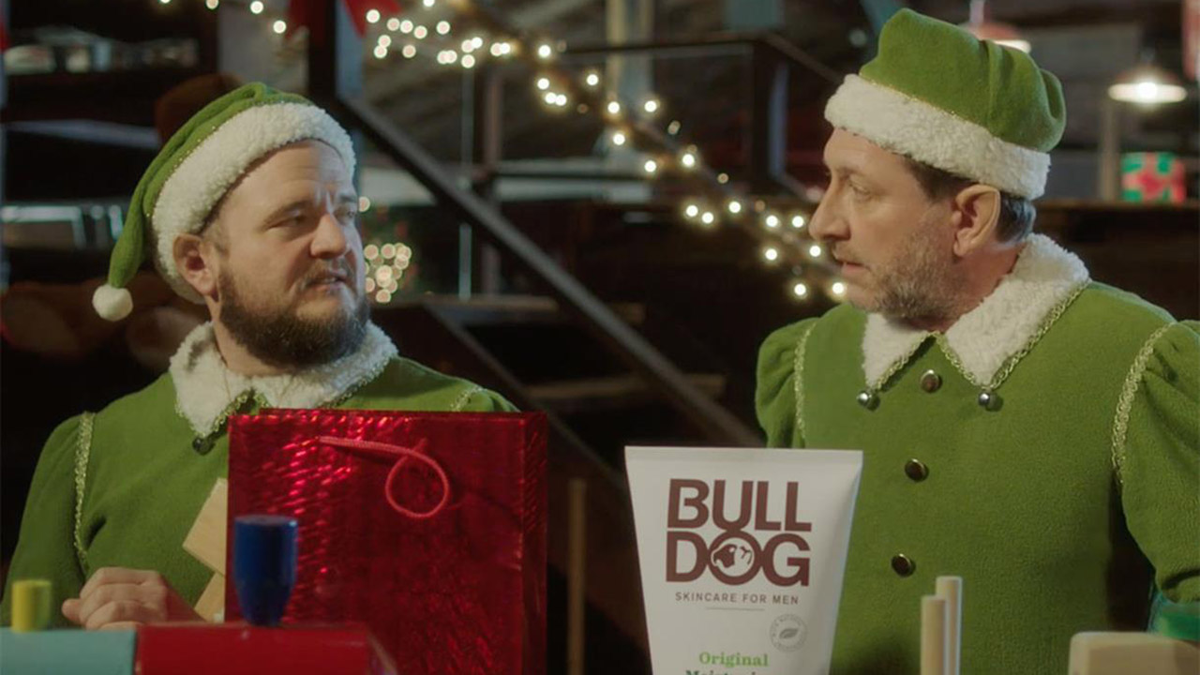
Bulldog drove some very elfy results from using TV
Challenge
To increase sales and drive share YOY
Solution
Funny and relatable creative specifically targeted at dual viewing occasions
The campaign launched on 1st December with a 60 second spot in I’m A Celebrity to create maximum impact and reach and continued running for 12 days in high impact quality shows.
Results
Growth rate grew from 19.5% to 55% (an increase of 182%)
Bulldog achieved its highest-ever market share at 16.5% - an increase of 30%
Notes:
Challenge:
Bulldog Skincare for Men is a David among the Goliaths of skincare, with tiny budgets in comparison with their competitors. Christmas is a key time of year for this category. Men have an excuse to treat themselves and women, who make up at least 60% of male skincare buyers, buy products for the men in their lives. Therefore, it gives lots of men a chance to try the category out.
For Christmas 2016, Bulldog’s objectives were to:
Drive share year on year
Create an emotional connection with the brand
Increase sales
Bulldog’s advertising agency, adam&Eve/DDB had created a very funny and engaging AV creative for their first ever media campaign and Bulldog briefed their media agency the7stars to create an online video plan to drive sales. However, the7stars felt that running the film online would probably only drive shares and likes but not the sales and share gain that Bulldog wanted. Instead, they felt that TV was best placed to deliver Bulldog’s objectives and they recommended a campaign that leveraged the fame and emotional power of TV.
Solution:
The script for the creative was based on the insight that many men feel awkward when it comes to giving or receiving gifts from their male friends. The ad showed the excruciating awkwardness that arises when one elf decides to give his colleague the unexpected Christmas gift of some male moisturiser.
The7stars knew that the ad had the potential to dive brand likeability but, as the budget was quite small compared to their competitors, they had to be smart and skilful when it came to TV planning. They opted to target dual viewing occasions to try and stimulate conversation between female buyers and male users about using this type of product. It was essential to focus on a concentrated area and a targeted audience in order to have a higher share of voice where and when it mattered.
In addition, because the ad was funny but awkward and different, they felt that the context of comedy, particularly alternative and proven comedy was the right environment for the ad.
Results:
Bulldog’s growth rate grew from 19.5% to 55% - an increase of 182% (source: Nielsen, excluding Christmas Gifts)
Bulldog achieved its highest-ever market share at 16.5% - an increase of 30%
Search in Bulldog grew strongly over the Christmas period and over a longer time period was the highest level of search for Bulldog. In addition, the brand visits could be matched to the TV spots so it was clear that the TV had had a direct impact on search.
The campaign generated lots of positive comments on social media
The campaign was shortlisted in ‘Best Newcomer to TV’ in TV Planning Awards
For the full case study and to view the ad campaigns visit: https://www.thinkbox.tv/Case-studies/Bulldog

