Slide 1


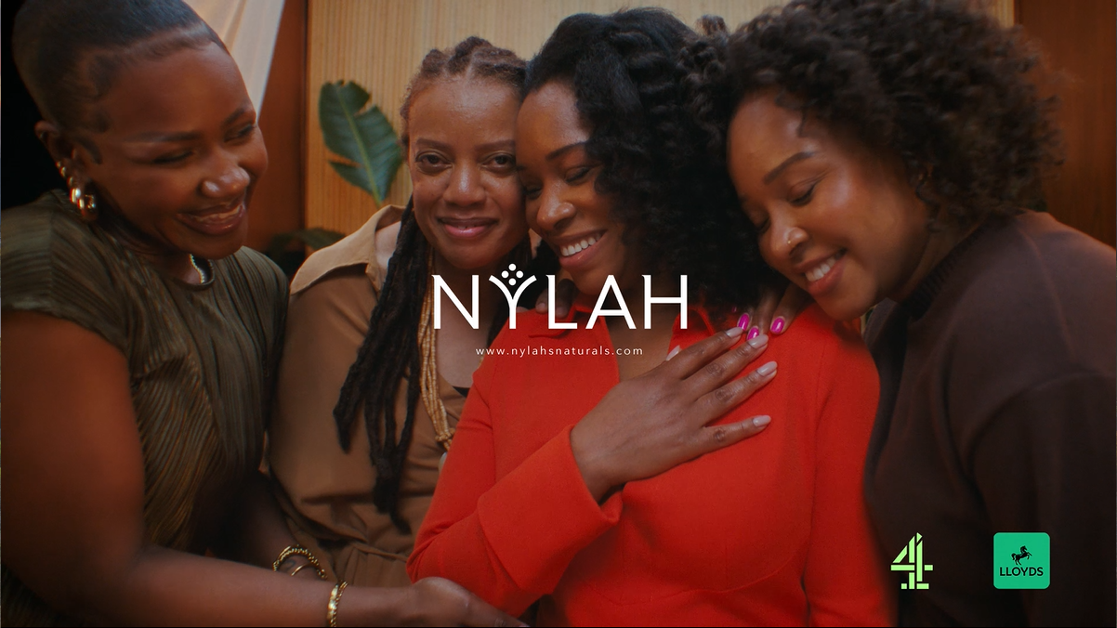
Nylahs: TV for the first time with Channel 4.
The Challenge:
Founded in 2013, Nylahs sought to grow their brand and create a movement in hair wellness.
The Solution:
Through Channel 4 and Lloyds’ Black in Business Initiative, Nylahs secured £150,000 of airtime across Channel 4’s ecosystem.
The Results:
Increased brand awareness, consideration and brand perceptions among women aged 25-44 with textured hair - surpassing Channel 4’s micro brand norms.
Notes:
The Challenge
Nylahs are a West Midlands based haircare brand founded by Kameese Davis, providing science-backed formulas for those with textured hair or experiencing hair loss.
With a desire to grow further, Nylahs entered Channel 4 and Lloyds’ Black in Business initiative in late 2024 to try and increase awareness and site visits.
The TV Solution
After successfully launching in 2022, Channel 4 and Lloyd’s Black in Business initiative returned for its second iteration. The scheme - designed solely for black owned businesses - sees the winning brand receive £150,000 in free advertising across Channel 4’s ecosystem along with 6 months of mentoring from both Channel 4 and Lloyds. The initiative is underpinned by research that shows that 56% of Black business owners only receive funding once they have successfully established the business, with one shocking statistic showing that just 0.24% of venture capital goes to Black owned businesses.
Entering alongside 200 other applicants, Nylahs were selected alongside 3 other businesses to be the winners of the funding last year. Given their objectives, TV served as the perfect channel – delivering
instant action and driving awareness by reaching millions on mass at once in a single night.
The Plan
Armed with a bespoke creative crafted by Quiet Storm, and a plan to match from Channel 4’s commercial sales team, Nylahs were ready for their first foray into TV. The campaign kicked off with a bespoke premier break with all four winners making their TV bow, reaching 1.4m million people during Bake Off: The Professionals.
Having launched with impact with a Premier break, the campaign kicked off in earnest across Channel 4’s ecosystem during August and September, with programming assessed and selected to ensure the campaign showed up at the right times with the right audience watching. As a result, the campaign appeared during high-profile Channel 4 content such as Educating Yorkshire, First Dates, Location, Location, Location and Celebs go Dating. This high-quality programming environment was extended to Channel 4 streaming, with the campaign showing up in Great British Bake Off, 24 hours in Police Custody and Celebrity SAS: Who Dares Wins. Finally, to support their activity on TV, Nylahs’ planned a social campaign to ensure they reached those already exposed, delivering enhanced frequency.
Results
The campaign was hugely successful with the core audience of women aged 25-44 with textured hair, performing in line with Channel 4’s micro brand norms.
The creative, delivered by Quiet Storm, showed a branding power score above that of others tracked within Channel 4’s brand tracking, achieving a creative rating higher than that of Channel 4’s small brand norms.
Brand awareness and consideration both improved, moving the brand to second place among their competitor set. Additionally, brand perception scores around statements such as ‘Trustworthy’ and ‘For people like me’ both saw an uptick with the core audience after the campaign ended.
These campaign results aligned with Nylahs’ spikes of activity across the Channel 4 ecosystem.

