Slide 1


The bottom line: creativity matters
“It’s Ok” - AA

Slide 2
The bottom line - creativity matters
Four analyses demonstrating the impact of creativity on key business and financial metrics:
Creativity is a significant contributor to sales delivery – Nielsen
Great creativity proven to drive market share growth – Peter Field / IPA Effectiveness Databank
Top creative work leads to better financial performance – McKinsey & Company
Creativity is the biggest ROI multiplier within our control – accelero
Notes:
Four pieces of analysis that demonstrate the impact/importance of creativity on key business/financial metrics – sales, market share growth, core financial KPIs and ROI multiplier effect. The following charts expand upon each of the four pieces of work.

Slide 3
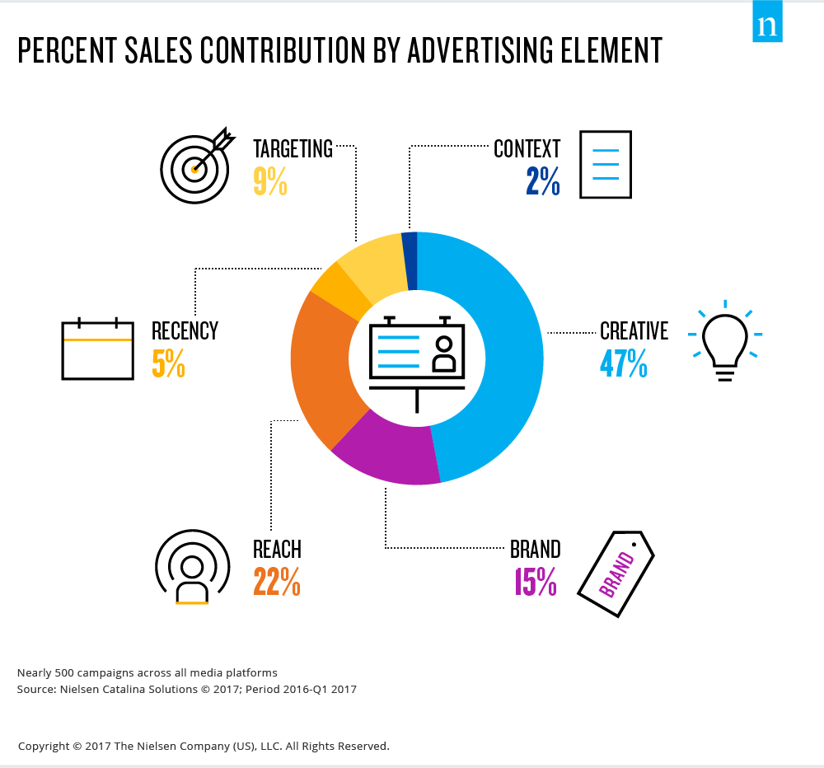
Creativity is a significant contributor to sales delivery
Nielsen analysis of 500 campaigns to quantify impact of advertising elements on sales
Creativity is the key sales drivers accounting for 47% of the overall contribution to sales delivered by advertising elements
The study also found that:
Weak creative results in a weak sales lift. Any sales lift is primarily attributed to media factors
The reverse is true when the creative is strong - sales lift is higher and is affected less by media factors
Notes:
For every ad campaign brand and agency leaders have to decide on an array of variables: how much to spend on creative development and testing; whether to seek high reach or more precise targets; the context for the message; and how to add an element of recency to deliver the ad prior to the next expected purchase.
It is important, therefore, for advertisers to understand how the different levers of advertising affect sales so they can make better, more informed decisions about how to plan their campaigns.
Creative is king
Creativity is the undisputed champ in terms of sales drivers according to research by Nielsen – accounting for nearly half (47%) of the overall contribution to sales delivered by advertising elements. The Nielsen research also highlighted how other advertising elements factor into the overall sales picture.
Analysis of both TV and digital campaigns in the study found that weak creative results in weak sales lift – in this case any sales lift is primarily attributed to media factors. The reverse is true when the creative is strong - sales lift is higher and is affected less by media factors.
Nielsen methodology: analysis of nearly 500 FMCG campaigns that ran in 2016 and first-quarter 2017 on all major media platforms: linear and addressable television, online digital and video, mobile, magazines and radio.
https://www.nielsen.com/insights/2017/when-it-comes-to-advertising-effectiveness-what-is-key/

Slide 4
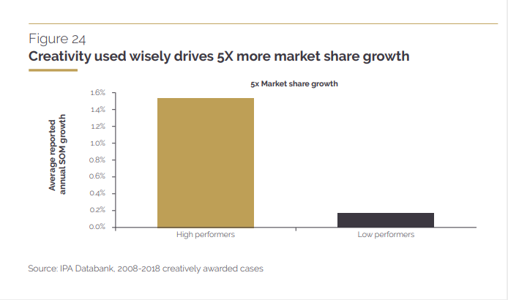
Great creativity proven to drive market share growth
“The crisis in creative effectiveness” – report by Peter Field based upon analysis of the IPA Effectivness Databank
Campaigns with high performing creative work were shown to drive x5 market share growth vs. low performers.
“High performers... don’t simply drive greater growth, they do so at greater profit margin”
High performers are almost 16-times more likely to generate very large profitability improvements
Notes:
The IPA Effectiveness Database (https://ipa.co.uk/awards-events/effectiveness-awardsv1/ease) is made up of over 1,500 case studies that have been entered for the Institute of Practitioners in Advertising (IPA - https://ipa.co.uk/) bi-annual Effectiveness Awards.
Entries to the awards are structured in such a way that consultants working with the IPA (e.g. Peter Field, Les Binet, etc.) are able to undertake meta-analysis to identify and quantify the drivers of ROI performance.
In the report “The crisis in creative effectiveness” (https://ipa.co.uk/knowledge/documents/the-crisis-in-creative-effectiveness-pdf), Peter Field outlines work he undertook incorporating data from almost 600 case studies.
The report covers case studies from 1996 to 2018 and is a follow-up to the IPA’s publication “Selling Creativity Short” that warned of the dangers to creative effectiveness posed by short-termism in marketing.
In “The crisis in creative effectiveness”, Peter looked at the factors that impact ROI performance – and in particular the role of creativity.
Peter segmented the case studies and identified campaigns that were high creative performers. He was then able to compare business performance of high creative performers with low performers to identify the variance in performance.
Creative high performers tend to have:
• A more balanced approach to short and long-term objectives
• The maintenance of the campaign in market long enough to embed behavioural change: at least six months typically
• Broader, earlier targeting of consumers rather than data-driven real-time communications linked to purchase intent
• Greater use of broad-reach brand building media, especially TV but also online video and OOH
• A balanced allocation of media expenditure between brand building and sales activation in line with latest best practice guidelines
A key metric Peter looked at was annual market share growth driven by advertising. He identified that campaigns with high performing creative work were shown to drive market share growth five times better than low creative performers.
Because of the advertising ability to protect pricing power, the impact on market share growth flowed through to significantly better profitability improvements. As Peter says in the publication:
“… it is the financial metrics associated with high [creatively awarded] performers that matter most and it is these that should act as a wake-up call to all businesses that believe in creativity. High performers’ impact on pricing power is more than twice that of low performers. So they don’t simply drive greater growth; they do so at greater profit margin. This adds up to a massively greater impact on profitability; they are almost 16 times more likely to generate very large profitability improvements.”

Slide 5
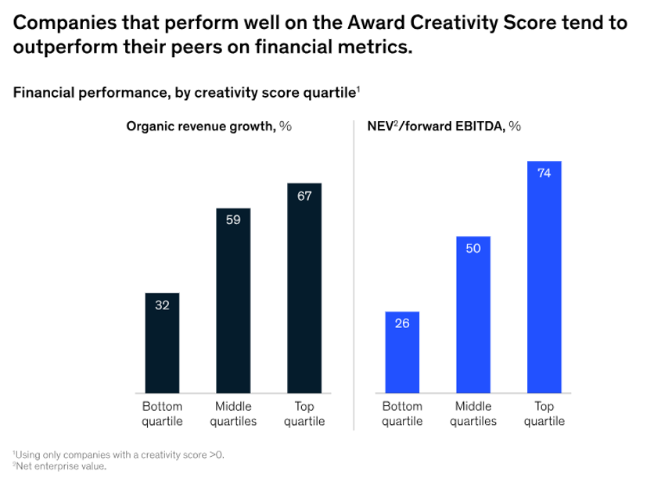
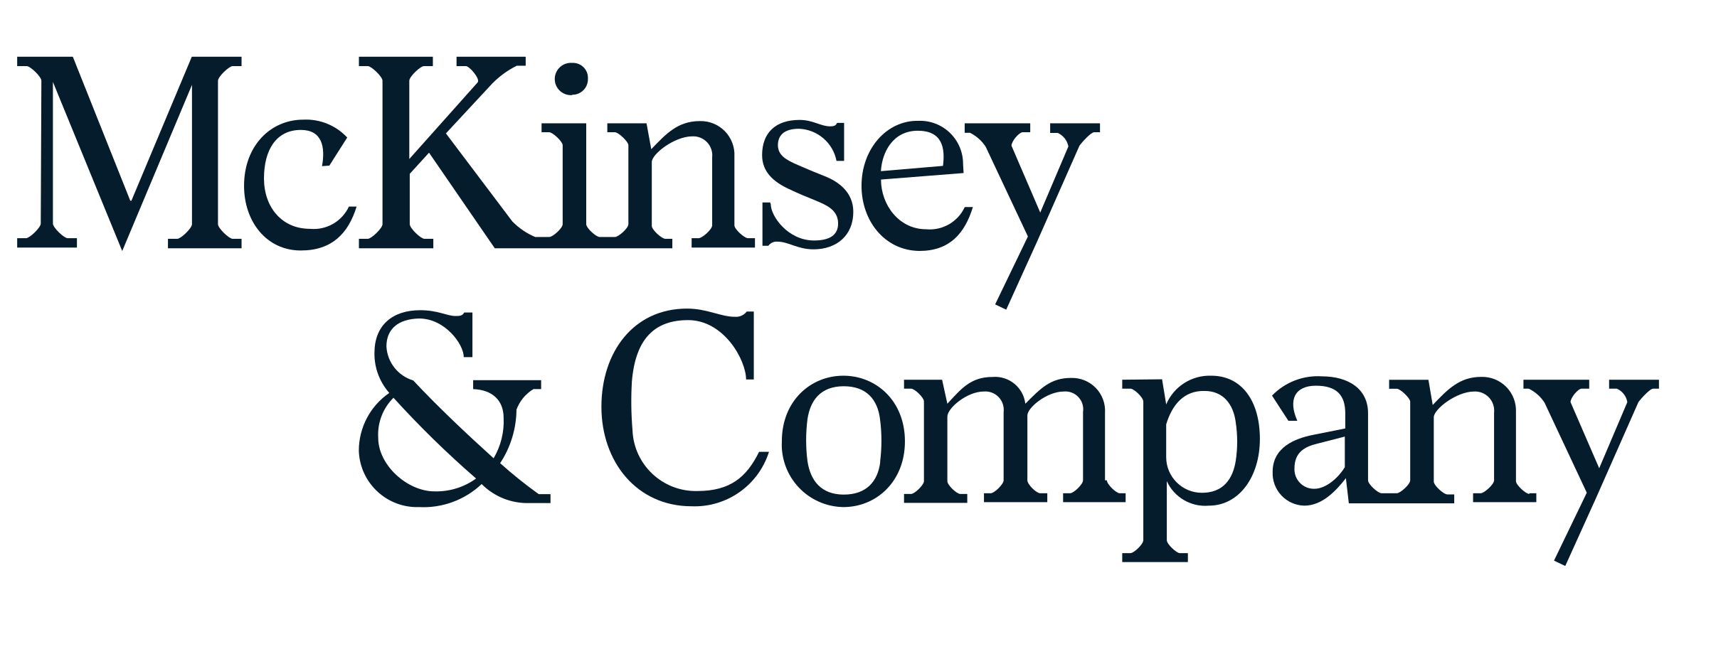
Top creative work leads to better financial performance
McKinsey study on whether creativity generates business value
McKinsey developed Award Creativity Score (ACS) to examine the linkage between creativity and business performance
ACS is based on Cannes Lions award winners 2001-2016
McKinsey concluded that creativity does drive better financial performance
Top quartile creative performing companies:
Had over twice the organic revenue growth of bottom quartile companies (67% vs 32%)
Nearly three times NEV/forward EBITBA of bottom quartile companies (74% vs 26%)
Notes:
Does creativity generate business value?
Business and financial consultancy, McKinsey, conducted a study to find out.
The short answer is yes – creativity does drive business value.
That conclusion came through clearly in McKinsey’s analysis of one proxy for creativity - Award Creativity Score (ACS).
In order to a quantitative measure that could be used to examine the linkage between creativity and business performance, McKinsey developed ACS, an index based on the prestigious Cannes Lions awards.
These awards (https://www.canneslions.com/) are given annually for advertising and marketing excellence and form part of The Cannes Lions International Festival of Creativity - a global event for those working in creative communications, advertising, and related fields. It is considered the largest gathering of the advertising and creative communications industry.
The ACS index weighs three factors: the total number of Lions won by each company between 2001 and 2016, with more points assigned for the most prestigious awards; the breadth of categories represented; and consistency over time, based on the number of years a company has been recognized.
McKinsey found that the most creative companies, based on their ACS, did better than peer firms on two key business metrics: financial performance and McKinsey’s Innovation Score.
As McKinsey say (https://www.mckinsey.com/capabilities/mckinsey-digital/our-insights/creativitys-bottom-line-how-winning-companies-turn-creativity-into-business-value-and-growth):
“This doesn’t mean there’s a straight-line path between climbing the podium at Cannes and besting market indices or out-innovating competitors. But when we dug more deeply, we found that the most creative companies did certain things differently. Specifically, they exhibited a set of four business practices that we believe drive their marketing creativity, their ability to innovate, and their capacity to translate those virtues into business value.”
__________________________________________________________
McKinsey Award Creativity Score (ACS)
Analysis of Cannes Lions 2001-2016
ACS factors:
Number of Lions won – upweighted for top awards
Breadth of categories represented
Consistency over time
Top quartile companies performed better than peers:
67% had above-average organic revenue growth
70% had above-average total shareholder return
74% had above-average earnings
https://www.mckinsey.com/capabilities/mckinsey-digital/our-insights/creativitys-bottom-line-how-winning-companies-turn-creativity-into-business-value-and-growth

Slide 6

Creativity is the biggest ROI multiplier within our control
Potential multipliers of advertising profitability - (2023)
Potential multipliers of advertising profitability - (2023)
X 20
X 12
X 5
X 2.5
X 3
X 1.6
X 1.7
X 2.0
X 1.1
X 1.2
Cost / Product seasonality
Budget setting across variants
Brand : Performance
Multi-media
Budget setting across portfolios
Budget setting across geographies
Target audience
Laydown / Phasing
Creative quality
Brand size
Source: The Drivers of Profitability, 2023, Paul Dyson - accelero, ROI multiplier = area of the circle
Notes:
A meta-study of effectiveness to understand potential multipliers of advertising profitability
Conducted by Paul Dyson from accelero
Update of work previously done in 2008 and 2014
Analysed publicly available data: academic papers, case histories, industry reports
28,000 global campaigns
7,000 UK campaigns
Isolating the creative effect from other variables - i.e. Brand size, Media Mix, Brand : Performance split
Size of the brand is the biggest single factor influencing the potential advertising driven ROI. This is good news for already established, large businesses, and a tough reality of the challenges facing emerging businesses – although it does point to the rewards waiting for those able to successfully scale up over time. Whilst a vital point of advertising effectiveness to understand, it’s not much help; we have little short-term control over the size of the brand we are working for.
This makes the second biggest driver of profitability all the more important, as it’s something marketers very much do have control over. Creative quality took this spot. It has a huge potential to supercharge ROI and, as such, the creative process should be allocated its fair share of resource and effort.
In an increasingly complex media landscape, it’s easy to overlook the importance of a well thought through creative strategy – ideally one that will burn across years rather than months.
But this is not to supersede the vital role of media planning. The majority of the elements on the chart all belong to the world of planning and strategy and collectively deliver the potential for huge ROI multipliers. If you’re not optimising budgets, brand/performance ratios, or buying the most cost-effective audience, then you’re missing out on low-hanging profit multipliers.
Having a killer creative strategy alongside a well-constructed and optimised media plan is by far the most effective route to profitable growth.

